Slide 1
Keeping an Eye on Kelp
3-ACT MATH TASK
BEGINNING ALGEBRA
Except where otherwise noted, this work developed by Pacific Education Institute (PEI) for the Washington Office of Superintendent of Public Instruction, is available under a Creative Commons Attribution 4.0 License. All logos and trademarks are the property of their respective owners.

Slide 2
Learning Goals:
Students will understand how to analyze complex, real-world scenarios. (Claim 4)
Students will understand how to construct and use mathematical models to interpret and solve problems. (Claim 4)
Success Criteria:
I can apply algebra concepts to solve a problem about monitoring Bull Kelp beds. (SMP 4)
I can build a function that models a relationship between two quantities. ( HAS-CED.A.2)

Slide 3
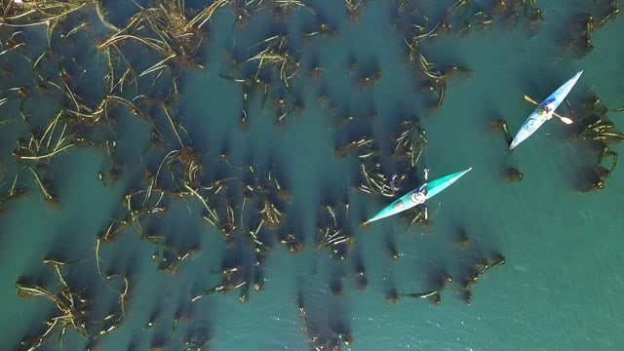
Bull Kelp Monitoring Project Washington State
https://www.snocomrc.org/projects/kelp-monitoring/

Slide 4
What do you notice and wonder about this map?
Scientists use maps like this to monitor Bull Kelp beds, a natural resource of Washington state.

Slide 5
What do you notice and wonder?
Notice (I noticed ________. | Wonder (I am wondering ________.)

Slide 6
What Questions Could Be Answered Using this Map?

Slide 7
Questions Scientist are Looking to Answer
Is the Bull Kelp bed area increasing or decreasing?
If the change in area is constant, what will the Bull Kelp bed area be in 2028, 2038, 2048?

Slide 8
Do you have everything you need to answer your question?
Important number
Formulas
Graph Paper
Ruler
???

Slide 9
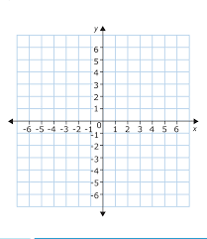
Helpful Information and Tools
Year | Area
2013 | 9m
2018 | 3m
y = m x + b

Slide 10
Discussion Frames
I think ________ because __________.
I learned that __________.
I agree because ______________.
I respectfully disagree because ____________.
Can you explain __________?
I can see connections between __________ and __________ because____________.
So what I think ________ is saying is that ____________. Is that correct ________?

Slide 11
Resolution
Is the area increasing or decreasing?
Most Recent area – Initial Area = change
3 – 9 = -6
Negative amount shows decreasing area.
Year | Area
2013 | 9m
2018 | 3m

Slide 12
Resolution
What will the area be in 2028, 2038, 2048?
2018🡪2013 is 5 years time, so in 5 years the change was -6.
Y=mx+b x= area y= amount time in years m= change b=initial area
Y=(-6)x + 9
2018🡪2028 is 10 years
10= (-6)x +9
10-9 = (-6)x 🡪 1=(-6)x
1/(-6) = x 🡪 -0.2=x
20= (-6)x +9
20-9= = (-6)x 🡪 11 =(-6)x
11/(-6)=x 🡪 -1.8=x
30= (-6)x +9
30-9 = = (-6)x 🡪 21 =(-6)x
21/(-6)=x 🡪 -3.5=x
Year | Area
2013 | 9m
2018 | 3m
http://www.shodor.org/interactivate/activities/SimplePlot/

Slide 13
Self Reflection What did you learn today?
I can apply algebra concepts to solve a problem about monitoring Bull Kelp beds.
I can build a function that models a relationship between to two quantities. ( HAS-CED.A.2)
Score yourself from 1–10 on each success criteria. Ten is you know it so well, you could teach someone else.

