Slide 1
Keeping an Eye on Kelp
3-ACT MATH TASK
GEOMETRY
Except where otherwise noted, this work developed by Pacific Education Institute (PEI) for the Washington Office of Superintendent of Public Instruction, is available under a Creative Commons Attribution 4.0 License. All logos and trademarks are the property of their respective owners.

Slide 2
Learning Goals:
Students will understand how to analyze complex, real-world scenarios. (Claim 4)
Students will understand how to construct and use mathematical models to interpret and solve problems. (Claim 4)
Success Criteria:
I can apply algebra concepts to solve a problem about monitoring Bull Kelp beds. (SMP 4)
I can use various formulas to determine the area of an irregular polygon.

Slide 3
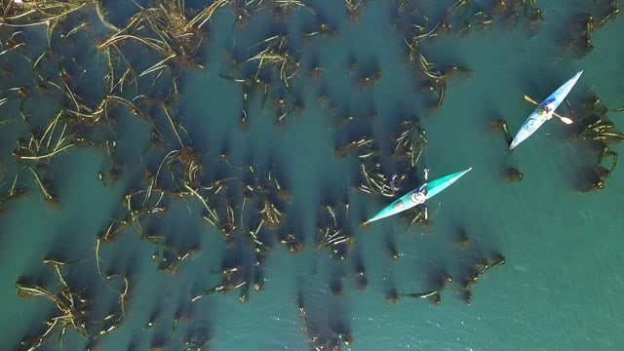
Bull Kelp Monitoring Project Washington State
https://www.snocomrc.org/projects/kelp-monitoring/

Slide 4
What do you notice and wonder about this map?
Scientists use maps like this to monitor Bull Kelp beds, a natural resource of Washington state.

Slide 5
What do you notice and wonder?
Notice (I noticed ________. | Wonder (I am wondering ________.)

Slide 6
What Questions Could Be Answered Using this Map?

Slide 7
Questions Scientist are Looking to Answer
Is the Bull Kelp bed area increasing or decreasing?

Slide 8
Do you have everything you need to answer your question?
Important number
Formulas
Graph Paper
Ruler
???

Slide 9
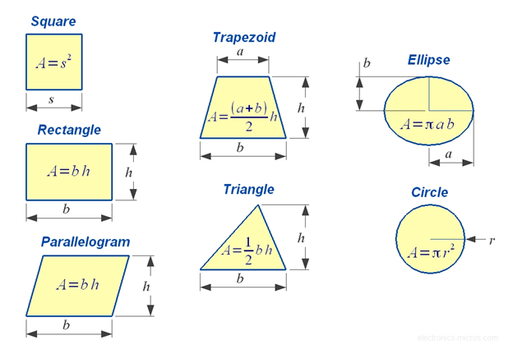
Helpful Information and Tools
Pick’s Theorem
Area = i + (b/2) -1

Slide 10
Discussion Frames
I think ________ because __________.
I learned that __________.
I agree because ______________.
I respectfully disagree because ____________.
Can you explain __________?
I can see connections between __________ and __________ because____________.
So what I think ________ is saying is that ____________. Is that correct ________?

Slide 11
Resolution
Has the area in square units increased or decreased?
Pick’s Theorem
Area = i + (b/2) -1
2013
2018
i = 70
b = 9
70 + (9/2) -1
70 + 4.5 – 1
74.5 – 1 = 73.5 sq units
i = 45
b = 18
45 + (18/2) -1
45 + 9 – 1
54 – 1 = 53 sq units
53 < 73.5 therefore the area has decreased

Slide 12
Self Reflection What did you learn today?
I can apply algebra concepts to solve a problem about monitoring Bull Kelp beds.
I can use various formulas to find the area of irregular polygons.
Score yourself from 1–10 on each success criteria. Ten is you know it so well, you could teach someone else.

