Slide 1
Too Many Stink Bugs
Counting and Cardinality Operations and Algebraic Thinking K-2
Except where otherwise noted, this work developed by Pacific Education Institute (PEI) for the Washington Office of Superintendent of Public Instruction, is available under a Creative Commons Attribution 4.0 License. All logos and trademarks are the property of their respective owners.

Slide 2
Too Many Stink Bugs
Stink Bugs are an Invasive Species.
They can cause problems by eating important crops and plants.
Scientists like Jennifer Parsons and Emily Grason help monitor different invasive species to make sure our crops, plants and ecosystems stay healthy.
From left to right, four nymphal stages of BMSB (second through fifth instar), adult male, and adult female. Photo by W. Hershberger

Slide 3
Learning Goals
Students will understand how to look closely at images to find patterns that will help them find a solution to a given question.
I know I’ve got it when…
I can find patterns in the problem. For example I can see numbers I know or math strategies I can use.
I can use the patterns to find the answer to our question.

Slide 4
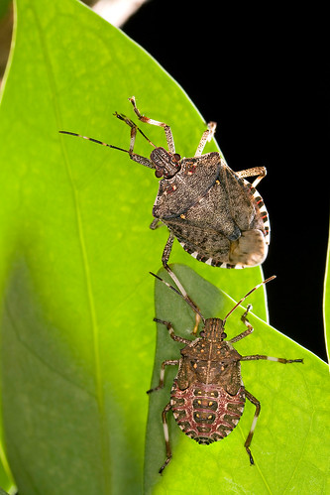
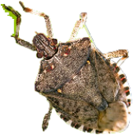
Scientist Need Our Help!
Top
What do you see?
I see ___ stink bugs at the_________.
How do you know?
I know that ___ and___ make ___.
I know the ___ +___= ____.
Left
Right
Bottom
Image created using USDA-ARS photo by Stephen Ausmus. https://www.usda.gov/media/blog/2013/09/13/stop-stink-bug-project

Slide 5
Share Your Strategy Discussion Sentence Frames
How many stink bugs do you see?
I see ____ stink bugs.
How do you know?
I see ___ stink bugs at the (top, bottom, left, right).
I know that ___ and___ make ___.
I know the ___ +___= ____.
Image created using USDA-ARS photo by Stephen Ausmus. https://www.usda.gov/media/blog/2013/09/13/stop-stink-bug-project
Within 10 Image

Slide 6
Share Your Strategy Discussion Sentence Frames
How many stink bugs do you see?
I see ____ stink bugs.
How do you know?
I see ___ stink bugs at the (top, bottom, left, right).
I know that ___ and___ make ___.
I know the ___ +___= ____.
Image created using USDA-ARS photo by Stephen Ausmus. https://www.usda.gov/media/blog/2013/09/13/stop-stink-bug-project
Within 20 Image

Slide 7
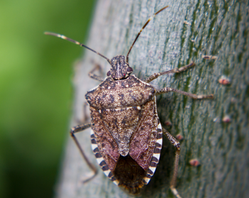
Lesson Resources
Student Strategy Recording Sheets ( within 10) Slide 7
Student Strategy Recording Sheets (within 20) Slide 8
Brown marmorated stink bug Halyomorpha halys (Stål). Photo: iStock.

Slide 8
__________________________ Strategy

Slide 9
__________________________ Strategy

