Slide 1
What’s the Problem? A Look at Why We Monitor Invasive Species
3 ACT MATH TASK
3RD-5TH
Except where otherwise noted, this work developed by Pacific Education Institute (PEI) for the Washington Office of Superintendent of Public Instruction, is available under a Creative Commons Attribution 4.0 License. All logos and trademarks are the property of their respective owners.

Slide 2
Learning Goals:
Students will understand how to analyze complex, real-world scenarios. (Claim 4)
Students will solve a complex problem by making productive use of knowledge and problem-solving strategies (Claim 2)
Success Criteria:
I can apply different operations to help me solve a real-world problem.
I can solve problems involving whole numbers with multiple digits.

Slide 3
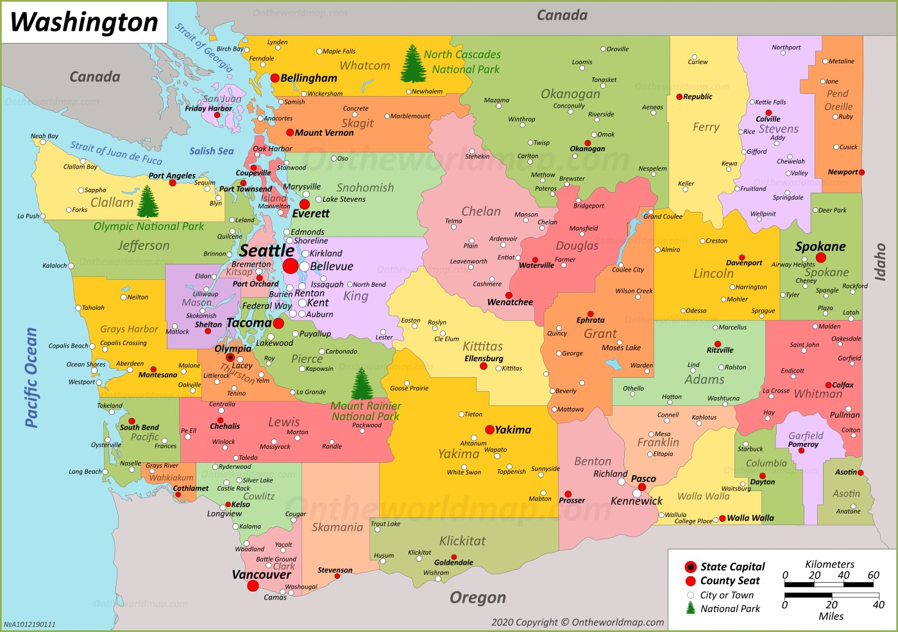

Slide 4
Washington Sea Grant's Crab Team
Link to YouTube video

Slide 5
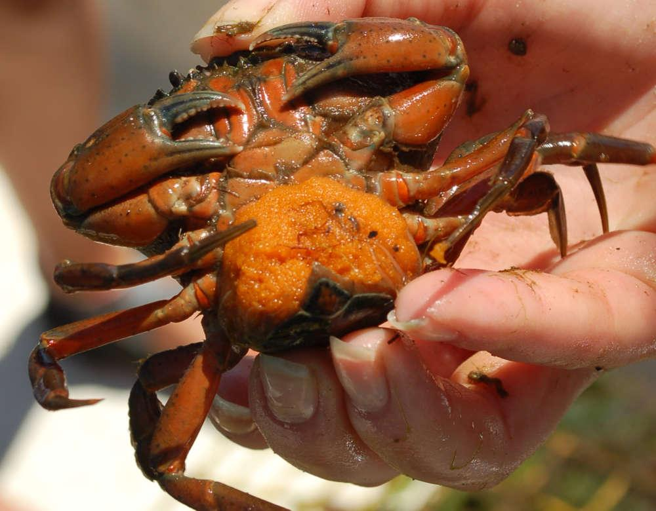
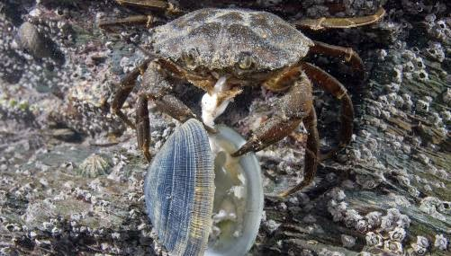
What do you Notice and Wonder?
http://blog.savetheharbor.org/2014/07/the-european-green-crab.html
https://www.wellsreserve.org/blog/green-crab-2019-update
One green crab can consume 40 half-inch clams a day.
Females can release up to 185,000 eggs once or twice per year.

Slide 6
What do you notice and wonder?
Notice (I noticed ________. | Wonder (I am wondering ________.)

Slide 7
What questions could we answer using these facts?
http://blog.savetheharbor.org/2014/07/the-european-green-crab.html
https://www.wellsreserve.org/blog/green-crab-2019-update
One green crab can consume 40 half-inch clams a day.
Females can release up to 185,000 eggs once or twice per year.

Slide 8
Questions Scientist are Looking to Answer
How many clams could be eaten by 1 green crab in a week, 30 days or 1 year?
How many clams could be eaten by 185,000 green crabs in 1 day?

Slide 9
Do you have everything you need to answer your question?
Important number
Strategies for Multiplication
Materials/Tools

Slide 10
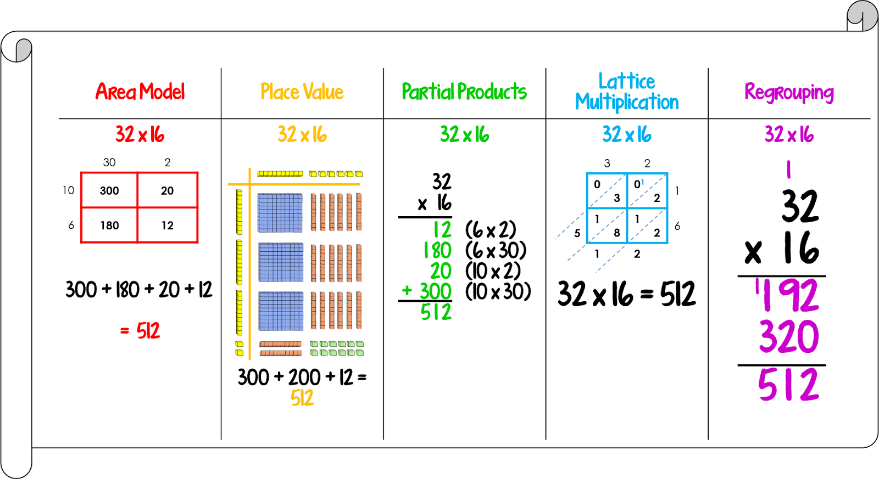
Helpful Information and Tools

Slide 11
Discussion Frames
I think ________ because __________.
I learned that __________.
I agree because ______________.
I respectfully disagree because ____________.
Can you explain __________?
I can see connections between __________ and __________ because____________.
So what I think ________ is saying is that ____________. Is that correct ________?

Slide 12
Resolution
How many clams will 1 green crab eat in 1 week?
40 x 7=
I know 4 x7= 28, but there are 4 10’s.
So 10 28 times (10x28) is 280
40x7= 280 clams in 1 week
How many clams will 1 green crab eat in 30 days?
40 x 30=
I know 4 x 3 = 12, but there are 4 10’s and 3 10’s.
So 12 x 10 = 120
120 x 10 = 1200
40 x 30 = 1,200 clams in 30 days
How many clams will 1 green crab eat in 1 year?
40 x 365 =
40x365= 14,600 clams in 1 year
http://blog.savetheharbor.org/2014/07/the-european-green-crab.html
One green crab can consume 40 half-inch clams a day.
https://www.calculatorsoup.com/calculators/math/longmultiplication.php?multiplicand=185000&multiplier=40&action=solve

Slide 13
Resolution
How many clams could be eaten by 185,000 crabs in 1 day?
1 crab eats 40 half-inch clams in 1 day.
185,000 x 40
http://blog.savetheharbor.org/2014/07/the-european-green-crab.html
One green crab can consume 40 half-inch clams a day.
https://www.calculatorsoup.com/calculators/math/longmultiplication.php?multiplicand=185000&multiplier=40&action=solve

Slide 14
Self Reflection What did you learn today?
I can apply different operations to help me solve a real-world problem.
I can solve problems involving whole numbers with multiple digits.
Score yourself from 1–10 on each success criteria. Ten is you know it so well, you could teach someone else.

