Slide 1
Get the Logs to the Mill
Management of Washington timber for processing.
3 ACT MATH TASK
Algebra

Slide 2
Learning Goals:
Students will solve a range of complex well-posed problems in applied mathematics (SMP1).
Students will solve a complex problem by making productive use of knowledge and problem-solving strategies (SMP2).
Success Criteria:
I can apply algebra concepts to solve a problem about timber harvest and transportation. (SMP1)
I can build a function that models a relationship between two quantities. (SMP2)

Slide 3
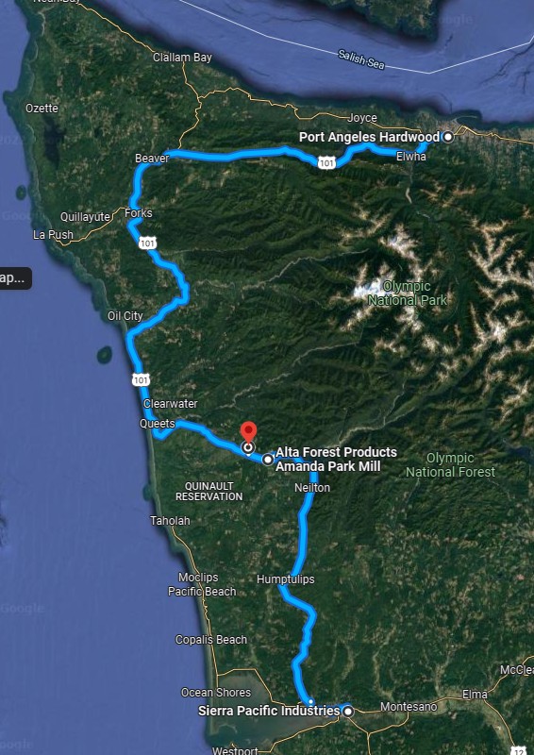
Scenario:
Logs have just been harvested from a field located in the Quinault Reservation at the red pin on the map.
There are three mills to choose from, located in Amanda Park, Port Angeles, and Aberdeen.

Slide 4
What do you notice and wonder?
We have 3000 tons of trees to get to the mill! We sell the logs to the mill, and pay log truck drivers to transport the logs. There are four trucks available to transport logs.

Slide 5
What do you notice and wonder?
We have 3000 tons of trees to get to the mill! We sell the logs to the mill, and pay log truck drivers to transport the logs. There are four trucks available to transport logs.
 | Mill Location
 | Aberdeen | Amanda Park | Port Angeles
Round trip (including loading/unloading) | 4 hours | 1.5 hours | 7 hours
What the mill will pay | $110/ton | $100/ton | $120/ton

Slide 6
Timber companies have to maximize profits.
Where should the freshly harvested timber be sold to be milled?

Slide 7
What other information do you need?
How long do we have to get the logs moved before they “expire”? | What can a log truck haul? | What is the hourly pay for each truck driver? | Is there a bonus for getting the job done in fewer days?
How much can a driver work in a day? | How much do drivers want/need to work in one day? | Can drivers get a bonus to encourage them to do a particular job? | Click the question to collect additional information.

Slide 8
Remember to talk about your ideas!
I saw ________, so I connected that to ________ .
We know ________ because ________ .
Since ________ , then we can calculate ________ .

Slide 9
Discussion
Listen to each presenting group.
Consider what assumptions they have made. Do you agree or disagree with their methods?
Modify your own solution based on what you hear from presenting groups.

Slide 10
Resolution
It will take 100 loads to get these logs to the mill.
Aberdeen: It will take nine days to complete the job.
Calculated profit: $290,000
Cons: 2 drivers work 8 hour days on the last day. Would need to provide them a bonus to get them to take the job. Using the bonus calculation, the final profit would be $289,565

Slide 11
Resolution
It will take 100 loads to get these logs to the mill.
Amanda Park: It will take four days to complete the job.
Calculated profit is $285,000
Cons: On the last day, you will need one driver to work a six hour day. You will need to give a bonus to this one driver. Using the bonus calculation, the
final profit would be $284,572.50.

Slide 12
Resolution
It will take 100 loads to get these logs to the mill.
Port Angeles: It will take 25 days to complete the job.
Calculated profit is $290,000
Cons: This is outside of the 9-day harvest-to-delivery constraint. Each day, drivers will only be able to make one delivery, and would need bonuses to make this attractive. You will need to give a bonus to this one driver. Using the bonus calculation, the
final profit would be $289,565.
Drivers would only earn a bonus of $108.75, barely the amount of one hour of work for 125 hours lost work.

Slide 13
Question:
Can drivers get a bonus to encourage them to do a particular job?
Answer:
Yes.
The calculation for the driver bonus is as follows:
Bonus money available is 0.15% of calculated profit before bonus.
(Example, if the profit was going to be $1000, then bonus available is $1.50. Therefore if you give the bonus, the actual profit would be $1000-$1.50=$998.50)

Slide 14
Question:
Is there a bonus for getting the job done in fewer days?
Answer:
No.
There is not a cash bonus.

Slide 15
Question:
How long do we have to get the logs moved before they “expire”?
Answer:
Logs need to get to the mill within 9 days for best quality.

Slide 16
Question:
How much do drivers want/need to work in one day?
Answer:
Drivers have options where to go to work.
They try to earn the most they can make per day by working 12 hours if possible.

Slide 17
Question:
What is the hourly pay for each truck driver?
Answer:
$100 per hour

Slide 18
Question:
How much can a driver work in a day?
Answer:
Drivers can work up to 12 hours a day.
They can’t work more because of safety concerns.

Slide 19
Question:
What can a log truck haul?
Answer:
One truck can haul 30 tons at a time.

