Slide 1
Housing our Community
Exploring Affordable Housing in Washington State
3 ACT MATH TASK
3rd - 5th
Except where otherwise noted, this work developed by Pacific Education Institute (PEI) for the Washington Office of Superintendent of Public Instruction, is available under a Creative Commons Attribution 4.0 License. All logos and trademarks are the property of their respective owners.

Slide 2
Learning Goals:
Students will solve a range of complex well-posed problems in applied mathematics (SMP1).
Students will solve a complex problem by making productive use of knowledge and problem-solving strategies (SMP2).
Students will analyze complex, real-world scenarios (SMP4).
Success Criteria:
I can make sense of problems and persevere in solving them.
I can explain what a value represents in my solution.
I can use mathematics to solve and discuss real world problems.

Slide 3
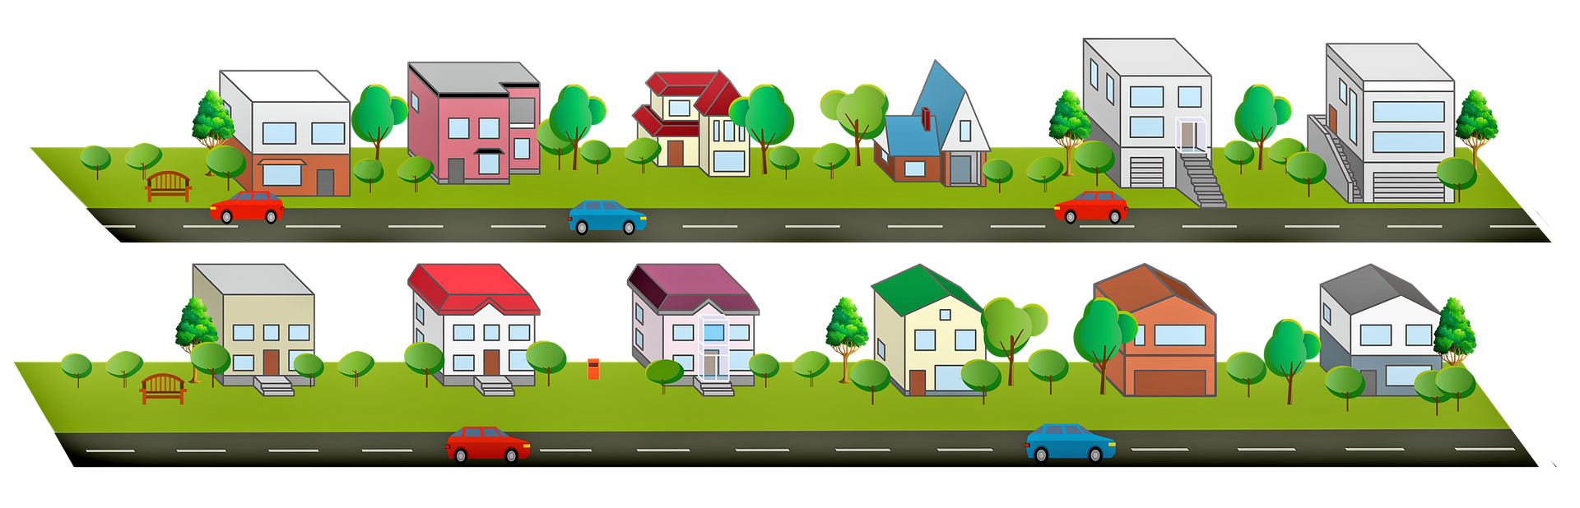
What do you notice and wonder?
When you walk around your community, observe the types of homes people live in. How many cars do you notice parked in front of the living spaces? Can you estimate how many adults live in the home?
Image from Pixabay https://pixabay.com/illustrations/houses-clipart-road-trees-4918284/

Slide 4
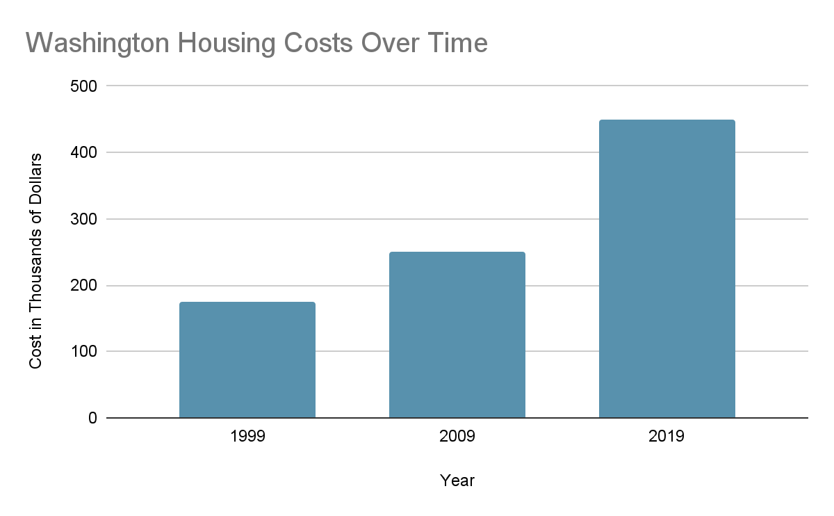
What do you notice and wonder?
Year | Average Household Income
1999 | $51,967
2009 | $56,276
2019 | $68,927

Slide 5
Vocabulary
Household Income - The amount of money a family makes in 1 year.
"But my mom gets paid on Fridays, not once a year." Household income would be all the Friday paychecks added up over the course of the year.

Slide 6


What do you notice and wonder?
I noticed… | I am wondering…

Slide 7

What questions can we answer with this data?
Year | Average Household Income
1999 | $51,967
2009 | $56,276
2019 | $68,927

Slide 8
City planners need your helping answering these questions:
How much more does a home in Washington state cost in 2019 than it did in 1999?
How much more income do families have in 2019 than they did in 1999?
Do you think the increase in income is enough compared to the increase in housing costs?

Slide 9
What do you need to solve this problem?
Relevant data
  Which numbers do you need?
Strategies for finding “How many more?”
Strategies for comparing numbers
Materials and supplies

Slide 10
Helpful Information and Tools

Slide 11
Remember to talk about your ideas with each other!
The strategy I used was ________ because ________ .
My strategy is like yours because ________ .
I used a different strategy because ________ .
Can you explain your thinking?
I disagree with the solution because ________ .
This answer makes the most sense because ________ .

Slide 12
Resolution
How much more does a home in Washington state cost in 2019 than it did in 1999?
I can use a ruler or straightedge to find the cost of a home in 1999 and 2019.
450 - 175 = 275
I notice that the axis has a label, “Cost in Thousands of Dollars”.
So my answer needs to be in thousands, and have the unit of dollars.
A home in 2019 costs $275,000 more than a home in 1999.
Notes:
NOTE: Students can use different estimations for the 1999 value and you can have a fantastic discussion about estimation and rounding!

Slide 13
Resolution
How much more income do families have in 2019 than they did in 1999?
Year | Average Household Income
1999 | $51,967
2009 | $56,276
2019 | $68,927
Families make
$16,960 more in 2019 than they did in 1999.
 |  |  | 18
 |  | 7 | 8 | 12
 | 6 | 8 | 9 | 2 | 7
- | 5 | 1 | 9 | 6 | 7
 | 1 | 6 | 9 | 6 | 0

Slide 14
Resolution
How much more income do families have in 2019 than they did in 1999?
Year | Average Household Income
1999 | $51,967
2009 | $56,276
2019 | $68,927
Families make
$16,960 more in 2019
than they did in 1999.
+3
+30
+8,000
+8,927
51,967
51,970
52,000
60,000
68,927
 |  | 8 | 9 | 2 | 7
 |  | 8 | 0 | 0 | 0
 |  |  |  | 3 | 0
+ |  |  |  |  | 3
 | 1 | 6 | 9 | 6 | 0

Slide 15
Resolution
Do you think the increase in income is enough compared to the increase in housing costs?
Housing costs more than doubled from 1999 to 2019. We can see that by drawing a straight line across.
If household income doubled from 1999, it would be
$51,967 + $51,967 = $103,934
Housing costs doubled, but household income did not.

Slide 16
Self Reflection
What did you learn today?
Score yourself from 1-10 on each success criteria. A score of 10 means “I know it so well, I could teach
someone else.”
I can make sense of problems and persevere in solving them.
I can explain what a value represents in my solution.
I can use mathematics to solve and discuss real world problems.

