Slide 1
Replanting Timber
Management of Washington forests for harvest.
3 ACT MATH TASK
Algebra

Slide 2
Learning Goals:
Students will solve a range of complex well-posed problems in applied mathematics (SMP1).
Students will solve a complex problem by making productive use of knowledge and problem-solving strategies (SMP2).
Students will analyze complex, real-world scenarios (SMP4).
Success Criteria:
I can apply algebra concepts to solve a problem about timber replantation. (SMP1, SMP2)
I can build a function that models a relationship between two quantities. (SMP4)

Slide 3
Scenario:
Bill needs to order seedlings for planting trees to restore 288 acres of burned timberland. Not every seedling that is planted will survive. He can order 1-year-old seedlings and 2-year-old seedlings. Bill has a work crew of 5 people available for the spring planting season to get the seedlings in the ground before the heat of summer.

Slide 4
Scenario
We would like to have survival of 300 trees/acre (TPA) at the end of 2 years of the following mix:
60% Douglas-fir (DF)
25% Western Hemlock (WH)
15% Western Red Cedar (WRC)
What does the forester want the forest to look like after two years?

Slide 5
Timber companies have to maximize profits.
There is a cost associated with the planting of new seedlings. As you work through your solution, consider:
How many seedlings do I need?
What are the costs?
Where can losses occur?
How many seedlings are needed?
What should the spacing be?
What age of seedlings should be planted?

Slide 6
Question:
What is your replanting plan?
Be prepared to explain your reasoning.

Slide 7
What other information do you need?
How large is an acre? | What is the planting season?
How many trees can be planted daily? | What are the tree species survival rates? |  | Click the question to collect additional information.

Slide 8
Remember to talk about your ideas!
I saw ________, so I connected that to ________ .
We know ________ because ________ .
Since ________ , then we can calculate ________ .

Slide 9
Discussion
Listen to each presenting group.
Consider what assumptions they have made. Do you agree or disagree with their methods?
Modify your own solution based on what you hear from presenting groups.

Slide 10
Resolution
How many seedlings do I need?
At the end of 2 years, you need 300 trees per acre (TPA).
The trees need to be in the following ratio 60% DF , 25% WH , 15% WRC
Each species has a unique survival rate that is less than 100%, so you will need to plant a surplus of seedlings to ensure 300 trees per acre outcome.
Figure out how many of each species you want to have after two years.
Figure out how many seedlings to plant to ensure that many trees will survive.
Calculate how many seedlings are needed to plant the 288 acre site.

Slide 11
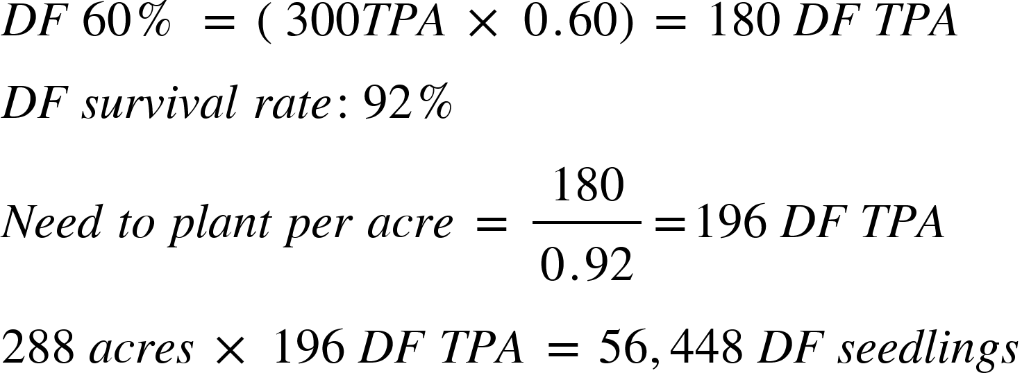
Resolution
How many seedlings do I need?
Douglas Fir (DF)

Slide 12
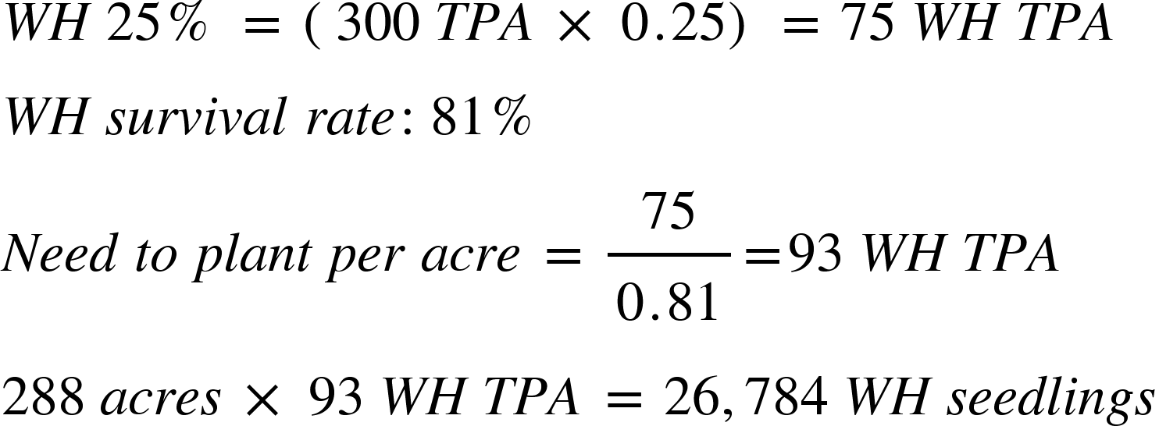
Resolution
How many seedlings do I need?
Western Hemlock (WH)

Slide 13
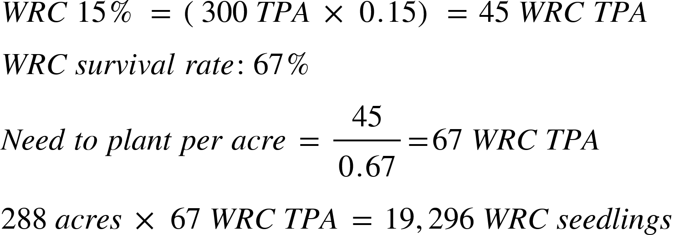
Resolution
How many seedlings do I need?
Western Red Cedar (WRC)

Slide 14
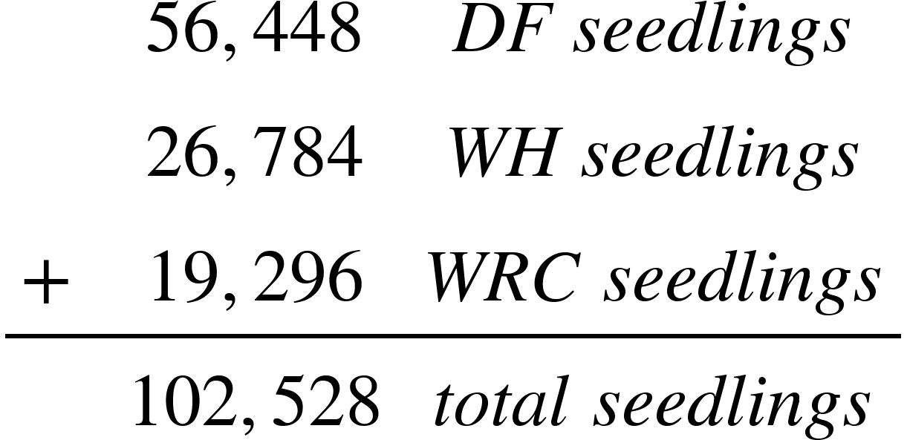
Resolution
How many seedlings do I need?
Total seedlings needed for replanting:

Slide 15
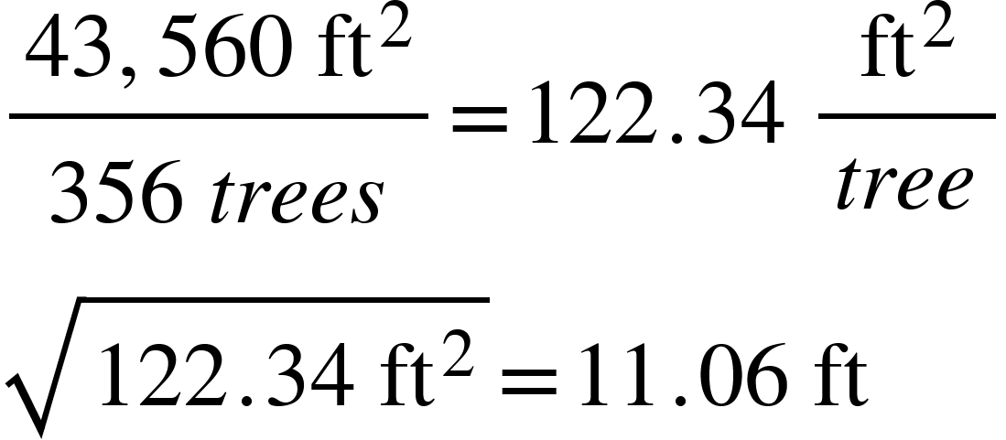
Resolution
How far apart should the trees be planted to ensure even distribution?
11.06 ft spacing between plantings if on a grid
1. Calculate the number of trees per acre
2. Calculate the number of square feet per tree
3. Find the distance between trees by calculating the square root.

Slide 16
Resolution
What age seedlings should I order?
Option 1: Order all seedlings of the same age
Since there are up to 45 days in the season, both of these solutions are feasible!

Slide 17
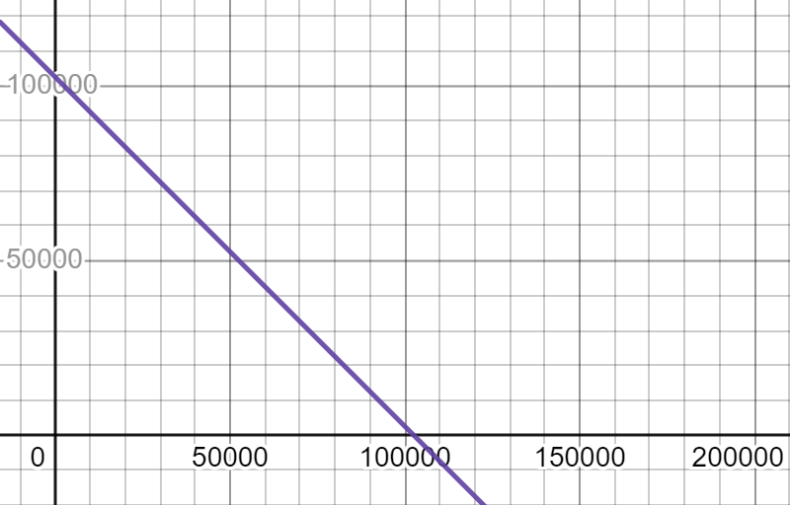
Resolution
What age seedlings should I order?
Option 2: Order a combination of 1-year-old and 2 year-old seedlings
Let x = the number of 1-year-old seedlings and y = the number of 2-year-old seedlings. The total number of seedlings must equal 102,528.
Notes:
Desmos graph:
https://www.desmos.com/calculator/yrjf6j8w9v

Slide 18
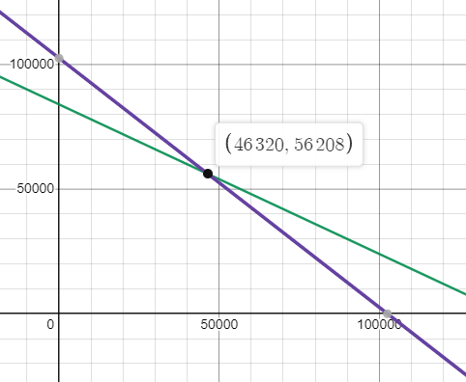
Resolution
Example solution: When the planting window is set for 28 days, then it is best to have 46,320 1 year olds and 56,208 2 year olds.
What age seedlings should I order if I’m worried the planting season isn’t going to be 45 planting days? (link to interactive graph)
Option 2: Order a combination of 1-year-old and 2-year-old seedlings
One worker can plant 1,000 1-year-old trees per day, or 600 2-year-old trees per day. There are 5 workers during a planting window, w, that could be from 0 to 45 days. Make w less than 45 to shorten the planting window.
Notes:
Desmos graph:
https://www.desmos.com/calculator/yrjf6j8w9v

Slide 19
Question:
How large is an acre?
Answer:
43,560 square feet (ft²)

Slide 20
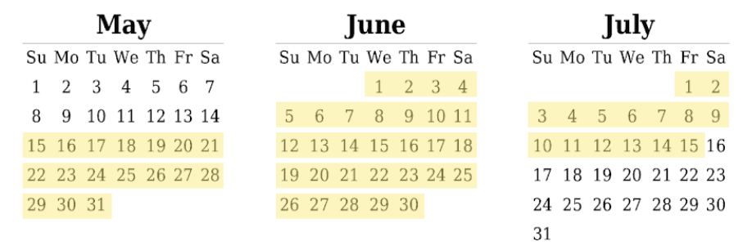
Question:
What is the planting window?
Answer:
For the particular 288 acres in question, the area is usually covered with snow until May 15. After July 15, the soil is too dry to support a newly planted seedling. There are about 9 weeks, so that is 45 maximum work days per person during the planting season. It is possible that the snow might not melt by the May 15th, and that hot weather comes before July 15.

Slide 21
Question:
How many trees can be planted each day?
Answer:
One tree planter can plant 1,000 one-year-old seedlings per day.
One tree planter can plant 600 two-year-old seedlings per day.
Planters work 5 days per week.

Slide 22
Question:
What are the tree species survival rates?
Answer:
* Because the area planted is at high elevation, planting 2-year-old trees instead of the normal 1-year-old trees we can ensure better growth if they survive.
 | Tree Species
 | Douglas Fir (DF) | Western Hemlock (WH) | Western Red Cedar (WRC)
seedling survival rate | 92% | 81% | 67%

Slide 23
Extension: Survival Survey Act 1
At two years old, it is necessary to do a survival survey to see how many trees that were planted survived. A distributed sample of one plot/acre is desired across the entire landscape. How long will it take a person to complete the job?

Slide 24
Extension: Survival Survey Act 2
To do this I know that one person can do 35 plots per day on gentle ground, 28 plots per day on marginally steep ground and only 20 plots per day on steep rugged terrain.
The 288 acres is comprised of a mix of: 28% gentle ground, 46% marginally steep ground and 26% steep rugged terrain.

Slide 25
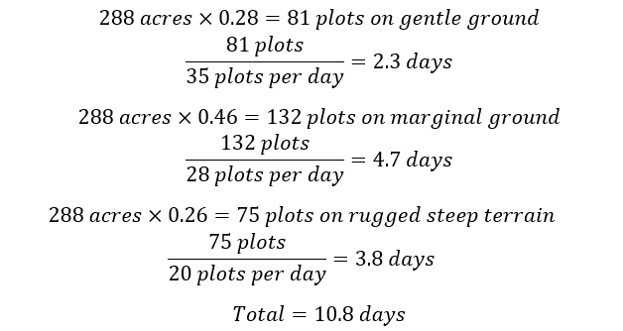
Extension: Survival Survey Act 3

Slide 26
Extension: Diameter of the trees Act 1
Once trees are around 25 years old, the diameter of the trees is measured. What is the diameter of the trees one foot above the ground when they are 25 years old?
Douglas-fir, Western Hemlock, and Western Red Cedar

Slide 27
Extension: Diameter of the trees ACT 2
The average circumference of the trees at age 25 at 1’ above the ground level is:
Douglas-fir: 30”
Western HemlocK: 36”
Western Red Cedar: 35”
Diameter is circumference divided by π.

Slide 28
Extension: Diameter of the trees Act 3
The average diameter of the trees at age 25 at 1’ above the ground level is:

Slide 29
Extension: Annual Growth rates Act 1
The trees were measured 2 years after planting for a survival survey. Then, 10 years after planting, the trees were measured again.
What was the average height growth per year between the survival survey and the 10-year remeasurement?
What is the predicted height for each tree 25 years after planting?

Slide 30
Extension: Annual Growth rates Act 2
When measuring the survival plots, tree heights of the seedlings was also measured and the average tree height by species after the second growing season in the ground was:
Douglas-fir: 4.8’
Western Hemlock: 5.2’
Western Red Cedar: 3.9’
After the tenth growing season the stand was remeasured with the following heights:
Douglas-fir: 33.1’
Western Hemlock: 29.6’
Western Red Cedar: 24.8’

Slide 31
Extension: Annual Growth rates Act 3
ANSWER for average rate of change:
Calculate (Year 10 height - Year 2 height ) divided by the elapsed time in years.

Slide 32
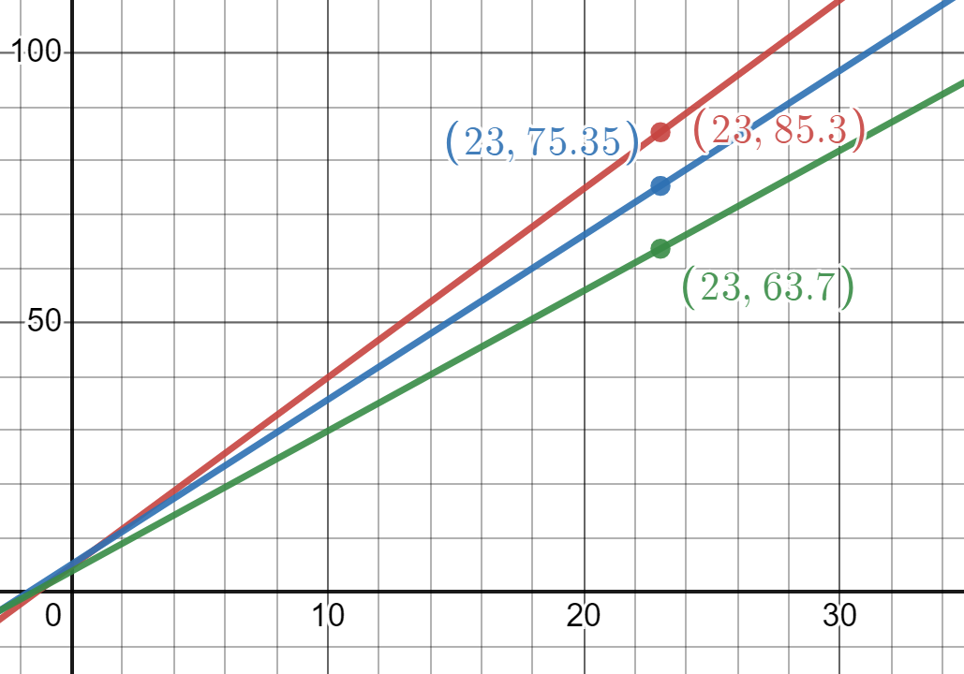
Extension: Annual Growth rates Act 3
Prediction of height at 25 years:
Use the 2 year height as your y-intercept, and find the height when x = 23.
(link to interactive graph)
Douglas fir = 85.3 ft tall
Western hemlock = 75.35 ft tall
Western red cedar = 63.7 ft tall
Notes:
Desmos graph:
https://www.desmos.com/calculator/ln6le7emnd

Slide 33
Extension: Thinning the trees Act 1
At age 25 it is desired to remove 50% of the trees to thin the growing timber stand in order to have a more healthy forest and get better growth on the remaining trees.
How many trees are remaining by species at age 25?
How many trees will remain of each species after removing 50% of the trees?

Slide 34
Extension: Thinning the trees Act 2
The normal mortality rate across all species is 2% per decade.
Assume after 2 years we have the following mix per each acre (from the very first problem):
60% Douglas-fir (DF)*300= 180 DF trees
25% Western Hemlock (WH)*300= 75 WH trees
15% Western Red Cedar (WRC)*300= 45 WRC trees

Slide 35
Extension: Thinning the trees Act 3
The normal mortality rate across all species is 2% per decade.
These populations will decay by 2% per decade for 2.3 decades. 25 years after planting we expect these populations per acre.

Slide 36
Extension: Thinning the trees ACT 3
The normal mortality rate across all species is 2% per decade.
25 years after planting we expect these populations per acre, so we will thin the trees by 50%.

Slide 37
Extension: Selling Thinned Trees Act 1
All the logs generated in the thinning will be delivered to a pulp mill to make paper from the logs that are shipped. What is the round-trip time to the mill? What is the total cost to haul 1 load of logs? If the average log truck can haul 29 tons per load, then what is the cost per ton of the haul?

Slide 38
Extension: Selling Thinned Trees Act 2
All the logs generated in the thinning will be delivered to a pulp mill to make paper from the logs that are shipped. The cost of harvesting the logs is $20/ton to cut, move and load the logs on a truck. Trucking costs $98/hour. It also takes 30 minutes to load logs on a truck and 20 minutes to unload the logs at the pulp mill. The timber is located 53 miles from the mill on the following road system:
Timber Area on rocked road to main line haul road: 8 miles
Main line haul road to State Highway: 14 miles
State highway to Pulp Mill: 31 miles
The average speed trucks can go on each road is:
20 mph on rocked road ; 35 mph on main line ; 55 mph on state highway

Slide 39
Extension: Selling Thinned Trees Act 3
What is the round-trip time to the mill? What is the total cost to haul 1 load of logs?
Since we are dealing with round trip trucking the miles for each segment of road must be doubled. Therefore, 16 miles of rocked road, 28 miles of mainline and 62 miles of highway. In addition to driver cost, also include cost to harvest the logs.

Slide 40
Extension: Selling thinned trees Act 3
If the average log truck can haul 29 tons/load, what is the cost per ton of the haul?

