Slide 1
Aquaculture in Willapa Bay
Growing oysters in the presence of ghost shrimp

Slide 2
Learning Goals:
Students will solve a range of complex well-posed problems in applied mathematics (SMP1).
Students will solve a complex problem by making productive use of knowledge and problem-solving strategies (SMP2).
Students will analyze complex, real-world scenarios (SMP4).
Success Criteria:
I can apply algebra concepts to solve a problem about oyster aquaculture. (SMP1, SMP2)
I can interpret a function that models a relationship between two quantities. (SMP4)

Slide 3
CCSS.MATH.CONTENT.HSS.ID.A.2
Use statistics appropriate to the shape of the data distribution to compare center (median, mean) and spread (interquartile range, standard deviation) of two or more different data sets.
CCSS.MATH.CONTENT.HSS.IC.A.1
Understand statistics as a process for making inferences about population parameters based on a random sample from that population.
CCSS.MATH.CONTENT.HSS.IC.B.4
Use data from a sample survey to estimate a population mean or proportion; develop a margin of error through the use of simulation models for random sampling.

Slide 4
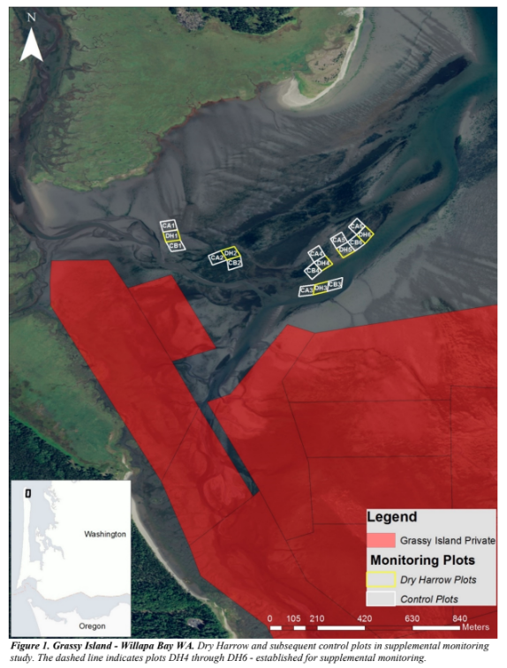
Scenario:
When populations of native ghost shrimp are too high, then it harms the population of oysters.
The problem: Ghost shrimp are a native species that lives in this environment. The ghost shrimp feed by “bioturbation”, meaning they shuffle up the sand in search of food. Their search for food causes any baby oysters nearby to be covered by sand and then suffocated. Instead of hard packed sand, which is better for oysters, the bioturbation causes the sand to be very soft, with the texture of quicksand.
Oyster growers did an experiment to see if the “dry harrowing” method would reduce population growth of ghost shrimp enough to use that area of the aquaculture of oysters.
This image shows Willapa Bay, and the plots where the monitoring of shrimp populations occurred.
(source: Willapa Bay Mechanical Management of Burrowing Shrimp WA DNR 2018)

Slide 5
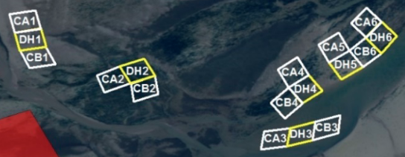
Scenario:
Oyster growers did an experiment to see if the “dry harrowing” method would reduce population growth of ghost shrimp enough to use that area of the aquaculture of oysters.
This image is zoomed in to the plots where the monitoring of shrimp populations occurred. Yellow was experimental plots that were dry harrowed and white was the control plots that did not get a treatment.

Slide 6
Aquaculture companies have to maximize profits
There is a cost associated with any treatment to reduce ghost shrimp populations.
As you work through your solution, consider:
How do you know if you have too many ghost shrimp?
How can I determine shrimp populations?
How can I determine the density of populations?
How can I tell if the dry harrowing treatment works? How long does it work?

Slide 7
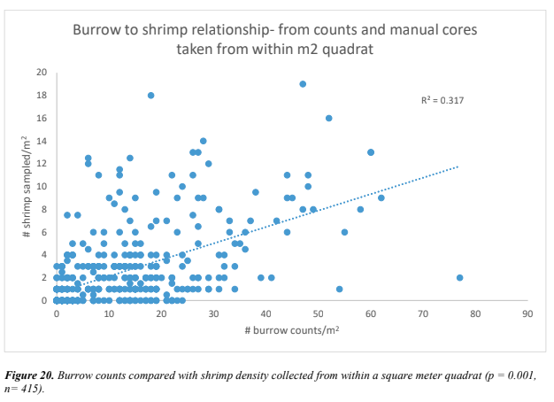
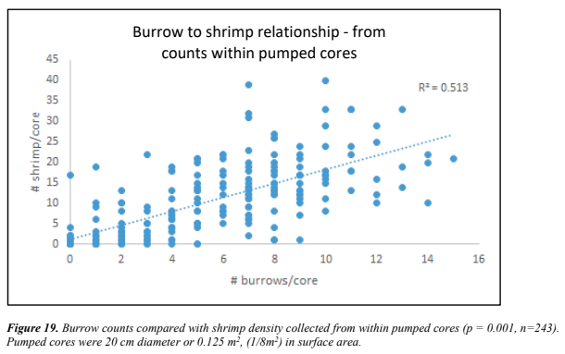
Problem 1: Notice and Wonder

Slide 8
Act 1 Problem 1a: Can you look at the surface burrows to determine the underlying shrimp population?
Source: Willapa Bay Mechanical Management of Burrowing Shrimp Supplement July 2018 WA Dept of Natural Resources.

Slide 9
Act 1 Problem 1b: Can you look at the surface burrows to determine the underlying shrimp population?
Source: Willapa Bay Mechanical Management of Burrowing Shrimp Supplement July 2018 WA Dept of Natural Resources.

Slide 10
Act 2 Problem 1
What information do you need to solve your problem?

Slide 11
Act 3 Problem 1: The Reveal
For problem 1a, no. The line of best fit has an r2 value of only 0.513. This means about 51% of the variance in the outcome could be explained by this linear model. In general, with an r2 value this low, the predictions we could make will be too imprecise to be useful.
For problem 1b, the r2 is 0.317, indicating that about 32% of the variance in the outcome is explained by the linear model.
Overall, you need to do either a pumped or manual core to get an accurate determination of the ghost shrimp population. It is more expensive because it takes longer to do it.

Slide 12
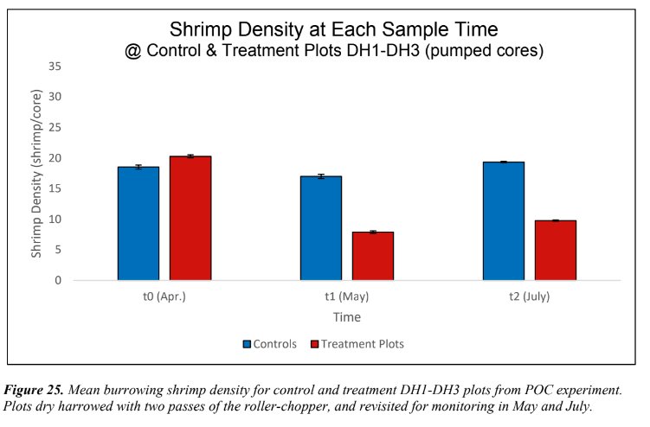
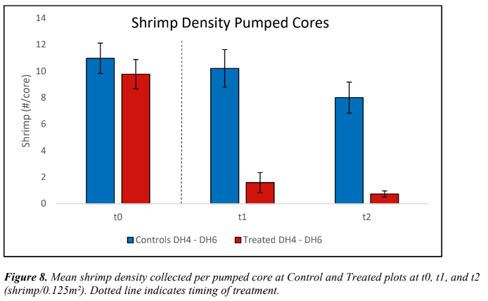
Problem 2: Notice and Wonder

Slide 13
Act 1 Problem 2: How many passes are needed?
Figure 25 shows plots that were dry harrowed twice, and figure 8 shows plots that were dry harrowed four times. The lines on top of each bar indicate the margin of error for the data. Note that no plots had been treated at t0. Source: Willapa Bay Mechanical Management of Burrowing Shrimp, WADNR 2018

Slide 14
Act 2 Problem 2: How many passes are needed?
What else do you need to know to solve your problem?

Slide 15
Act 3 Problem 2: How many passes are needed?
Answer: Two passes gives a significant reduction in the ghost shrimp population, while four passes reduces it even more. If there is the time and money to do it four times, then do it. If there is only time or money for 2 passes, it is still very helpful.

Slide 16
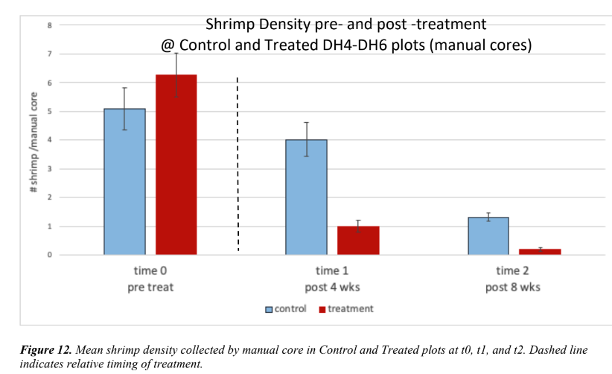
Problem 3: Notice and Wonder

Slide 17
Act 1 Problem 3: Are pumped cores as accurate as manual?
These graphs are both about the measurements taken at the same time on the same treatment plots. Source: Willapa Bay Mechanical Management of Burrowing Shrimp, WADNR 2018

Slide 18
Act 2 Problem 3: Are pumped cores as accurate as manual? Because they are quicker and cheaper!
What additional information do you need to solve your problem?

Slide 19
Act 3 Problem 3: Are pumped cores as accurate as manual?
No, they are not as accurate. In these graphs, pumped cores appear to be overestimating. However, it seems like they are similar enough that pumped cores could work if there is a shortage of time/$ to do the measuring work. It is a good idea to do a mixture of sampling types to balance the time/cost with the accuracy needed to make good decisions.

Slide 20
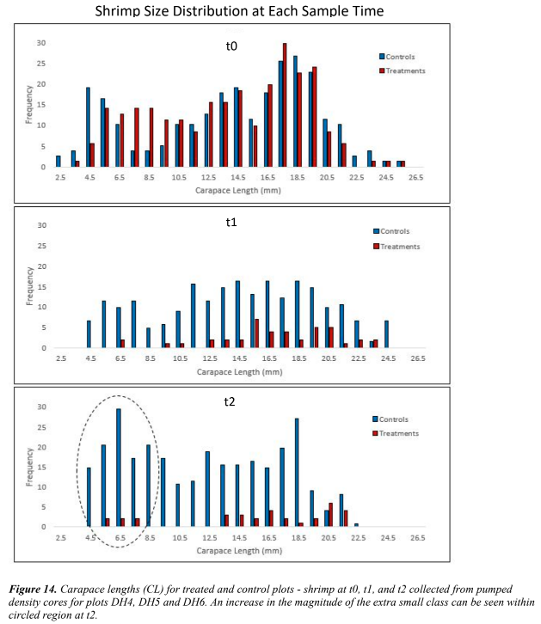
Problem 4: Notice and Wonder

Slide 21
Act 1 Problem 4: How did size of shrimp change after treatment compared to control?
Source: Willapa Bay Mechanical Management of Burrowing Shrimp, WADNR 2018

Slide 22
Act 2 Problem 4: How did size of shrimp change after treatment compared to control?
What else do you need to know to solve your problem?

Slide 23
Act 3 Problem 4: How did size of shrimp change after treatment compared to control?
Answer: All sizes of shrimp were reduced. If there was already a small population of that particular size before treatment, then after treatment the population went down a lot. Shrimp 16.5mm and larger were greatly reduced. By t2, some of the very smallest sized shrimp were growing back in the treated areas. Also by t2, the largest sized shrimp in the control group are also gone for some unknown reason.

Slide 24
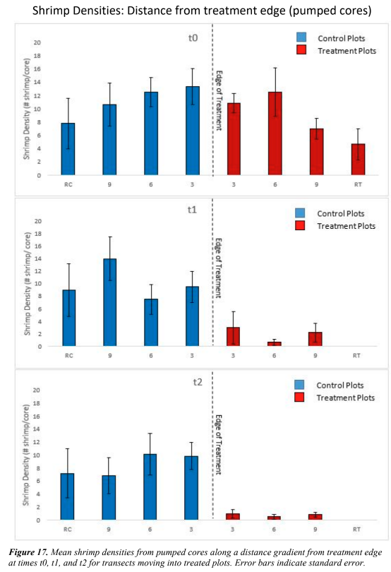
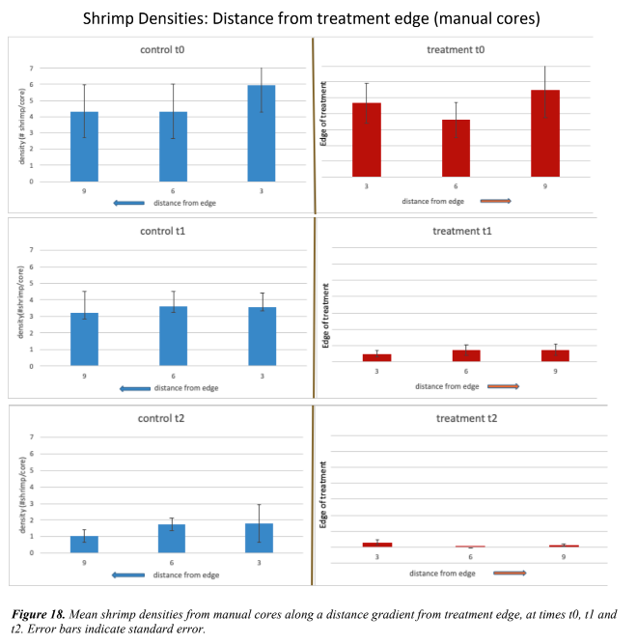
Problem 5: Notice and Wonder

Slide 25
Act 1 Problem 5a: After dry harrowing, do shrimp move into untreated areas?
In these graphs, the dotted line represents the edge of the treatment. The distance from the dotted line represents the distance of a plot from the border. Source: Willapa Bay Mechanical Management of Burrowing Shrimp, WADNR 2018

Slide 26
Act 1 Problem 5b: After dry harrowing, do shrimp move into untreated areas?
In these graphs, the dotted line represents the edge of the treatment. The distance from the dotted line represents the distance of a plot from the border. Source: Willapa Bay Mechanical Management of Burrowing Shrimp, WADNR 2018

Slide 27
Act 2 Problem 5: After dry harrowing, do shrimp move into untreated areas?
What else do you need to know to solve your problem?

Slide 28
Act 3 Problem 5a: After dry harrowing, do shrimp move into untreated areas?
Answer: It does not appear that the shrimp are moving. In the control plots, population at each location fluctuates up and down. In the experiment plots, population decreases over time. If there was movement from control to experiment plots, you would expect to see the population on the red 3 meter mark increase or at least not decrease over time, but this didn’t happen.

Slide 29
Act 3 Problem 5b: After dry harrowing, do shrimp move into untreated areas?
Answer: It does not appear that the shrimp are moving. In the control plots, population at each location does always decrease over time. In the experiment plots, population decreases more drastically.
If there was movement from control to experiment plots, you would expect to see the population on the red 3 meter mark increase or at least not decrease over time, but this didn’t happen.

Slide 30
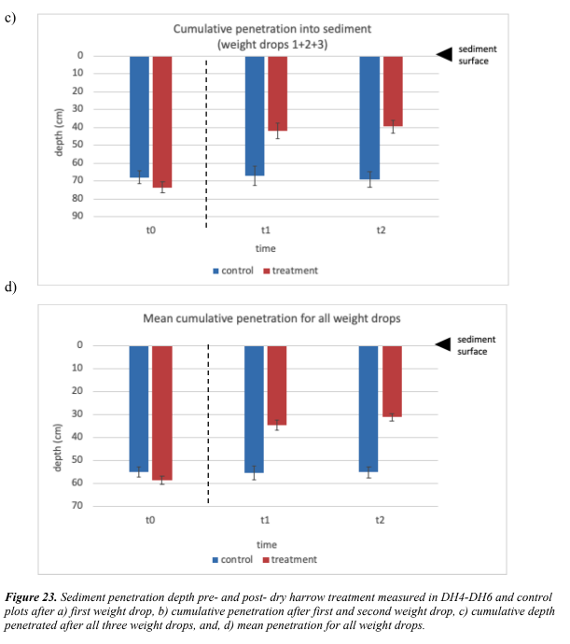
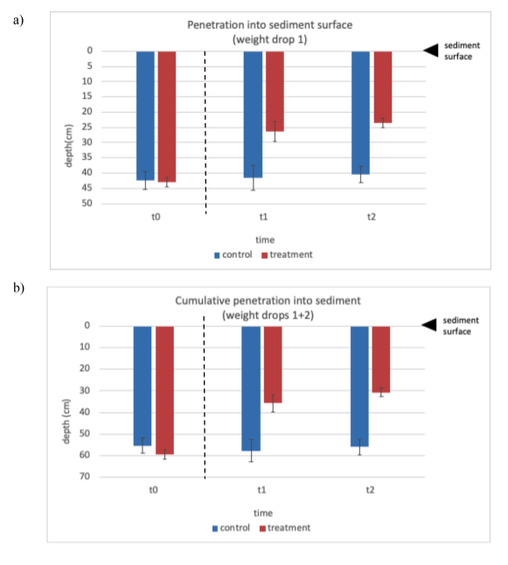
Problem 6: Notice and Wonder

Slide 31
Act 1 Problem 6: Did dry harrowing reduce shrimp enough to make the sand more compacted?
Source: Willapa Bay Mechanical Management of Burrowing Shrimp, WADNR 2018

Slide 32
Act 2 Problem 6: Did dry harrowing reduce shrimp enough to make the sand more compacted?
What do you need to know to answer your question?

Slide 33
Act 3 Problem 6: Did dry harrowing reduce shrimp enough to make the sand more compacted?
Answer: Yes, it did. There does not appear to be any change in the control plots even though their population went down, too (as we saw on previous problems).

Slide 34
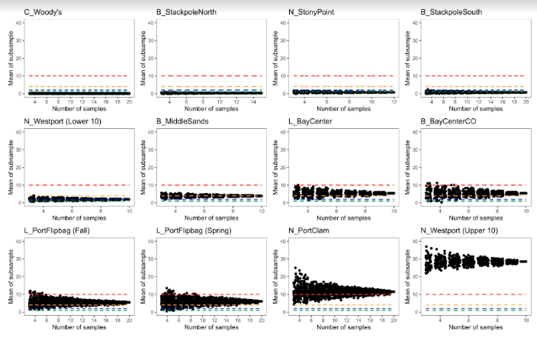
Problem 7: Notice and Wonder

Slide 35
Act 1 Problem 7: What is your recommendation to make the most accurate population estimates? Growers hope for less than two shrimp per sample.
Ghost shrimp populations were measured in both Grays Harbor and Willapa Harbor at different locations.
This figure shows the model output for randomized subsets of mean shrimp density data based on number of samples collected.
Mean number shrimp was calculated from a random subset of actual samples, without replacement.
Dashed lines represent thresholds of shrimp density.
Source: Figure 8, Assessment of burrowing shrimp densities on shellfish aquaculture beds in Grays Harbor and Willapa Bay by hand-coring technique, Subbotin and Ruesink 2021.

Slide 36
Act 2 Problem 7: What is your recommendation to make the most accurate population estimates?
What else do you need to know to solve your problem?

Slide 37
Act 3 Problem 7: What is your recommendation to make the most accurate population estimates?
Answer: the more samples you can take, the more accurate your population estimate will be.
For sites in the top row that had low populations and low variability, four samples will be enough to know if the population is under 2 shrimp per sample.
When there is a population gradient, meaning there is a lot of variability in the population, you need to take 10 to 20 samples in order to get an accurate estimate. So if your first 10 samples have a lot of variability, take 10 more.

Slide 38
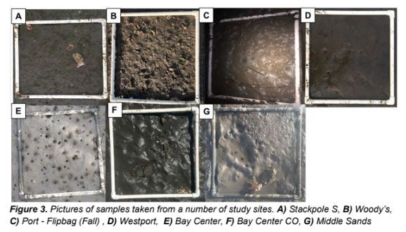
Information: What do burrows on the sand look like?
Here are examples of how the surfaces of different sites can appear. The holes usually indicate the burrow of some type of animal, including the ghost shrimp.
Source: Assessment of burrowing shrimp densities on shellfish aquaculture beds in Grays Harbor and
Willapa Bay by hand-coring technique (Subbotin and Ruesink 2021)

Slide 39
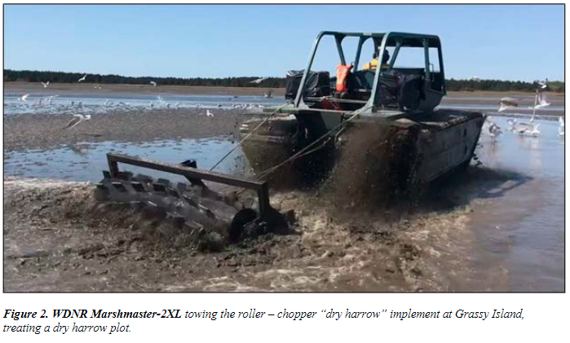
Information: What is dry harrowing?
Dry Harrow Treatment: Dry harrowing involved towing a robust steel roller behind an amphibious tracked vehicle called the “Marsh Master-2LX” (Figure 2). The roller is a product from Coast Machinery LLC., weighs 700 pounds empty, and is designed to cut an 8-foot wide swath through marsh and wetland cat-tail (Coast Machinery LLC. 2018). It has a series of flat plates welded to it, which penetrate into the sediment approximately 30 cm. The implement can be either hooked up to a 4 point hydraulic hitch, or towed with load bearing rope. It both crushes and forces shrimp out of their burrows where they can be consumed by birds.
Source: Willapa Bay Mechanical Management of Burrowing Shrimp Supplement July 2018 WA Dept of Natural Resources.

Slide 40
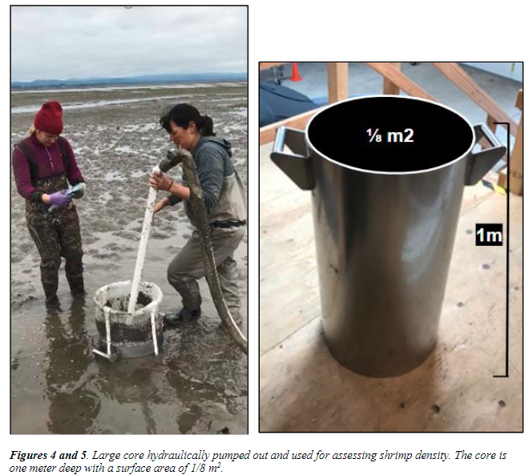
Information: What is a pumped core?
To assess shrimp density and biomass at each plot, the entire contents of a 1/8 meter² (m²) surface area core was liquified. Shrimp are buoyant and float to the surface of the core, where they are scooped up, placed in site-specific labelled bags then frozen for later lab processing.
Source: Willapa Bay Mechanical Management of Burrowing Shrimp Supplement July 2018 WA Dept of Natural Resources.

Slide 41
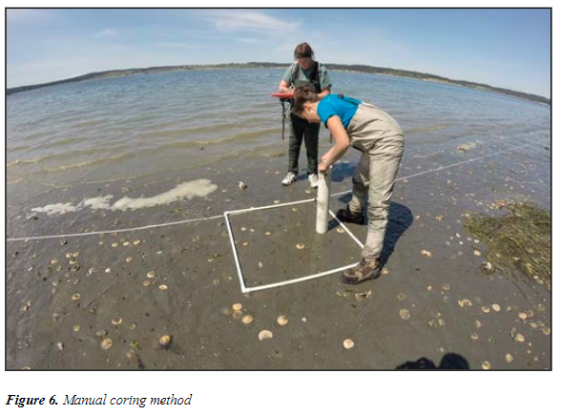
Information: What is a manual core?
Clam guns are used to excavate sediment cores of one meter in depth and approximately .078 m² in surface area (Figure 6). Once the sand is excavated, then organisms are counted.
Source: Willapa Bay Mechanical Management of Burrowing Shrimp Supplement July 2018 WA Dept of Natural Resources.

Slide 42
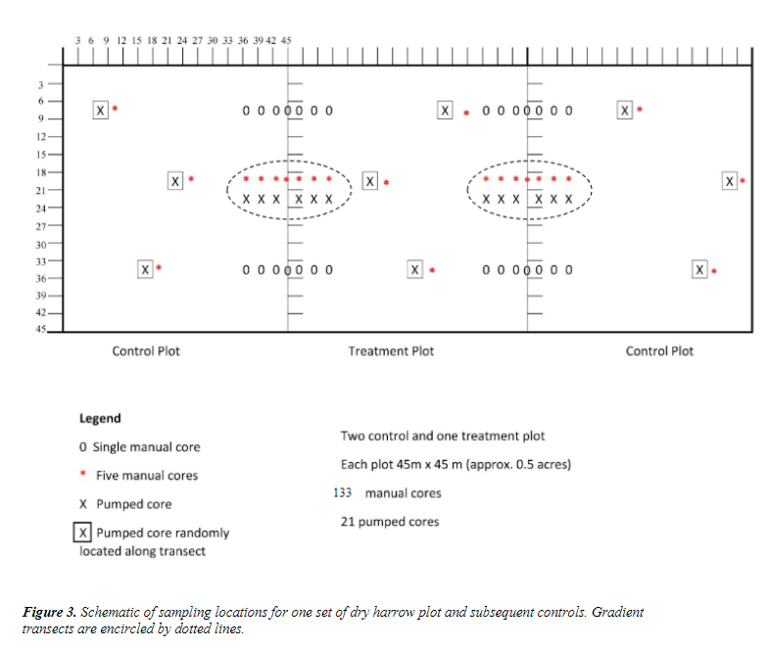
Information: How did they set up the core samples?
The axes are measured in meters. For a manual core, the entire m² was dug up and shrimp were counted. For the pumped core, a ⅛ m2 core was taken and its contents multiplied by 8 to determine the population in that m² section.
Source: Willapa Bay Mechanical Management of Burrowing Shrimp Supplement July 2018 WA Dept of Natural Resources.

Slide 43
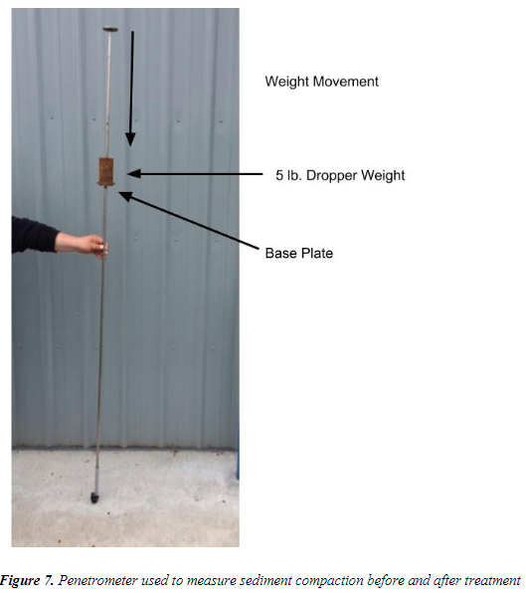
Information: How did they determine sand compactness?
They used this tool. The base plate started on the surface of the sand and got driven into the sand by dropping the weight. The softer the sand, the farther the base plate would drive into the sand.
Source: Willapa Bay Mechanical Management of Burrowing Shrimp Supplement July 2018 WA Dept of Natural Resources.

Slide 44
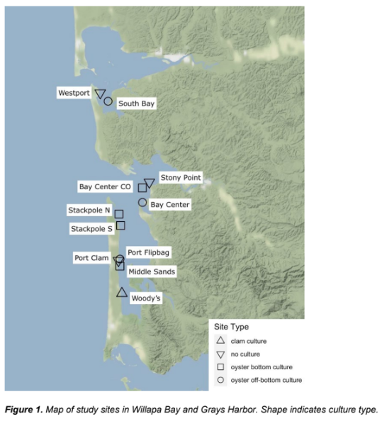
Information: Where was the study for problem 7?
These areas were studied.
Source: Figure 1, Assessment of burrowing shrimp densities on shellfish aquaculture beds in Grays Harbor and Willapa Bay by hand-coring technique, Subbotin and Ruesink 2021.

