Slide 1
European Green CRAB
5th Grade Workshop

Slide 2
Learning Goals:
I can explain the effects green crabs are having on shellfish and other parts of the environment.
I can explain what environmental specialists are doing to protect sensitive habitats from green crabs.
I can solve multi-step word problems.
I can multiply and divide multi-digit numbers.
I can identify green crabs based on their features.

Slide 3
What do we already know about European green crabs? | What do we want to know more about?

Slide 4
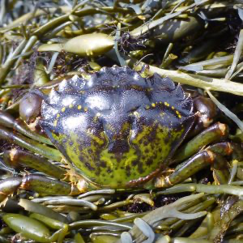
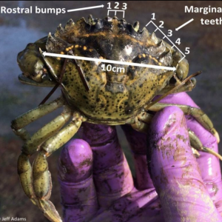
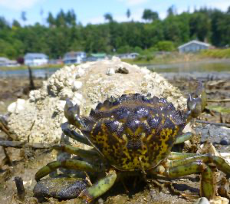
European green crab
Green crabs made their way to the united states from Europe in the 1800s by ship transportation of young green crab.
Green crabs were first discovered in the pacific northwest in 1998.
An adult green crab measures only about 3-4 inches across (about the size of a crayon).
They range in color from dark green to brown with yellow or brown patches. They can be an orange-red color underneath.
They can be identified by the set of five triangular teeth, or spines, evenly spaced on each side of their shell between the eyes and the widest part of the shell.
Female green crabs can reproduce twice in a season.
They can produce 175,000-250,000 eggs each time!
Green crabs prefer estuary habitats that are protected from waves but can also survive on the open coastline.
https://wsg.washington.edu/crabteam/greencrab/id/
https://wsg.washington.edu/crabteam/greencrab/id/

Slide 5
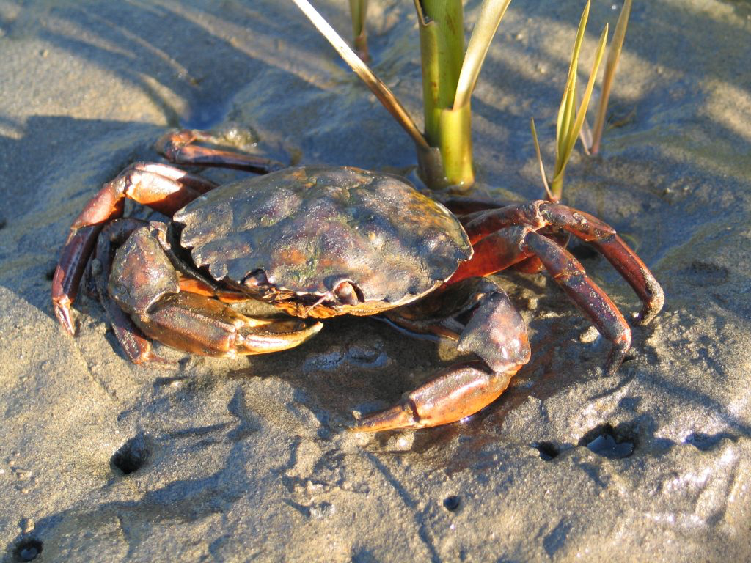
Green Crab diet
Green crabs can eat just about anything, but enjoy eating species such as: mussels, snails, algae, crabs, oysters, and clams.
One green crab can consume 40 clams in a single day.
https://wsg.washington.edu/crabteam/greencrab/id/

Slide 6
What’s the problem?
Green crabs are an invasive species.
An invasive species is any new species that, when introduced to a new area outside of its native range, can cause great ecological harm to that ecosystem if it becomes widespread.
Since green crabs can reproduce extremely fast, they can cause serious damage to ecosystems.
They can disperse over a large area and eat a large quantity of prey.
They are direct competition for local crabs (such as Dungeness crab) to get the food they need.
They slice through seagrass destroying many other creature’s habitats.
They can also cause coastal erosion.
Coastal erosion happens when sediment or rocks get removed from the shoreline by waves, storms, and wind.
Green crabs burrow in the sediment to look for food, which causes more sediment to be swept away.
Seagrass does a good job at protecting the coast because it can trap rocks and sediment.
When green crabs destroy the seagrass, they destroy that natural barrier, and more rock and sediment can escape the shoreline.

Slide 7
What’s the problem? (continued)
They are also an economical issue.
Green crabs eat the same food as native crabs.
If the native crabs are not getting the food they need, their population will decrease.
There are many people who earn a living by fishing for crab who may experience a loss of income because of the reduced populations of native crabs.
Green crabs eat clams, oysters, and other crabs.
There are many shellfish growers who will experience a loss of income because green crabs eat clams and oysters.
• Crab fishermen may also lose income because of fewer native crabs.
Green crabs do have predators (such as larger native crabs, fish, birds, and otters) but these animals barely make a dent on green crab population, so natural predation is not a practical control method.

Slide 8
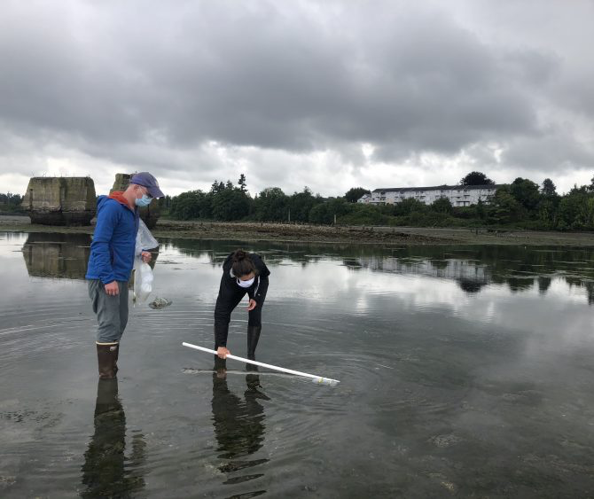
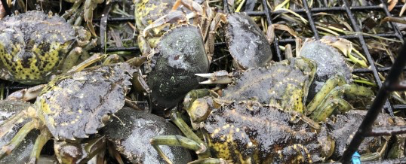
What are our environmental specialists Doing about it?
Tracing DNA
Scientists have found a way to detect the presence of green crab in an area by collecting a bottle of water from that area and extracting the DNA from the water. They use this DNA (also known as eDNA) to determine if green crabs have been present recently.
Trapping
The best-known control method for green crabs is to trap them. Scientists can use many different types of traps to capture green crabs.
Native crab species are often mistaken as green crabs, so it’s important that trappers are trained in species identification.
https://wsg.washington.edu/crabteam/greencrab/id/
Ryan Kelly, left, and Abigail Keller collect water samples in Drayton Harbor, Washington, in 2020.Emily Grason/Washington Sea Grant

Slide 9
Washington Sea Grant’s Trapping Summary for 2021

Slide 10
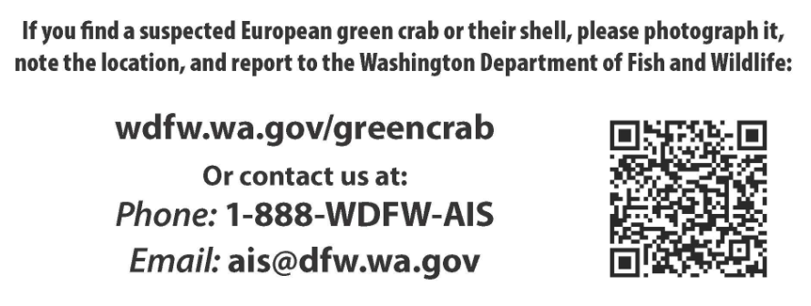
What can you do?
If you see a green crab, report it as soon as possible.
It is illegal to possess a green crab in Washington state, so if you find one, report it and leave it there.

Slide 11
The Washington seagrant’s crab team needs your help!
There are 10,000 clams along your local beach’s shoreline. There are also 50 European green crabs.
The crab team needs your help figuring out how long it would take for the green crabs to eat all the clams on your shoreline.
Then they need your help figuring out how many traps to put out to get rid of all the green crabs in the area.
Finally, they will need your help identifying some of the crabs they caught to figure out which are green crabs and need to be disposed of and which are not green crabs and are safe to return to the water.

Slide 12
Resources
Washington Sea Grant Green crab Information
https://wsg.washington.edu/crabteam/greencrab/
Washington Department of fish and wildlife
https://wdfw.wa.gov/species-habitats/invasive/carcinus-maenas#resources
Guide to identifying crab
https://wdfw.wa.gov/sites/default/files/2022-06/wa%20sea%20grant%20crab%20team%20id%20guide%202022%20version.pdf
Free Green crab coloring book
https://www.greencrab.org/blog/2021/7/30/green-crabs-at-the-beach

