Slide 1
The Winner Is…Native Plants!
Using Native Plants to Support Drought Conscious Communities

Slide 2
Learning Goals:
  Students will understand how to analyze complex, real-world scenarios. (Claim 4)
  Students will solve a complex problem by making productive use of knowledge and problem-solving strategies (Claim 2)
Success Criteria:
  I can apply different operations to help me solve a real-world problem.
  I can solve problems involving whole numbers with multiple digits.

Slide 3
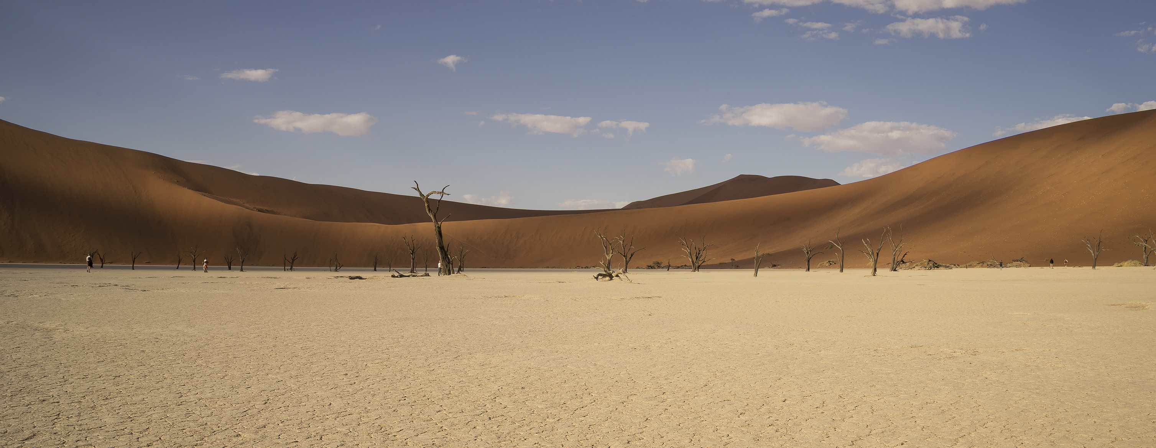
What is Drought?
Not having enough water for living things such as plants, animals, and humans.

Slide 4
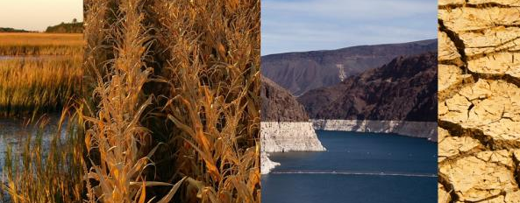
What are Signs of Drought?
Take some time to head outside.
Explore your playground for signs that life is not getting enough water.

Slide 5
What do you notice and wonder?
Notice (I noticed ________.) | Wonder (I am wondering ________.)

Slide 6
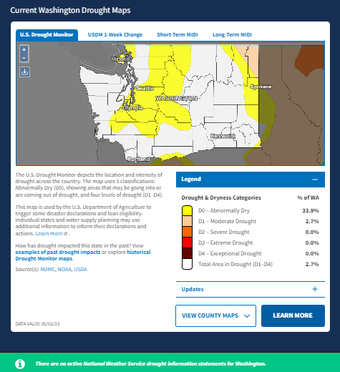
Current U.S. Drought
Monitor Conditions
drought.gov/states/washington
Use this link to find your counties graphs. The slides that follow are for Yakima County.

Slide 7
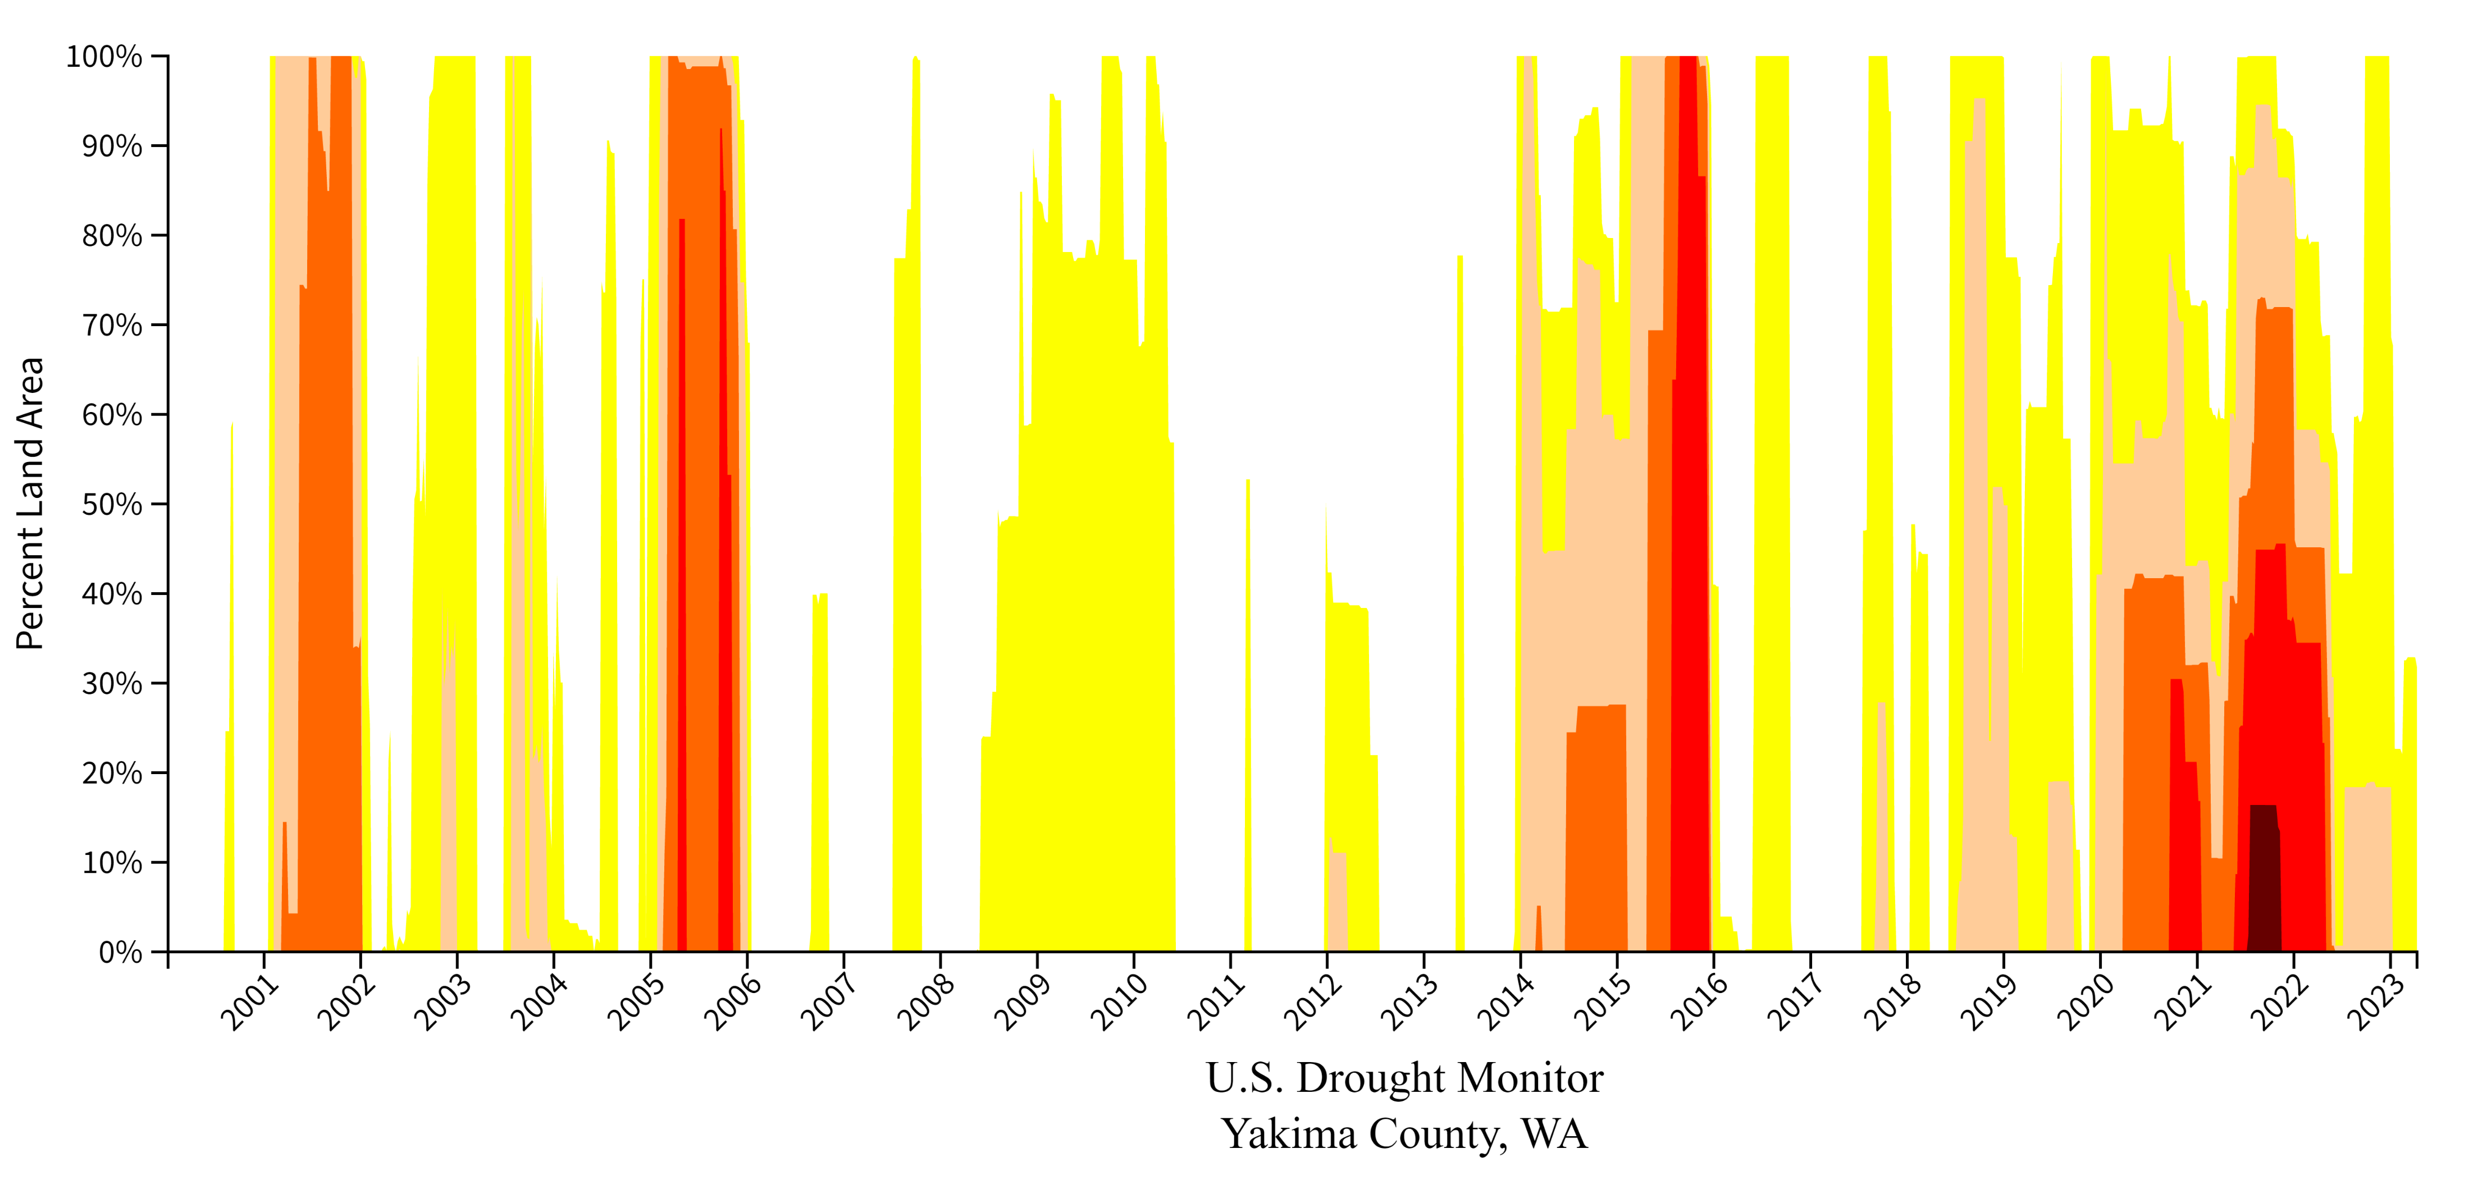
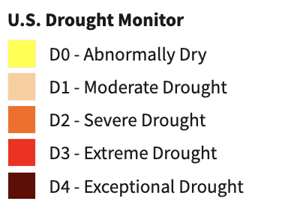
Drought Charts
Image from: https://www.drought.gov/states/washington/county/Yakima

Slide 8
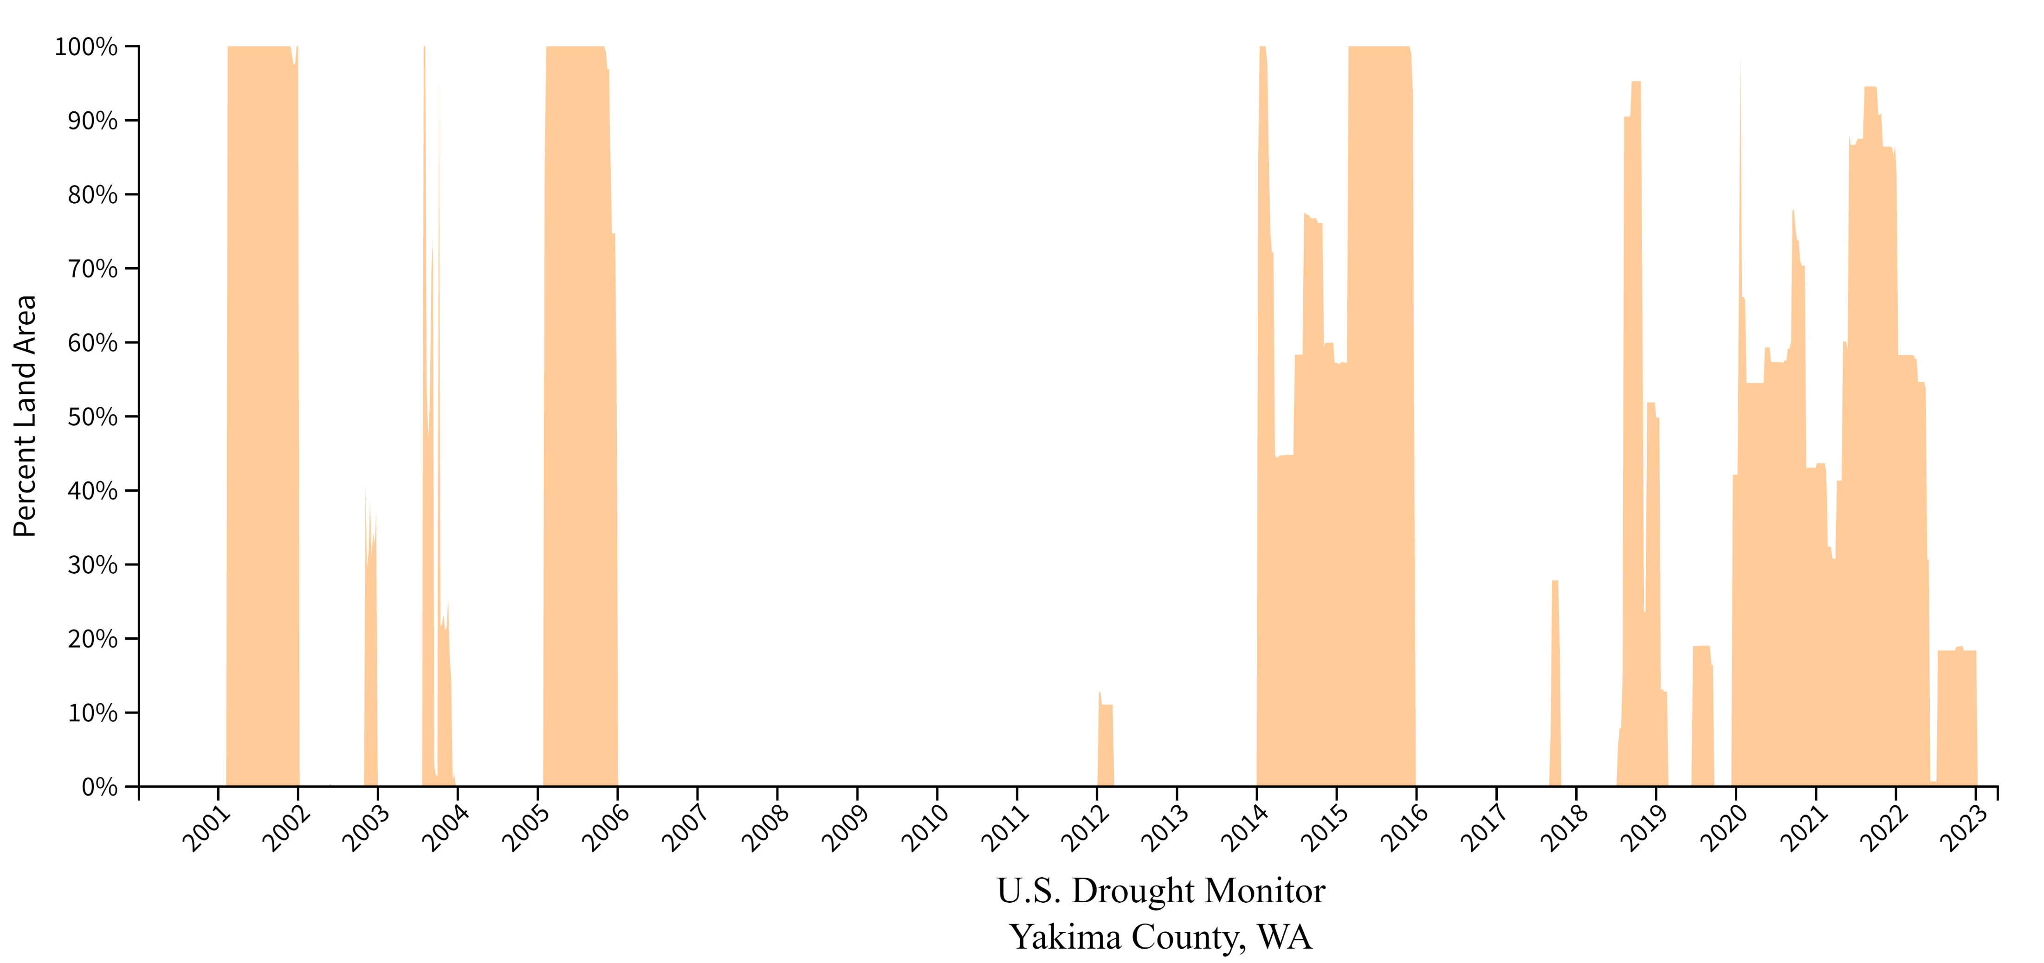
Drought Charts
Image from: https://www.drought.gov/states/washington/county/Yakima
Drought Charts

Slide 9
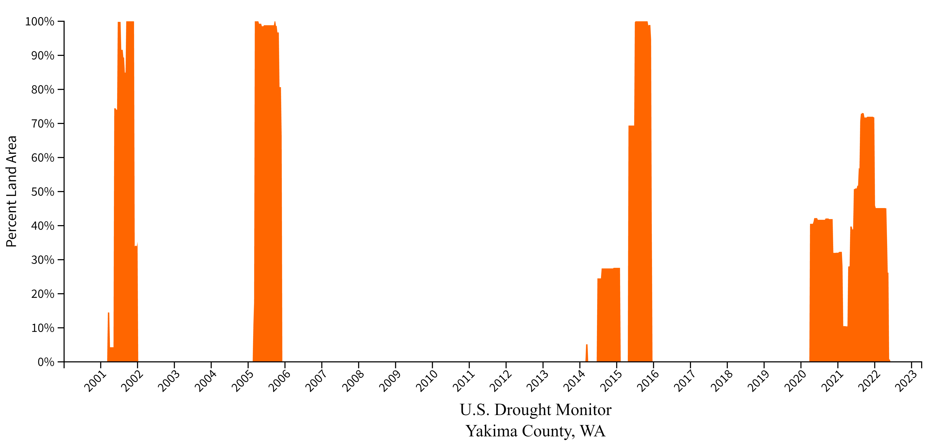
Drought Charts
Image from: https://www.drought.gov/states/washington/county/Yakima

Slide 10
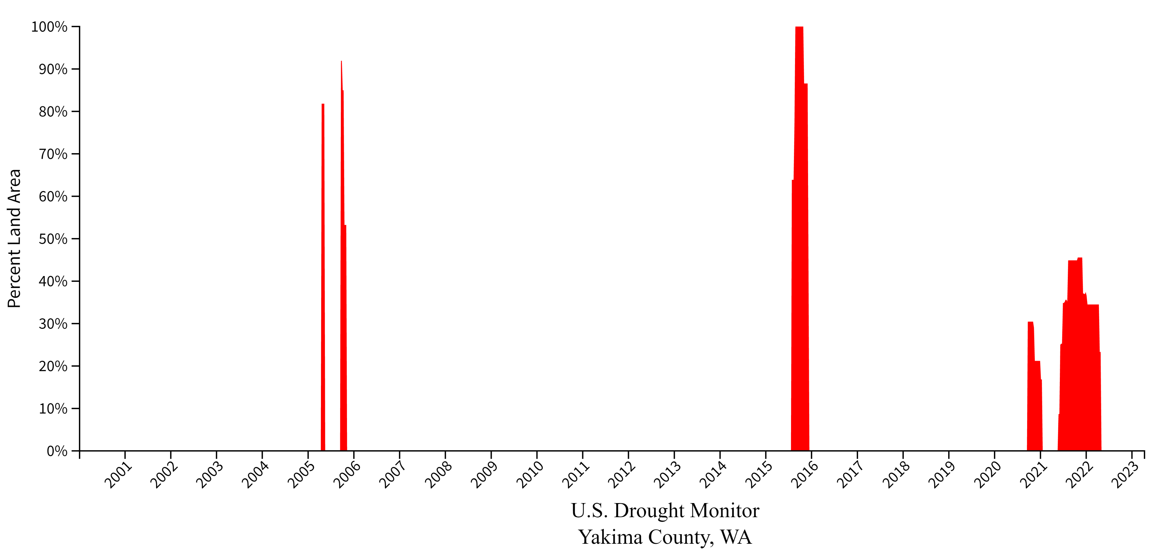
Drought Charts
Image from: https://www.drought.gov/states/washington/county/Yakima

Slide 11
What do you notice and wonder?
Notice (I noticed ________.) | Wonder (I am wondering ________.)

Slide 12
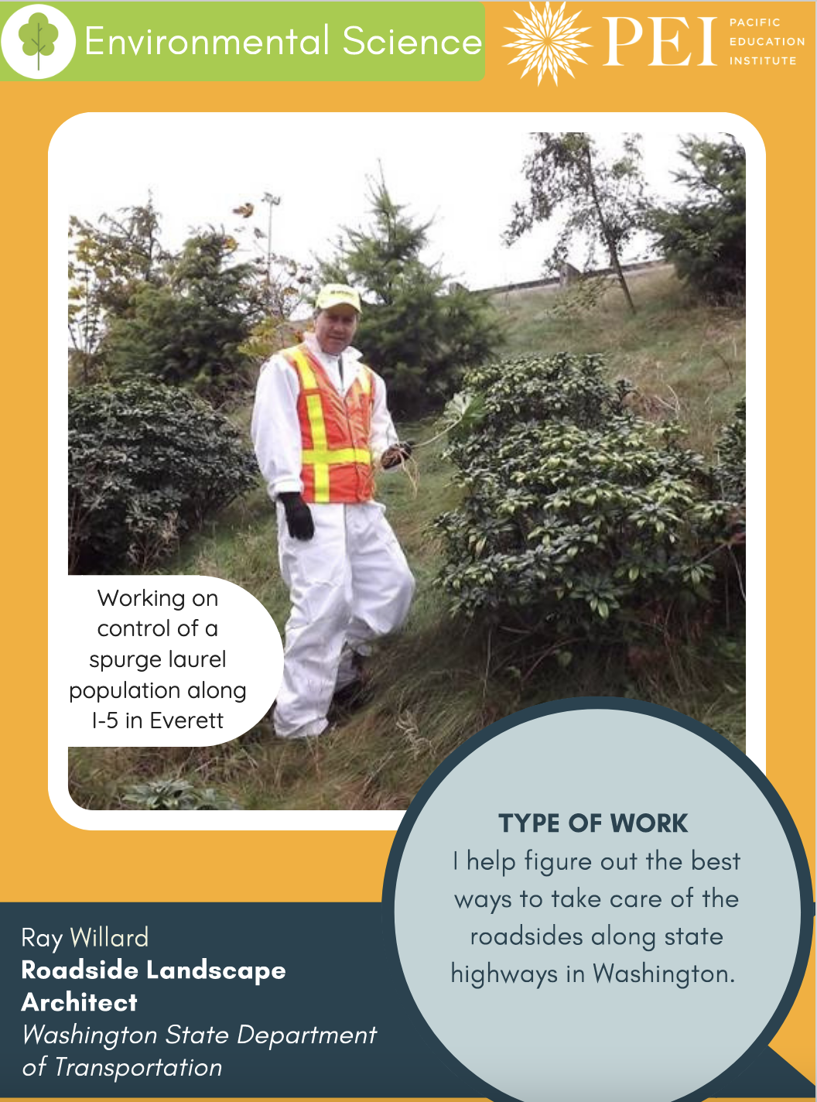
How often are we in drought?
Drought is something that city planners, homeowners, and other community members consider when making decisions about our community.
One job that considers how to conserve water is Roadside Landscape Architect.

Slide 13
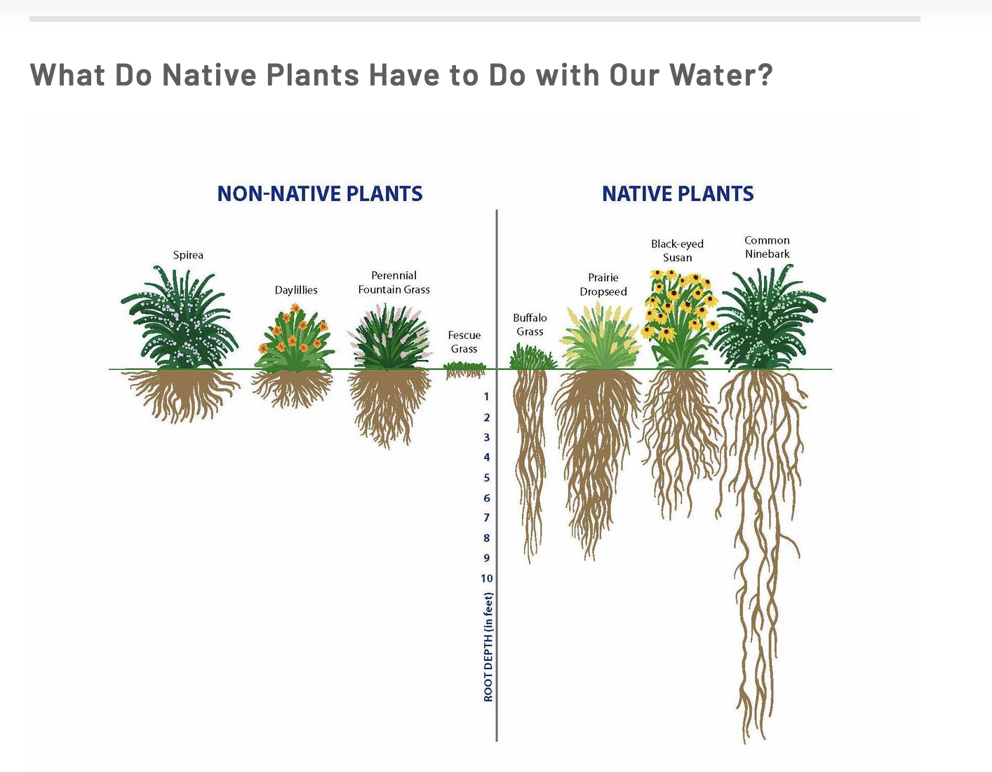
The Solution: Native Plants
Native plants are plants that are specific to an area and have adapted over time to thrive in the local climate.
How do long roots help the plant survive?
Image from: https://toledolakeerie.clearchoicescleanwater.org/pledges/native-plants-and-pollinators/plant-1/

Slide 14
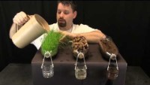
Another Reason
After watching this video, what other benefits do native plants provide our community?

Slide 15
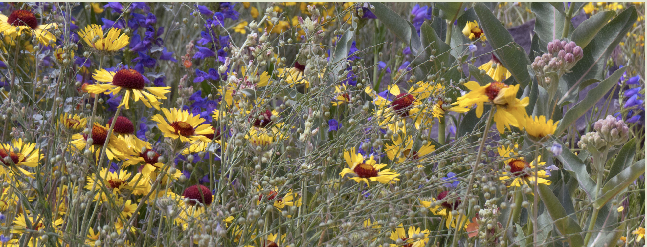
A Schoolyard Challenge
Native Plants are a tool in helping us conserve water. Your local Roadside Landscape Architect has invited you to help design a garden for (Insert School Name) that demonstrates the beauty and brilliance of native plants. Designs must meet given requirements in order to be considered for the project.
Image from https://www.taptealnativeplants.com/

Slide 16
A Community Challenge
Native Plants are a tool in helping us conserve water. Your local Roadside Landscape Architect has invited you to help design a garden for your community that demonstrates the beauty and brilliance of native plants. Designs must meet given requirements in order to be considered for the project.
Image from https://www.taptealnativeplants.com/

Slide 17
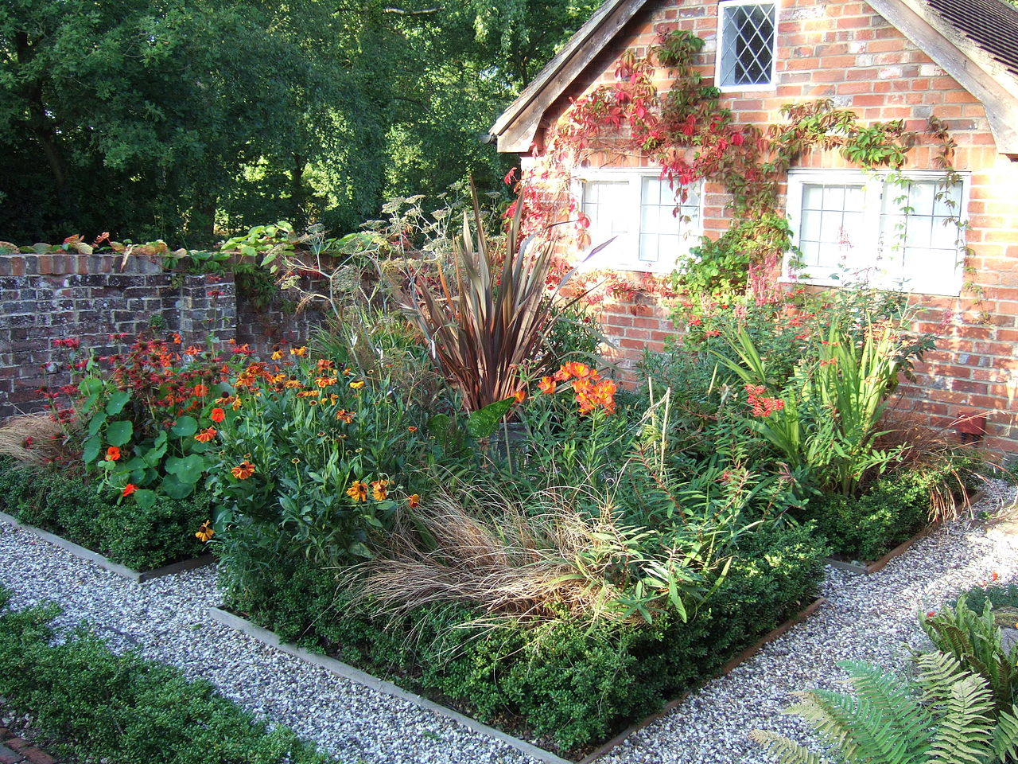
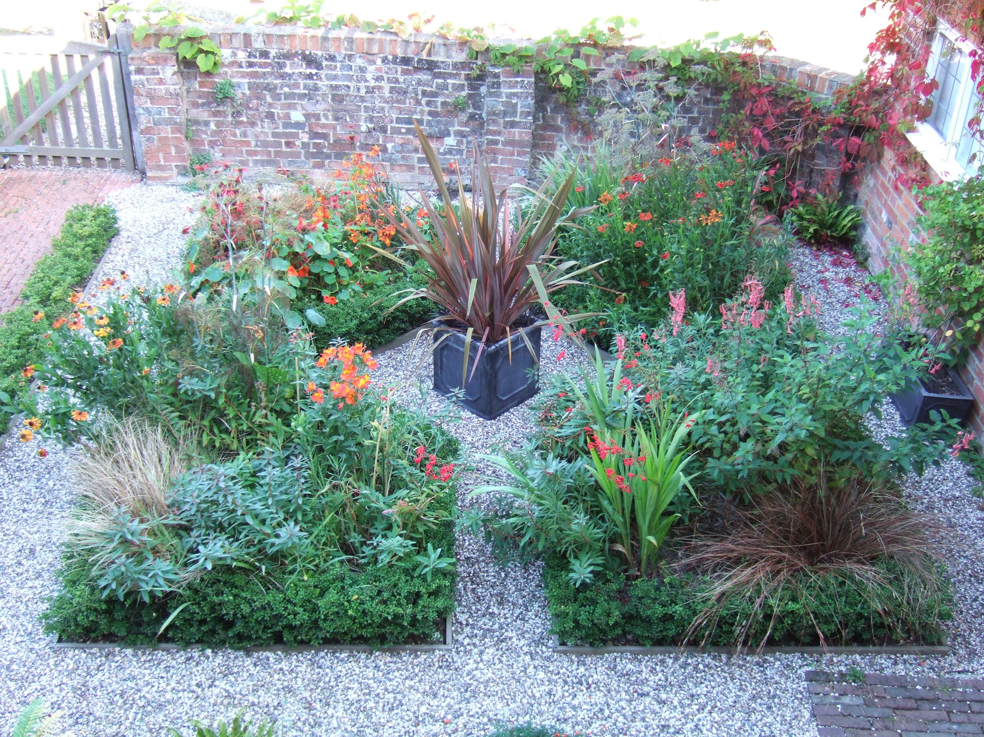
The winning design must meet the following guidelines:
Total Area of 450 square feet – garden beds and walking path combined
(Bonus Points: greatest area with smallest perimeter)
At least 2 garden beds that have straight sides

Slide 18
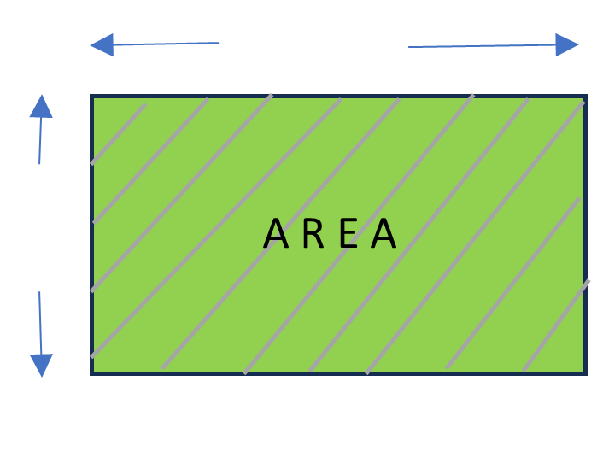
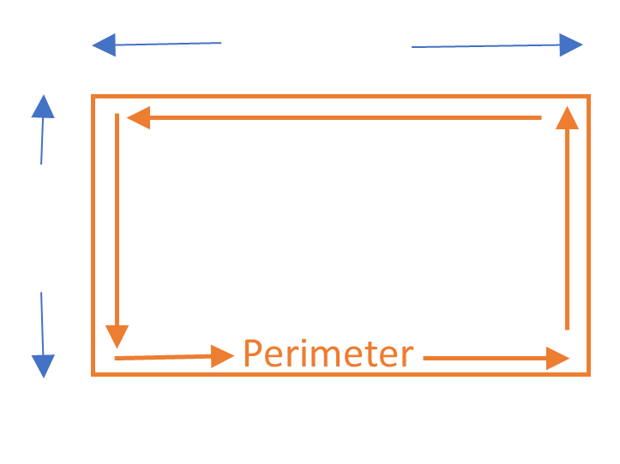
The winning design must meet the following guidelines:
Designers must calculate the area and perimeter for each garden bed and their walking path
All measurements for garden beds and walking path should be displayed on the design
Calculations:
Area: L x W
Perimeter:
(2 x L) + (2 x W)

Slide 19
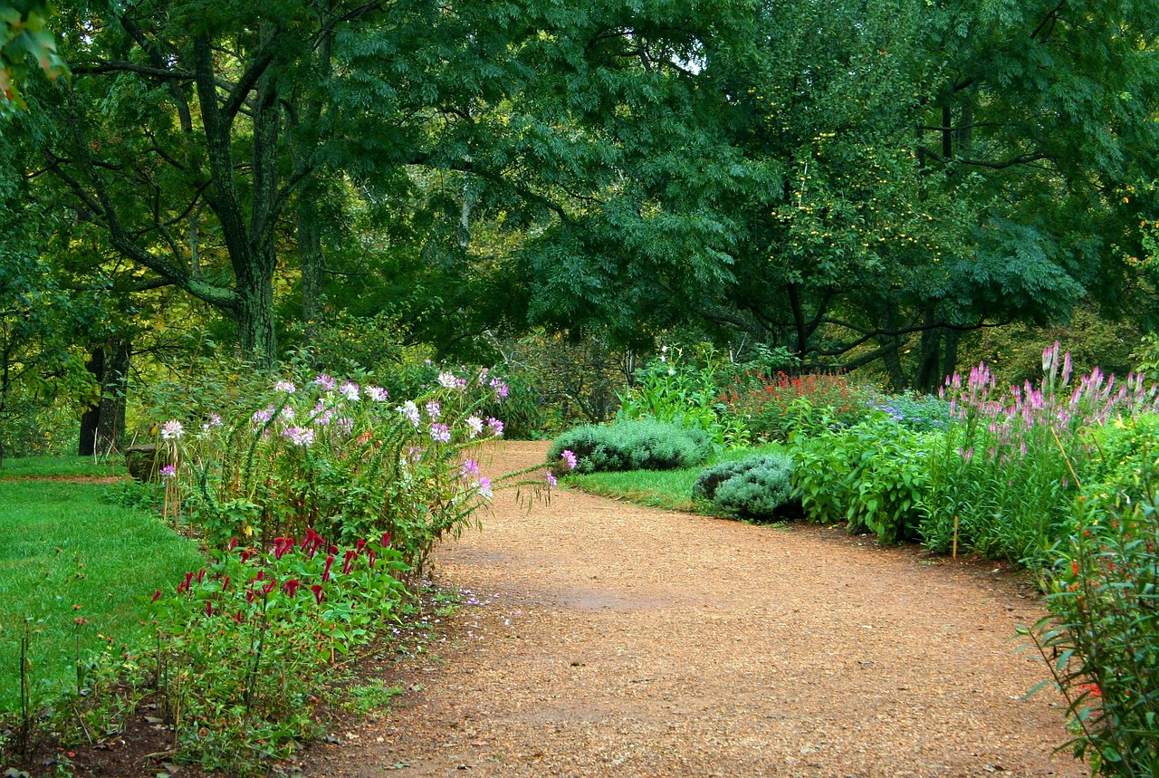
The winning design must meet the following guidelines:
Design must have a walking path with a 36-inch width that connects one end of the area to the other
36 inch width

Slide 20
Do You Have Everything You Need?
Graph Paper
Rulers
Formulas
Other?

Slide 21
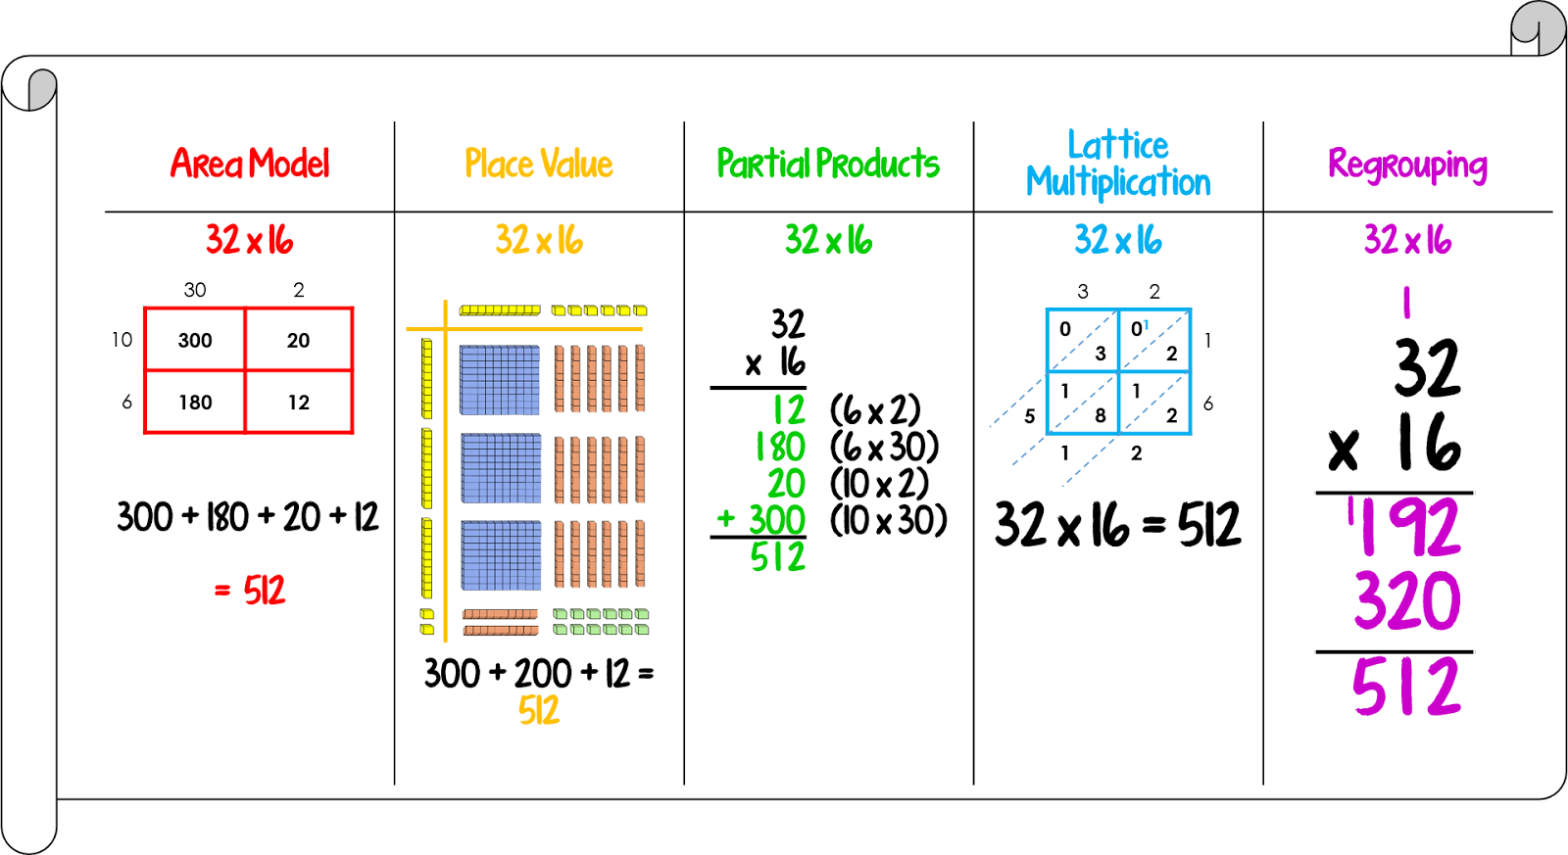
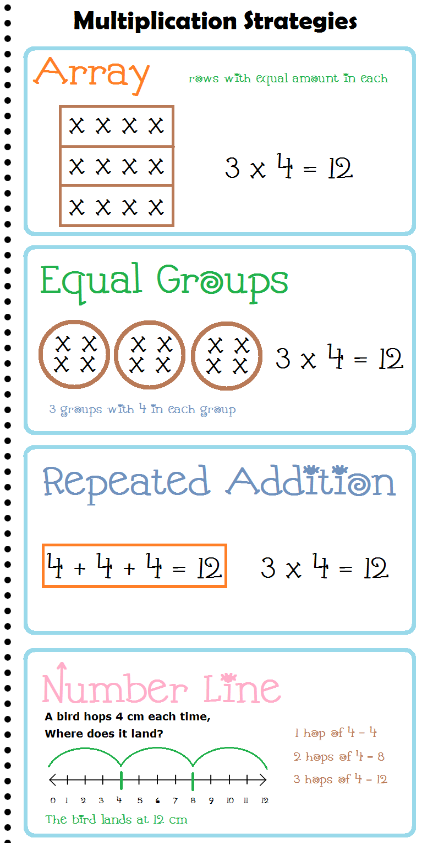
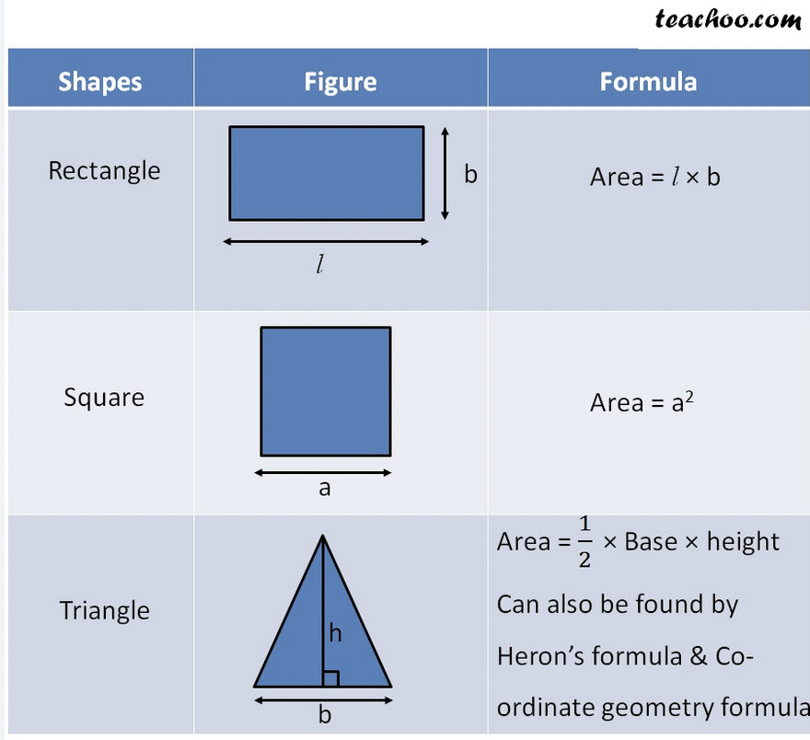
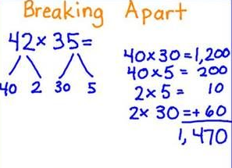
Helpful Information and Tools

Slide 22
Discussion Frames
I think ________ because ________.
I learned that ________.
I agree because ________.
I respectfully disagree because ________.
Can you explain ________?
I can see connections between ________ and ________ because ________.
So what I think ________ is saying is that ________. Is that correct ________?

Slide 23
Design Guidelines Summary:
Total Area of 450 sq feet (Bonus Points: most area with the smallest perimeter)
At least 2 garden beds that have straight sides
Design must have a walking path with a 36-inch width that connects one end of the area to the other
Designers must calculate the area and perimeter for each garden bed and their walking path
All measurements for garden beds and walking path should be displayed on the design

Slide 24
Resolutions
Students present their designs and the class shares connections and observations of strategies, successful or not, that were used in the solution.

Slide 25
Self Reflection
What did you learn today?
Score yourself from 1–10 on each success criteria. Ten is you know it so well you could teach someone else.
Write what you learned in 1 – 3 sentences.
  I can apply different operations to help me solve a real-world problem.
  I can solve problems involving whole numbers with multiple digits.

