Slide 1
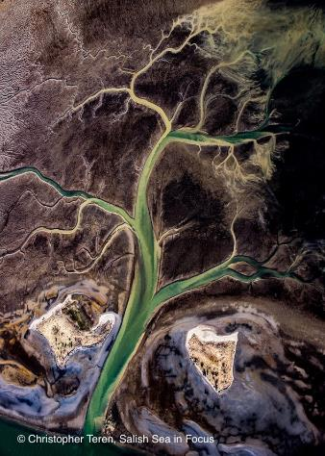
Unit 2 Stormwater
Welcome to your very own watershed, where you and your students will discover many connections between the land where you live and the sea where your water flows.
This unit is yours to explore, modify, and tailor to your classroom needs.
All resources are available to access or download at www.juniorseadoctors.com/stormwater

Slide 2
Background for teachers
Water that evaporates from the land, ocean, and waterways rises to the sky where cold air condenses it to droplets, snow, or sleet that falls to the ground and seeps in until its saturated. It then rolls downhill, gathers in streams, moves into rivers, then arrives at an estuary where it heads back to sea. You know this as the water cycle that we all had to memorize in school through diagrams. This unit takes a more exploratory approach, building on the experience of a cloud forming before their eyes in unit 1 to following that water from “snow caps to white caps”.
As water flows from the mountain crests and ridges and gathers in the valley below, it is being “shed” by the hillsides into one gathering place, such as a river, lake, or estuary, where the fresh river water meets the salty sea. One area shedding water to a common body of water is called a watershed. The Salish Sea can be defined as one great watershed, but so can individual river valleys, the hills that drain to them, and the estuary where the river meets the sea.
A vegetated watershed, with forests, meadows, wetlands, salt marsh, and seagrass beds, will slow and absorb the running water, prevent flooding, prevent erosion, keep streams and rivers clear, and even chemically change and absorb pollutants like a sponge, cleaning the water for wildlife and people.
Impervious surfaces (such as asphalt, concrete, and metal and composition rooftops) keep water from soaking into the soil and keep plants from purifying the waters. They act more like a cookie sheet than a sponge, allowing water to move faster to the sea. This water can then wash with it pollutants, like: soaps and detergents from washing cars and boats, fetillizers and pesticides from lawn care and farms, road film (rubber tire and copper break particles, oil and fuel, antifreeze, and more), and industrial wastes.
This water, called stormwater, eventually lands into the rivers, estuaries, and sea. Science is showing that stormwater is affecting salmon and killer whale survival by disrupting oxygen absorption, immune response, and many other health issues among many other species.
Read this EPA article to better understand stormwater quality issues: https://www.epa.gov/salish-sea/freshwater-quality
Notes:
The Salish Sea was named officially in 2009 for the hundreds of Tribes and Bands of First Nations peoples who share a common language group, we call Coast Salish. Coast Salish knowledge of these waters is vast and essential for seafaring. Do you know what tribes or Bands live in your Salish Sea neighborhood? No matter where you are along these shores, you are in Coast Salish historical territory.

Slide 3
s
There is great hope in results seen from biofiltration. Biofiltration is the directing of stormwater runoff to soils planted with beneficial native plants that reduce the toxin and sediment load, purifying the water before it is returned to the stream, river, or bay.
In this unit your students will observe a storm drain to spark wonder about just what is flowing from our communities to the sea. From here they will find out what makes up a watershed by modeling one, discover what happens with and without biofiltration, and design an investigation to test out a waterway near your school.
Results from their study will be used in unit 8 as they choose a project to improve the environment in your own community. Reaching out and building a relationship with a local watershed conservation expert will add value to this unit and help shoulder the load of materials, expertise, and scientific inquiry organization.
You can find willing experts in our Marine Experts Map on the Junior SeaDoctors website: www.juniorseadoctors.org/map, as well as connecting with your local tribe or First Nation through your district’s indigenous liaison.
NOTE: This slideshow and the accompanying student journal are focused on the Puyallup River watershed in Tacoma. It will be more relevant for your students if you substitute maps, issues, and video clips for those in your own region.
Notes:
Read goals. When we come back we will jump right into experiencing a sample lesson, so summon your inner 5th grader, grab your Explore the Salish Sea book and student journal, and get your engineer on!

Slide 4
EXPLORE TEAM ROLES
Chief Scientist Research
Manager/team
Manager/
encourager
Research Associate
Recorder/Experiment design
Manager/data manager
Field and Lab Technician
Materials manager/ station organizer/ Infographic artist
Cultural Historian
Traditional
Knowledge sharer
Science Communicator
Reporter/ presentation manager
Notes:
Form Explore Teams of up to 5 students each. Up to you, keep the same Explore Teams or mix it up. Either way rotate positions for equity. Put the creepy crawly-loving kids together, kids who like poking around in the forest and identifying plants together, kids who like physics together, etc.

Slide 5
PRE-ASSESSMENT
Notes:
Start measuring student growth with a pre-assessment. Print, administer, collect, and compare to post-assessment responses.
Link in paper and pen icon.

Slide 6
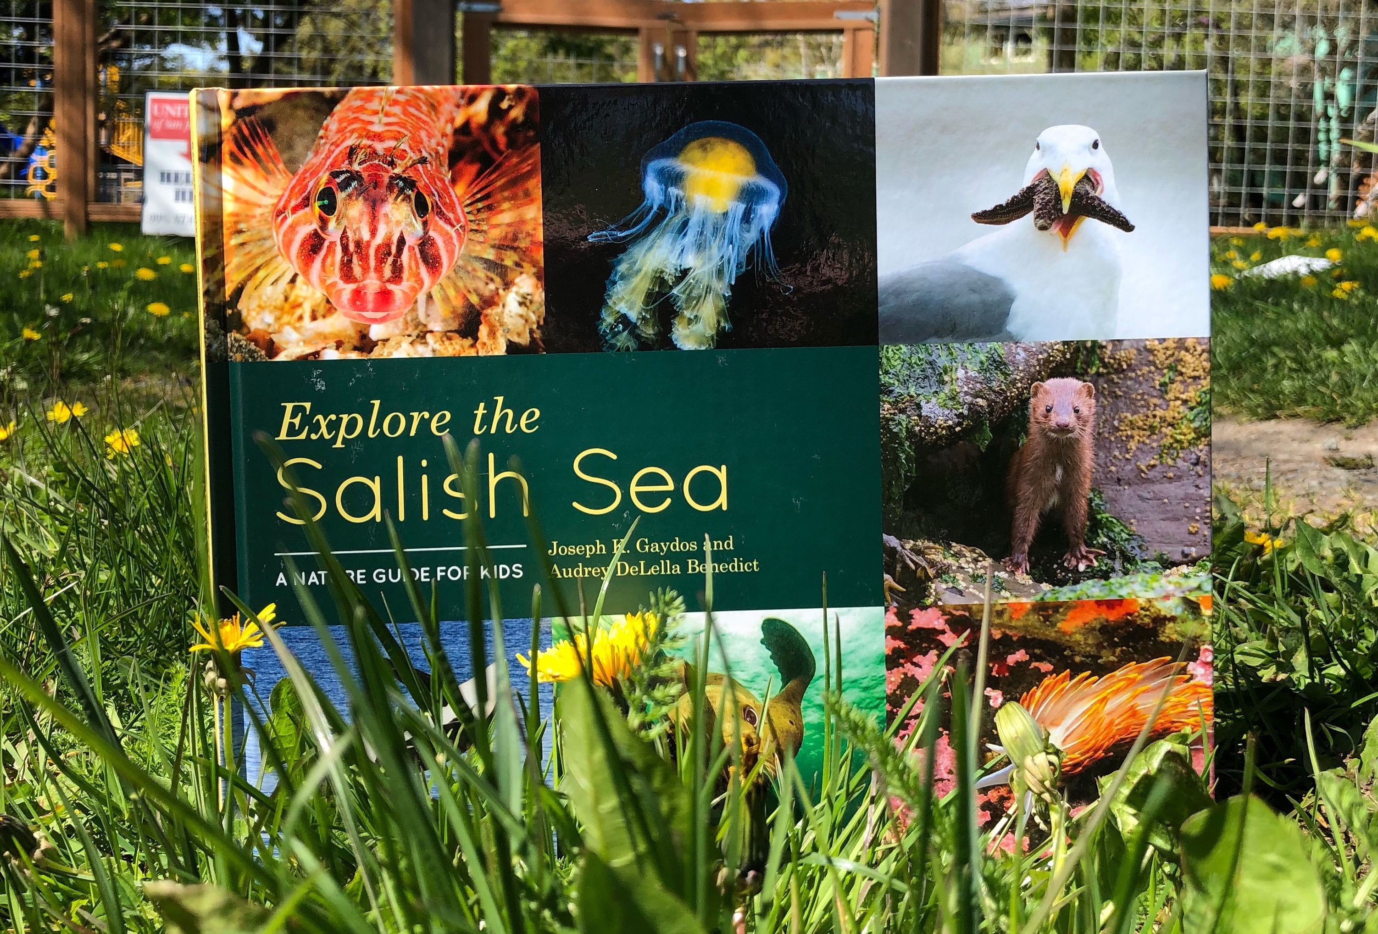
EXPLORE CHAPTER 2 WHY THE SALISH SEA IS SPECIAL
Notes:
Have students read Ch 2 and when finished, free-write thoughts on journal p. 4

Slide 7
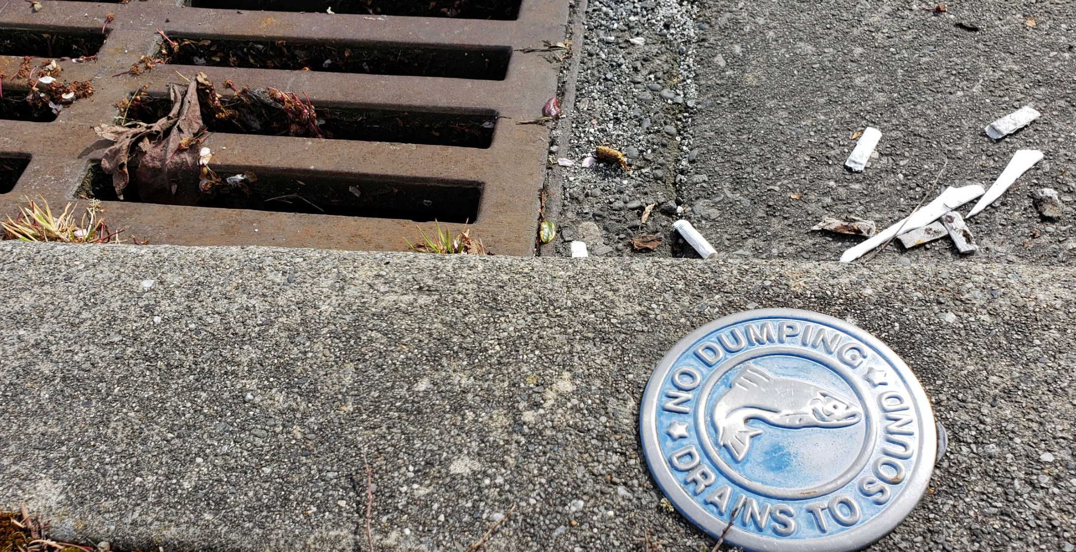
Wonder
Notes:
Wonder: Take kids out to the storm drain in your school parking lot with their student journals and observe. Don’t explain, just allow them to ask questions, wonder where it goes, and what that means for the stream and bay. This is a great phenomenon to observe just after a hard rain!

Slide 8
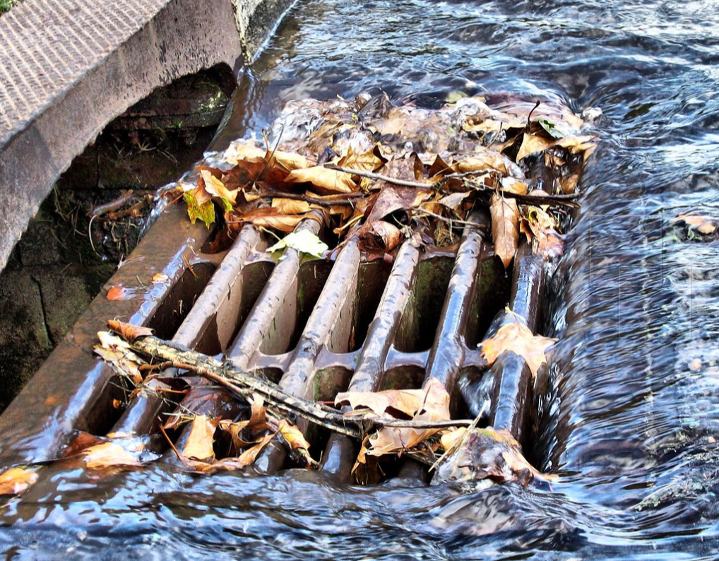
Image by Billy
Flickr Creative Commons 2.0
Notes:
Click image to play video of coho salmon gasping in a Burien creek (near Seattle).

Slide 9
TEAM TALK
Notes:
The University of Victoria’s Ocean Networks Canada operates cabled scientific observatories that collect a variety of data about our ocean. With large nodes acting like electrical outlets, we can “plug in” a variety of scientific instruments that collect data about the ocean. This is similar to National Science Foundations’ Ocean Observatories Initiative Coastal Endurance Array off the Pacific coast of Washington and Oregon.

Slide 10
ESSENTIAL QUESTION
Notes:
This is the student-generated, overarching question that will drive students’ explorations into the theme of stormwater in their community.

Slide 11
BACKGROUND RESEARCH
Notes:
Guide students to witness the water cycle in action as they model cloud formation in a jar.

Slide 12
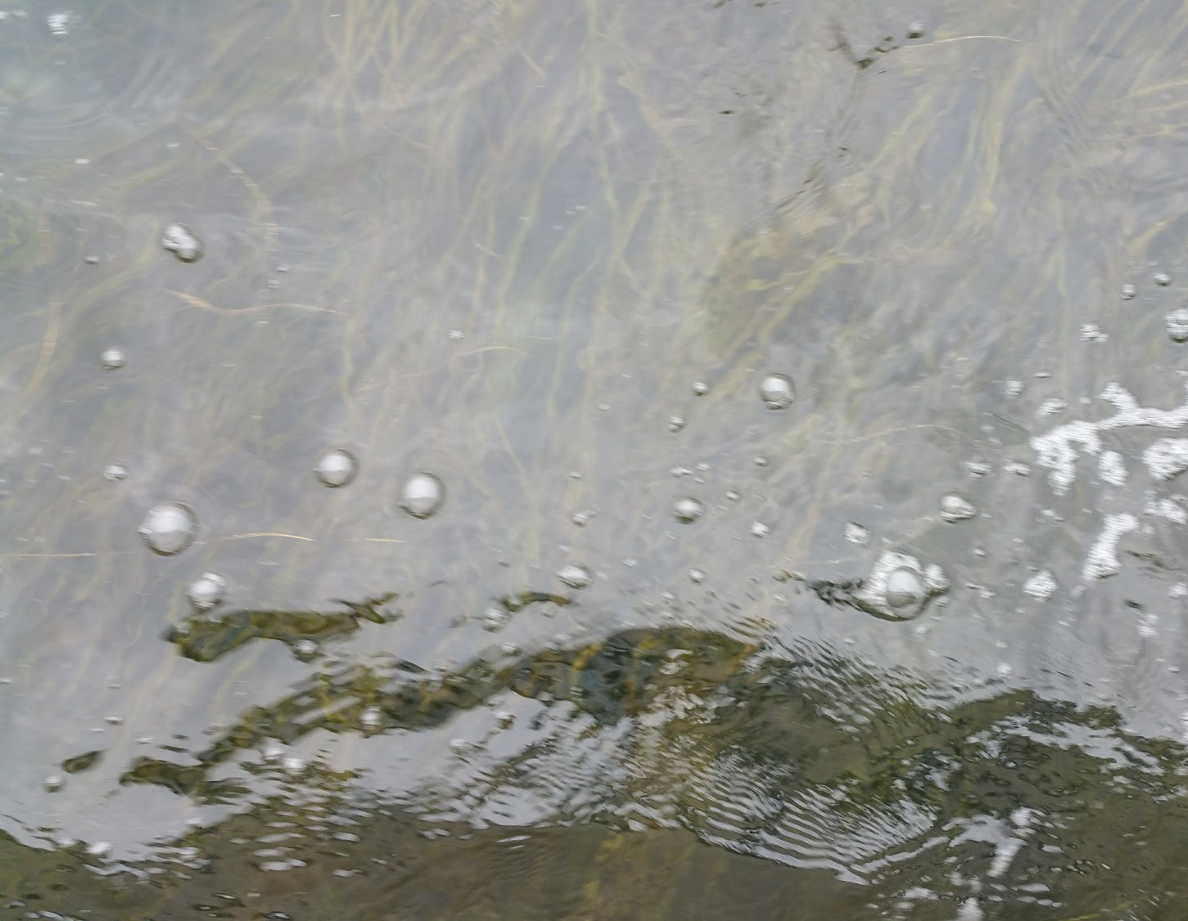
WATER CYCLE SONG
Notes:
Review the water cycle with the water cycle song! Review this video to learn the song and hand-motions if you haven’t already: https://www.instagram.com/p/Bs1qr2xB69x/

Slide 13
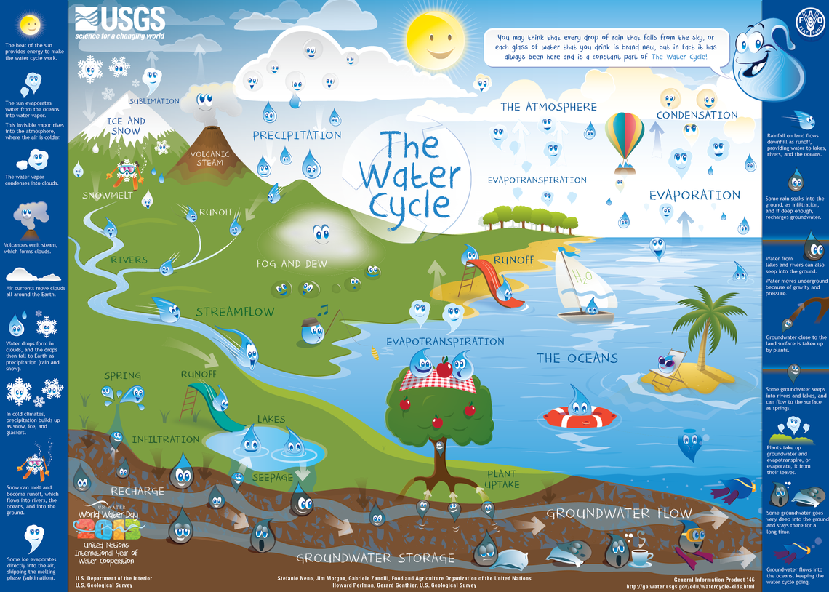
Notes:
Also in Spanish: https://www.usgs.gov/special-topic/water-science-school/science/el-ciclo-del-agua-water-cycle-schools-spanish?qt-science_center_objects=0#qt-science_center_objects

Slide 14
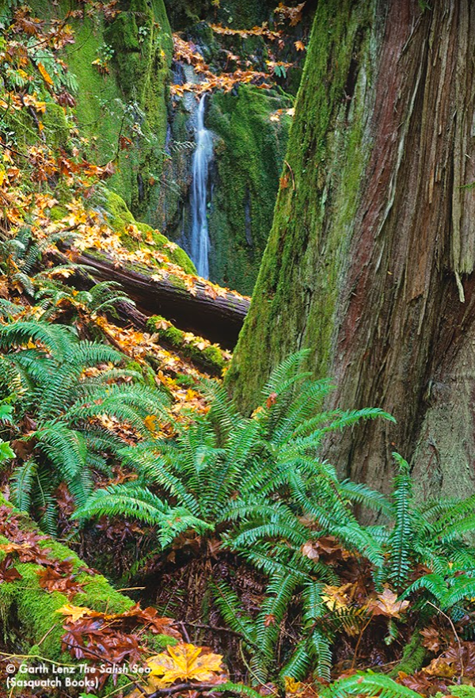
What’s a watershed?
Let’s model one!
Notes:
Borrow an Enviroscape ® watershed model activity-check with your local Conservation District or other environmental resources for a class visit or model-borrowing. It is also fun and valuable to have students make their own following instructions in the online resource listed in the unit plan.

Slide 15
Super-Amazing Student Web map
Example of Excellence!!
Add a student web map here
Notes:
Click the image to play a 2 min video of an oceanographer, Dr. Keith Hunter describing ocean density with a great animation: https://www.sciencelearn.org.nz/resources/687-ocean-density

Slide 16
TEAM TALK
Notes:
The University of Victoria’s Ocean Networks Canada operates cabled scientific observatories that collect a variety of data about our ocean. With large nodes acting like electrical outlets, we can “plug in” a variety of scientific instruments that collect data about the ocean. This is similar to National Science Foundations’ Ocean Observatories Initiative Coastal Endurance Array off the Pacific coast of Washington and Oregon.

Slide 17
BACKGROUND RESEARCH
Notes:
Guide students to witness the water cycle in action as they model cloud formation in a jar.

Slide 18
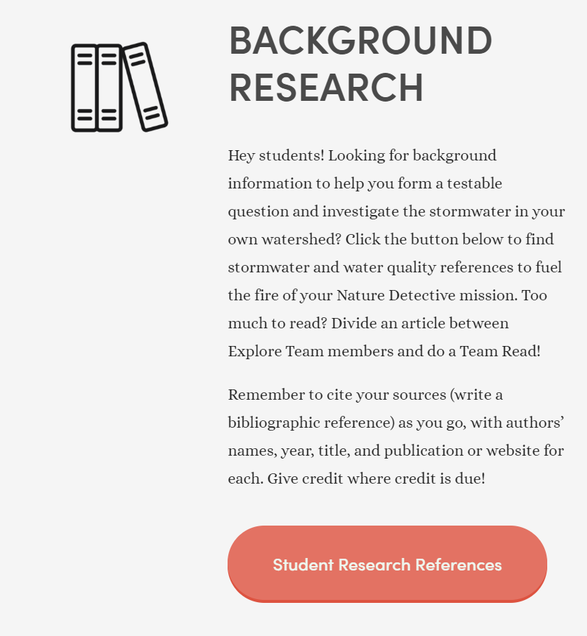
TEAM READ
www.juniorseadoctors.com/stormwater
Notes:
Have students divide their water quality article in equitable parts. Differentiate by giving developing readers a smaller section and high performing readers a longer, more complex one.

Slide 19
Additional Sources for Clues?
The big, orange button on the Stormwater webpage:
https://www.juniorseadoctors.com/stormwater
The Nature Conservancy’s Stormwater Heatmap: https://www.stormwaterheatmap.org/

Slide 20
PUT SCIENCE TO WORK
Notes:
It’s time to put Science to Work. The next step is to create a testable question to determine if a stormwater treatment in your own community is improving water quality. Work with a community partner to help design the project and provide supplies.

Slide 21
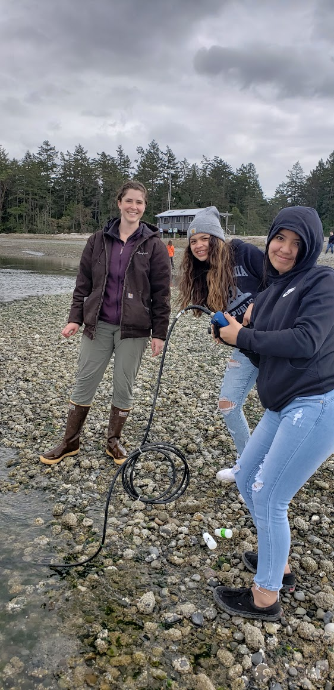
WRITE A TESTABLE QUESTION
Using these sentence-starters will ensure a measurable outcome:
Is
Are
Do
Does
Will
Notes:
Have students consider a classroom globe. Then a model of something tiny, such as a cell or the plankton they observed. Assess their current understanding of the word scale.

Slide 22
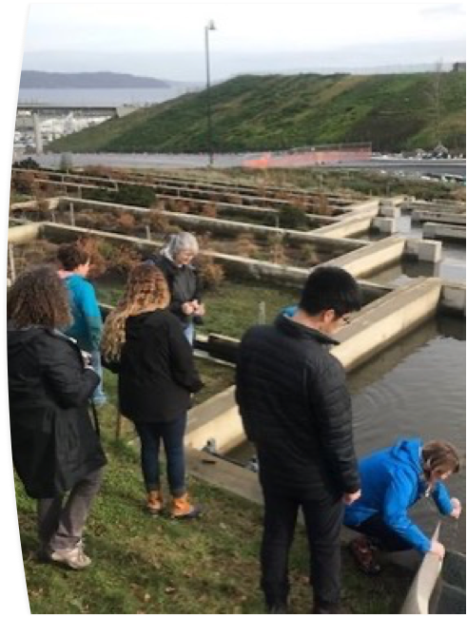
Variables are what you compare and measure in an investigation
South Sound teachers learning to sample water at Point Defiance Park’s stormwater filter inlet
Compared Variable
What you choose to compare, such as the location before and after a stormwater filter
This is also called
Manipulated Variable
Independent Variable
Measured Variable
What you measure, such as the water quality
This is also called
Responding Variable
Dependent Variable
Controlled Variables
All the things
Notes:
Here students will elaborate on their concept of ocean density and circulation by exploring the effects of density on a very important group of organisms, plankton. Introduce plankton, animals that must live at the mercy of ocean motion because they are too weak to swim against currents. And nearly every other living thing in the ocean, and even us, depend on plankton’s survival to live here on Earth.

Slide 23
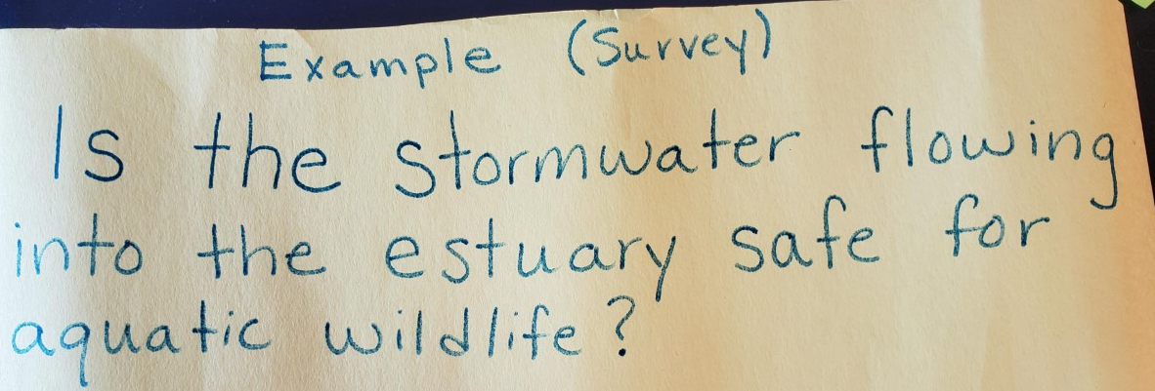
1. Write your testable question 2. Mark your Compared Variable with CV sticky note and your Measured Variable with your MV sticky note 3. List your Controlled Variables

Slide 24
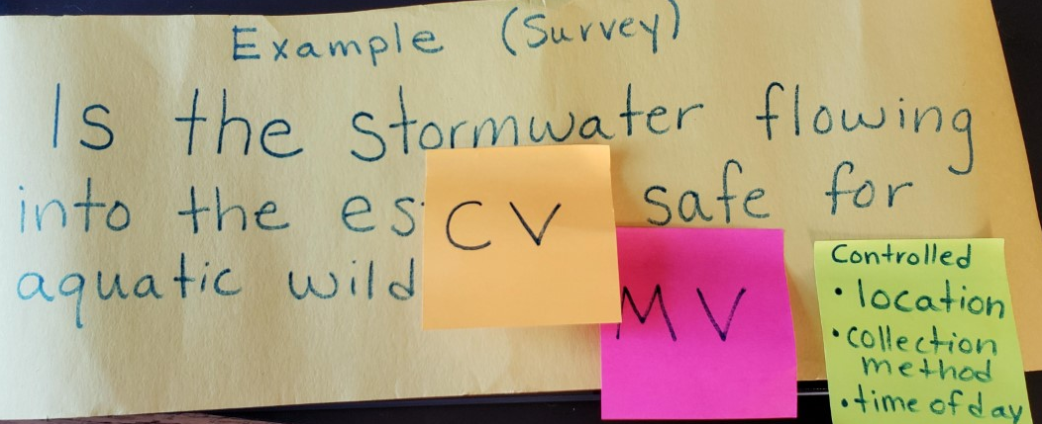

Slide 25
1. Write your testable question 2. Mark your Compared Variable with CV sticky note and your Measured Variable with your MV sticky note 3. List your Controlled Variables

Slide 27
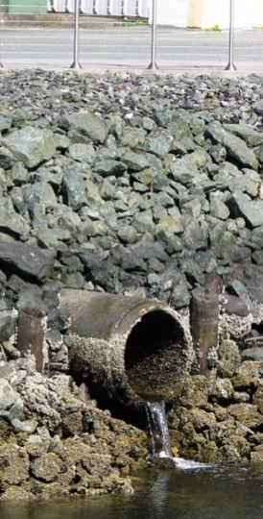
Form a Hypothesis a guess based on background information (hey, we have that!)
If we do this…..,
then this will be the result……
because……

Slide 28
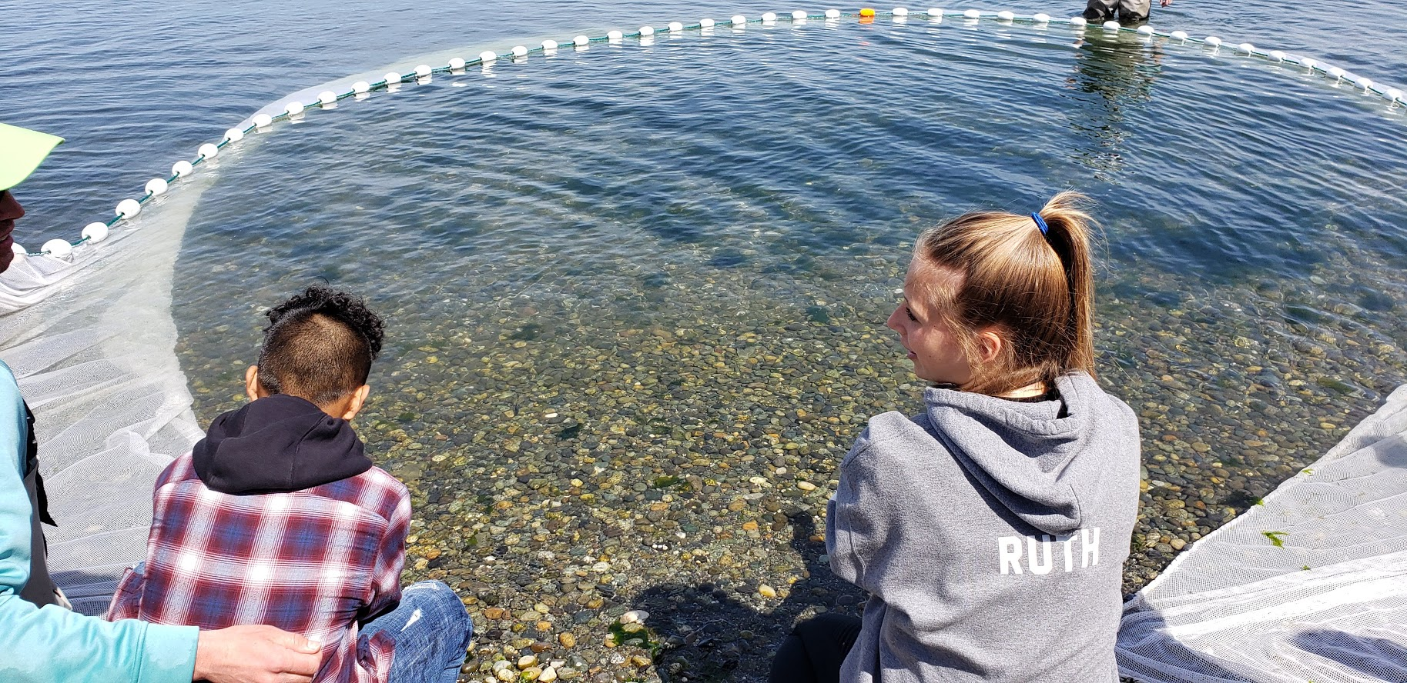
Research Design
What materials will you need?
How will each item be used?
How many times will you repeat your test to ensure results that represent reality?
DRAW IT! Make a labeled diagram
Include every item and show how it will be used.
A picture is worth 1,000 words!
Notes:
Either plan a trip to collect your plankton or contact a marine science organization near you (see unit plan or www.juniorseadoctors.com for resources in your county) to help collect plankton to your specifications.

Slide 29
Get CERIAs
CLAIM | EVIDENCE from graph from math or oral history
Reasoning explanations, possible errors)
Implications (how do these date change our thinking?) | Applications (how this info changes the world)
Notes:
See p. 12 in journal

Slide 30
COMMUNICATE
Notes:
CERIAs forum, science-based recommendations (What did the data suggest? What actions do you recommend based on the data?)
.

Slide 31
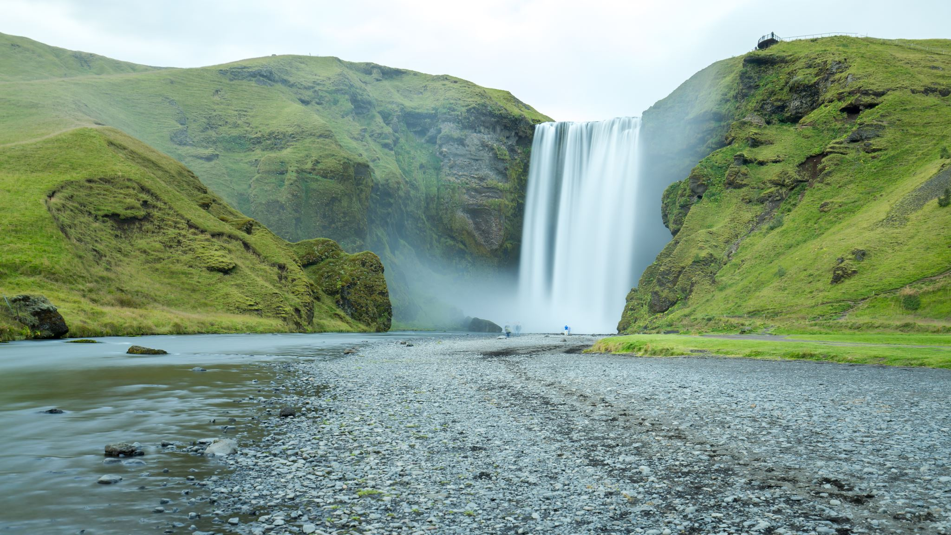
STORMWATER FILTRATION DESIGN CHALLENGE (Optional)
Notes:
Stormwater filtration design challenge: Invite students to consider the best materials with which to filter stormwater using this prompt: What type of ground surface filters water best?
Gather student suggestions, gather their requested materials (within reason), provide materials, and let the Nature Detective work begin!

Slide 32
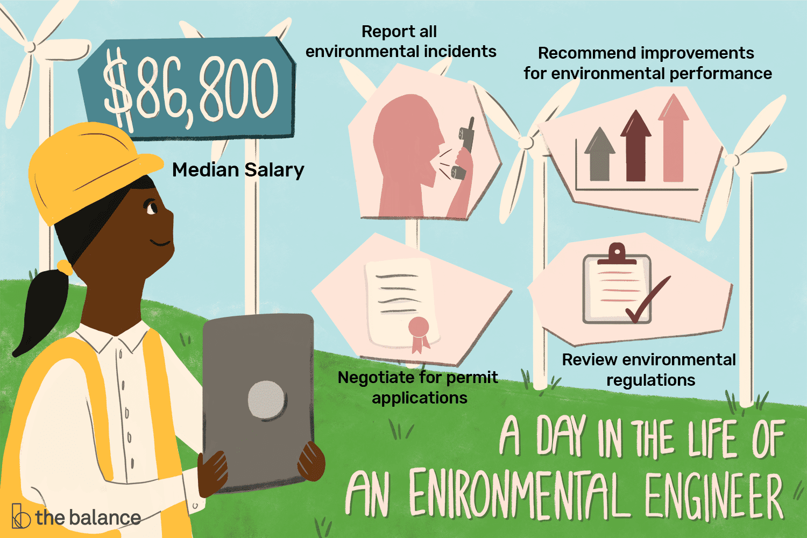
This could be my job
Environmental Engineers design landscapes that work with nature to support sustainable economy and ecology for people and wildlife.
Notes:
Share a career moment

Slide 33
Stormwater and Salish Sea Heroes
Copper smelter, heavy metals, and Superfund Sites, Oh my!
https://vimeo.com/207346630
From Puyallup Stormwater Initiative
Taryn Olson,
Associated Petroleum Products
Map by Tom Dailey
Notes:
The Salish Sea was named for the hundreds of Tribes and Bands of First Nations peoples who share a common language group, we call Coast Salish. Coast Salish knowledge of these waters is vast and essential for seafaring. What Tribes or Bands live in your Salish Sea neighborhood?

