Slide 1
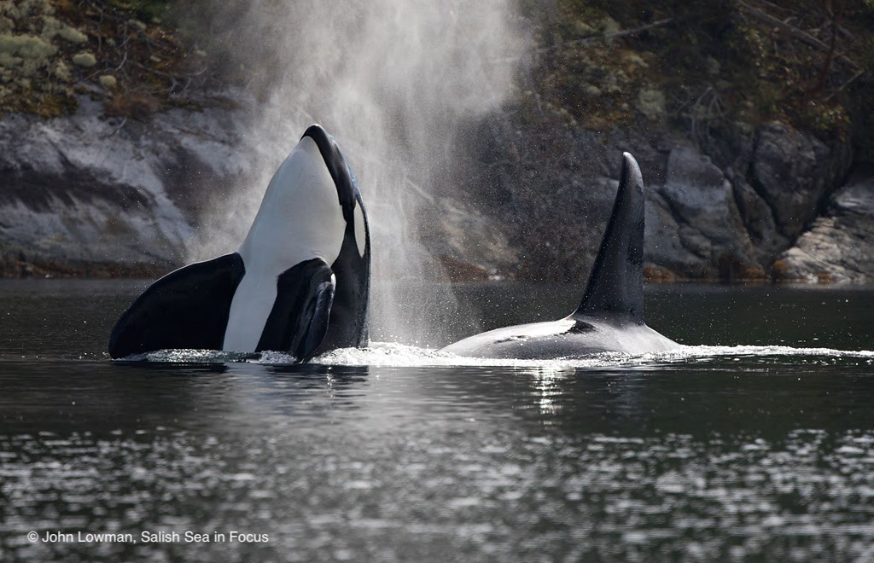
PEOPLE AND SCIENCE
HEALING THE SEA

Slide 2
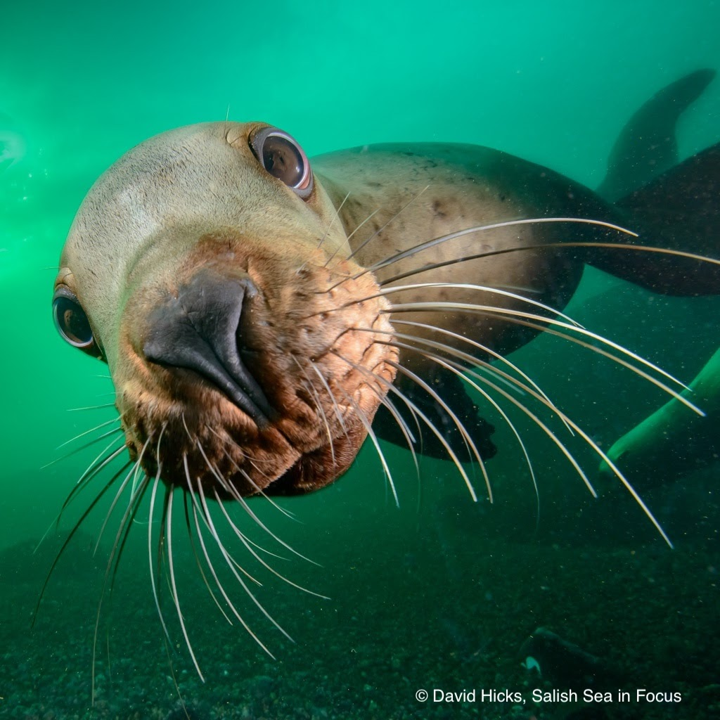
Dive!
Notes:
Let’s dive right in! You have received this book, written by our Science Director and Wildlife Veterinarian, Joe Gaydos and his co-author, naturalist, Audrey DeLella Benedict. The sole purpose of writing this book was to offer 5th and 6th graders an introduction to our neighbors in the sea and inspire them to stewardship action. Use it with your class in the way that fits best for you.

Slide 3
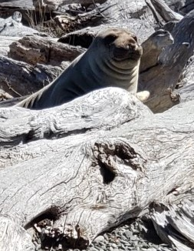
Background for teachers
Did you know that a elephant seal can hold its breath for 77 minutes and dive 5,000 feet in the sea? We are still working on the science to discover just what enables these remarkable feats under intense pressure, cold, and dark.
This unit will review the concepts of pressure changing with depth, structure and function,, photosynthesis and respiration, and of course, the process of science. It will introduce metabolism, the diving reflex, sensory structures for detecting prey, wave properties, and bioaccumulation of toxins in long-lived predators.

Slide 4
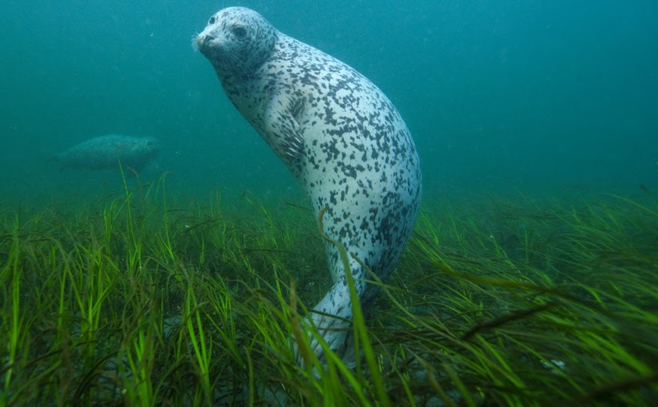
s
Background for teachers
Diving birds and mammals demonstrate physical, behavioral, and physiological adaptations that help them dive as efficiently as possible. Some structural adaptations these animals have are: hydrodynamic body shapes, fins and wings for lift and propulsion, back legs evolved into powerful flukes or flippers, and slick skin, feathers, or fur to slip through the water.
Physiological adaptations kick in on a dive to save energy-fueling oxygen. Diving animals slow circulation to extremities to keep vital organs oxygenated, they have high concentrations of myoglobin (an iron and oxygen-binding protein) to power muscles with more oxygen for longer, and they slow their heart rates during a dive to decreases oxygen use and build-up of CO2 .
Highly-developed sensory organs help diving animals navigate and locate prey. Seals sense subtle changes in water density caused by passing fish through their whiskers. Some seabirds do the same with specialized facial feathers. Dolphins and beaked whales employ echolocation, using images of the echoes of their clicks bouncing back from objects.
Notes:
Read goals. When we come back we will jump right into experiencing a sample lesson, so summon your inner 5th grader, grab your Explore the Salish Sea book and student journal, and get your engineer on!

Slide 5
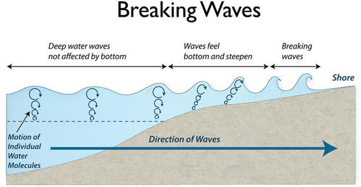
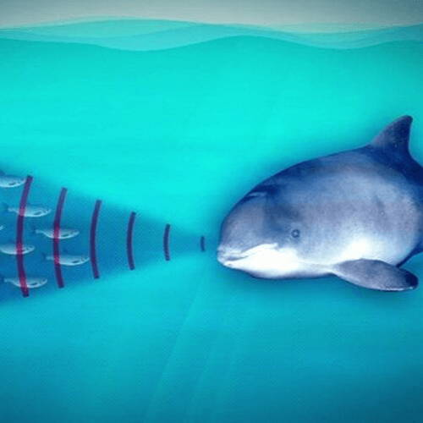
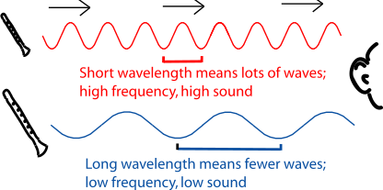
Background for teachers
The use of sound is a rich opportunity to introduce the properties of waves. Sound is the compression of particles (air, water, or solids) caused by a force pushing on them. When particles are pushed together, more and faster collisions occur causing an increase in energy.
This energy is transferred through collisions to neighboring particles- imagine Dominos- in a wave-like pattern. The frequency with which these compressed particles strike an organ (like an ear drum) makes it a low or high sound. The height of the sound wave, or amplitude, makes it a soft or loud sound.
Here sounds waves will be compared with ocean waves for a tangible study of the physics of sound.

Slide 6
EXPLORE TEAM ROLES
Chief Scientist Research
Manager/team
Manager/
encourager
Research Associate
Recorder/Experiment design
Manager/data manager
Field and Lab Technician
Materials manager/ station organizer/ Infographic artist
Cultural Historian
Traditional
Knowledge sharer
Science Communicator
Reporter/ presentation manager
Notes:
Start unit here with an Explore Team change-up. Mixtures of ability levels work best so students can support each other and combine strengths to conquer.

Slide 7
PRE-ASSESSMENT
Notes:
Administer the Unit 6 pre-assessment to establish a baseline of student knowledge.

Slide 8
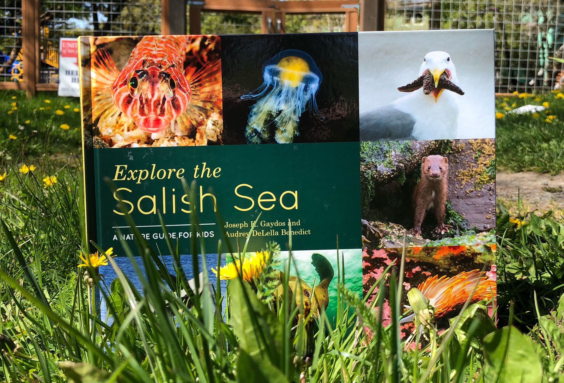
EXPLORE CHAPTER 6 Dive!
Notes:
Skim Ch 6 and when finished, free-write thoughts on journal p.

Slide 9
“ if you cause your ship to stop and place the head of a long tube in the water and place the outer extremity to your ear, you will hear ships at a great distance from you".
-Leonardo Da Vinci 1490

Slide 10
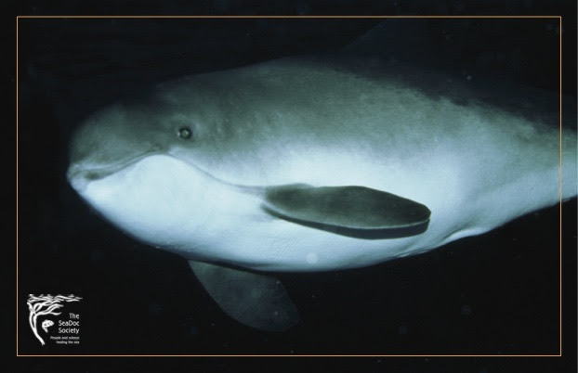
HUNGRY HUNGRY PORPOISE

Slide 11
ESSENTIAL QUESTION
Notes:
Administer the Unit 6 pre-assessment to establish a baseline of student knowledge.

Slide 12
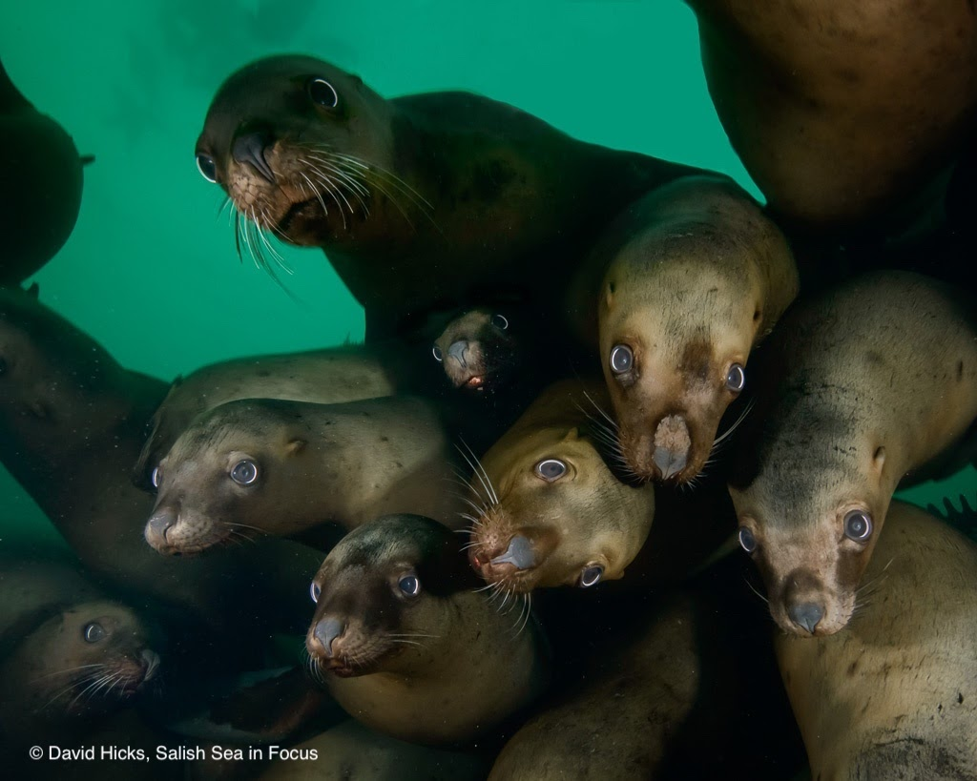
Notes:
Like these Stellar sea lions

Slide 13
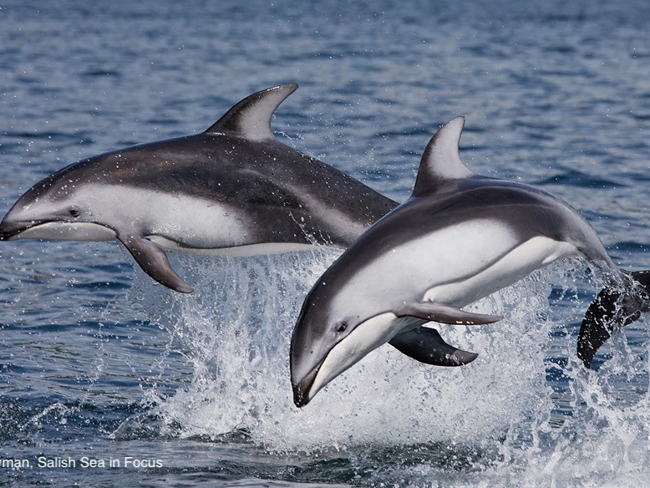
Notes:
Or Pacific white-sided dolphins

Slide 14
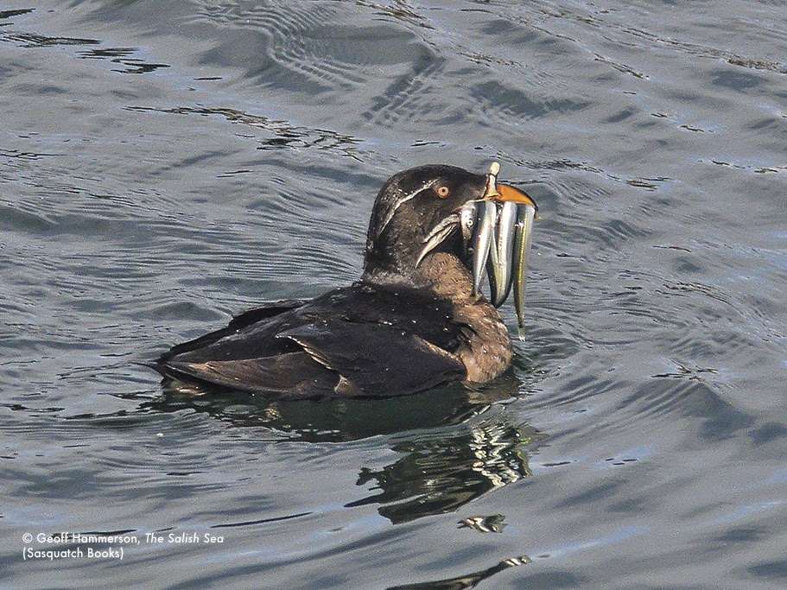
Notes:
And this rhinoceros auklet. And all for what? (Ask class, why dive?) This auklet gives a clue. Click photo to see a rescued (was found on a road) rhinoceros auklet diving.

Slide 15
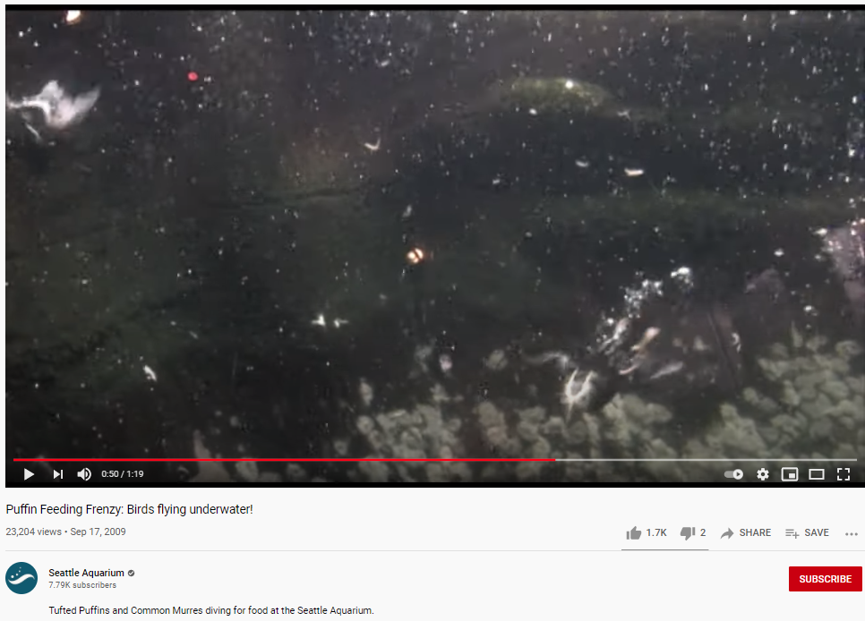
Notes:
Click to show 1 min video of diving pigeon guillemot, tufted puffins and common murres flying underwater at Seattle Aquarium

Slide 16
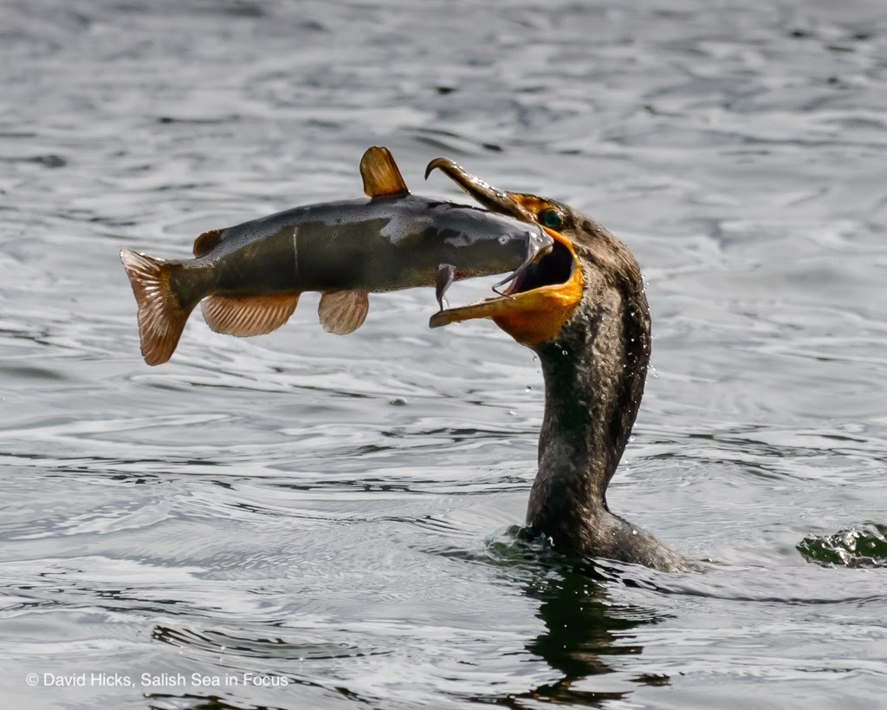
Diving Similarities and Differences?
Notes:
Compare the rhinoceros auklet diving to this cormorant diving. Ask for how each of these animals structure and behavior is similar and different while diving.

Slide 17
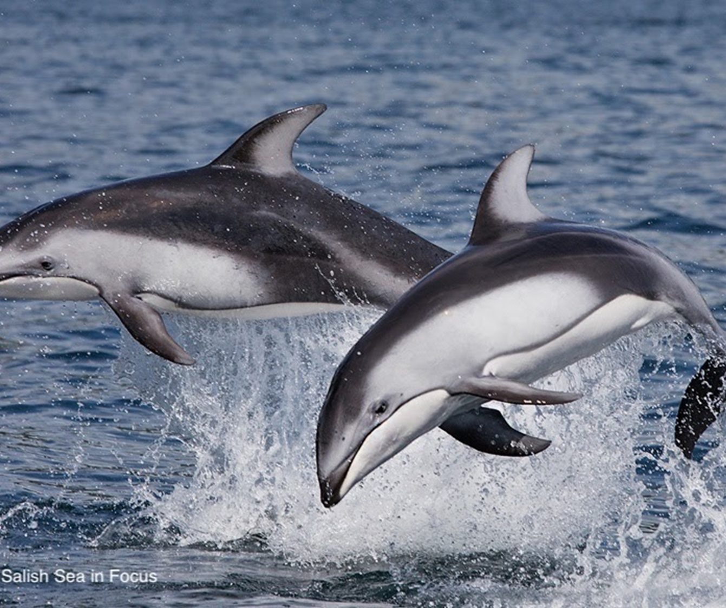
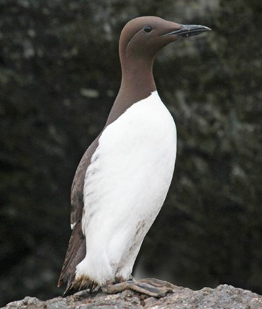
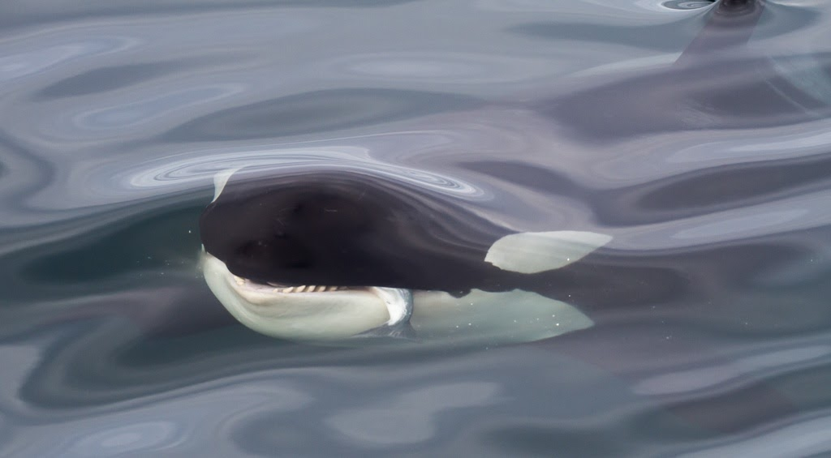
Breath holding times
20 minutes
6 minutes
3.5 minutes
2.5 minutes
11 minutes
20 minutes

Slide 18
85 minutes

Slide 19
DESIGN CHALLENGE
REMEMBER THIS? We modeled plankton that could sink slowly.
Can you model a diving animal that can sink fast?
*NOTE: Plankton is not a real plankter, but he plays one on TV.
Notes:
But what if you WANT to sink? Some animals that breath air need to get down to the deep. But why? And what adaptations do they have that enable them to do so?

Slide 20
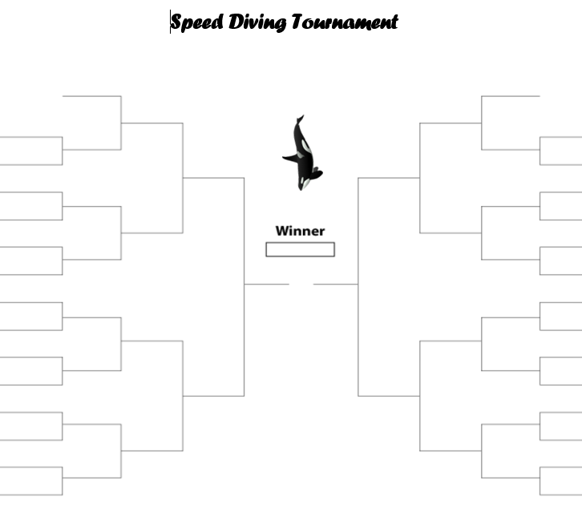
Let’s model!
Send Lab Techs for materials
Send Science Communicators to fill in names on a side of class bracket (one name per line)
Build a model of a fast-diving animal
Race it against your Explore Team in the aquarium
Send Science Communicators to fill in winner’s name on next bracket over
Winner leads the next Research It! investigation

Slide 21
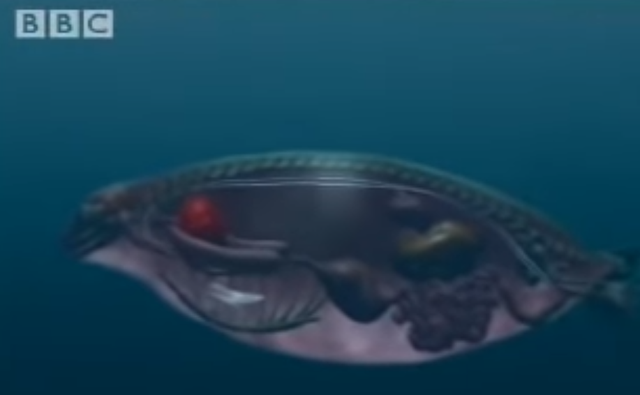
Atlantic Gray Seal diving reflex video
Notes:
Click image to play BBC video on the marine mammal dive reflex in gray seals. https://www.youtube.com/watch?v=UYkiRbgiwx0

Slide 22
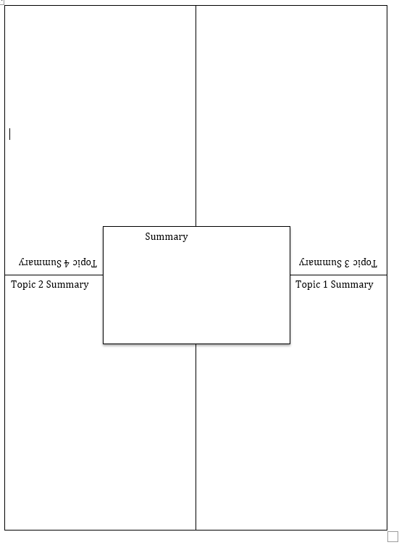
Team Read: How Diving Mammals Stay Underwater So Long
Draw this template onto your poster paper
Lay it out on your table
Divide article into equitable portions
Read your part, choose a marker color
Summarize your part in your box on the poster
Share each of your parts, one min each.
Research Associate writes summary in the center, color-coding each person’s contribution.

Slide 23
Notes:
Wonder: Just click the photo to start the video, “The Truth About Mermaids” Then let your students write and/or draw in their journals about what this made them wonder.

Slide 24
Do this man’s results corroborate (agree with) your own?
Notes:
Click this image to show video. Form a circle to run a mini CERIA Forum to discus whether this video corroborates their own findings.

Slide 25
Lesson 2 –
Sensing
Sound
Example by Creatively.com
Notes:
Ask what students currently understand about diving animals finding prey in the dark. Then introduce the game, Hungry Hungry Porpoise.

Slide 26
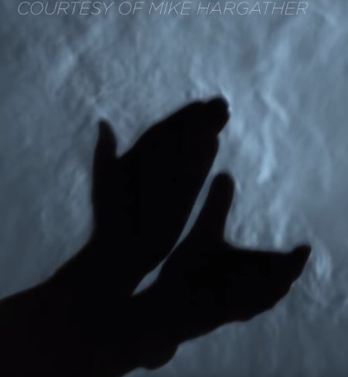
How wave characteristics affect sound
Notes:
https://www.youtube.com/watch?v=px3oVGXr4mo&feature=youtu.be
Click the photo of the hands or the link above to watch actual sound waves captured on film, and the science behind the film technique.

Slide 27
How ears work video

Slide 28
How wave characteristics affect sound
Low amplitude = quiet High amplitude = L O U D

Slide 29
Near total silence - 0 dB
A whisper - 15 dB
Normal conversation - 60 dB
A lawnmower - 90 dB
A car horn - 110 dB
A rock concert or jet engine - 120 dB
A gunshot or firecracker - 140 dB
Killer whale call (average) – 155 dB
Supertanker or blue whale– 190 dB
Container Ship - 198
Human eardrums burst at 165 dB
Killer whale eardrums burst at
Sound Level = the intensity of a sound, measured in decibels (db)
CONSIDER THIS:

Slide 30
There are other types of waves-some are FUN!

Slide 31
Some aren’t
Raging Seas photo by Phillip Male
Notes:
These are both wind-generated waves, meaning winds move the water surface and push it forward, lifting the water up and making a rolling motion of the water beneath.

Slide 32
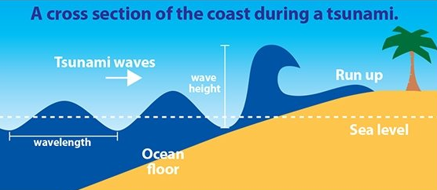
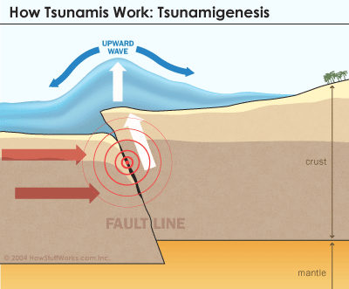
Some waves are caused by earthquakes: Tsunamis!
Earthquake in the ocean
Ocean water gets pushed up
The wave spills over with a very long wavelength
Image by Nat Geo Kids
Notes:
These are both wind-generated waves, meaning winds move the water surface and push it forward, lifting the water up and making a rolling motion of the water beneath.

Slide 33
Notes:
This is how wind or tsunami-generated waves “break.” When the water depth is 1.3 times the wave height, the bottom of the wave motion is slowed by the ground, yet the top is still speeding along, so the wave topples over.

Slide 34
Are there waves in the deep sea?
Notes:
Click image to play video of a deep sea internal wave, one of the ways water circulates in the deep sea.

Slide 35
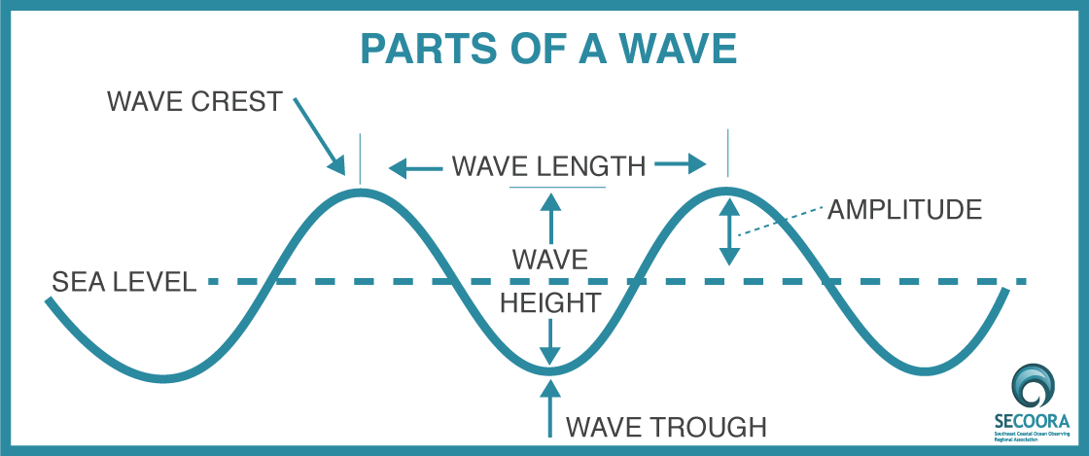
Label your wave diagram with words from the wave word bank on journal p16.

Slide 36
Image by SeaWorld
ECHOLOCATION in toothed whales
Notes:
Explain that sound waves generated by squeezing air through nasal sacks near the blow hole, like we do by forcing air through the larynx. These sounds get focused into a beam by the fat-filled melon that directs them into the water ahead as a rapid-fire series of clicks. The clicks bounce off solid objects in the water and echo back to the whale. Returning clicks are received by fat-filled cavities in the lower jaw bone then to the middle ear, inner ear, then to hearing center in the brain via the auditory nerve, like humans.

Slide 37
Listen to orcas here: https://www.orcasound.net/listen/

Slide 39
Team Read: Ocean Noise
Draw this template onto your poster paper
Lay it out on your table
Divide article into equitable portions
Read your part, choose a marker color
Summarize your part in your box on the poster
Share each of your parts, one min each.
Research Associate writes summary in the center, color-coding each person’s contribution.

Slide 40
How can we decrease sound in the sound?

Slide 42
1. Propeller cavitation is noisy
“Treat cavitation like any other NATURAL DISASTER.” –Nick the Naval Architect
Notes:
Show the first video to demonstrate cavitation. Have them listen for a noise increase once the bubble appear. Show the second video for ways of reducing cavitation. Stop it at 3:50.

Slide 43
2. Turbulence is noisy

Slide 44
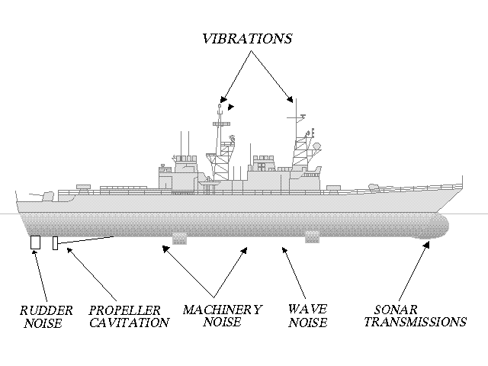
3. Machinery in contact with the hull is noisy

Slide 45
COMMUNICATE
Notes:
Get CERIAs forum, science-based recommendations (What did the data suggest? What actions do you recommend based on the data?)
It is time to share this information through a community presentation, science symposium, art installation, music concert or video.

Slide 46
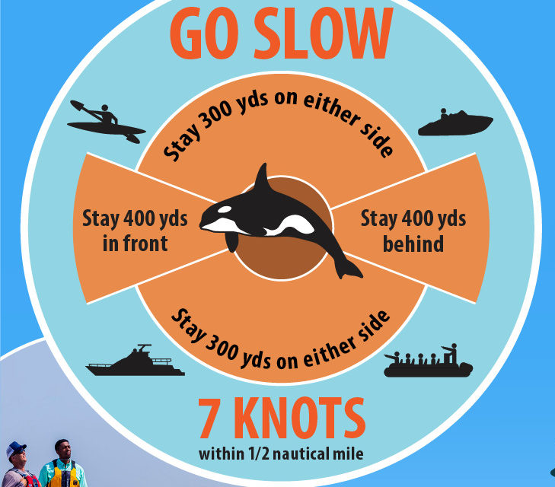
Be Whale Wise
Notes:
Be whale wise video by WDFW: https://www.youtube.com/watch?v=uO9o8VT2pEw

