Slide 1
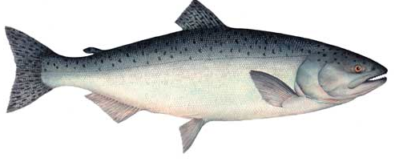
Species: _____________________________
Notes:
Adult - Spawn - eggs - jv - migrate to sea

Slide 2
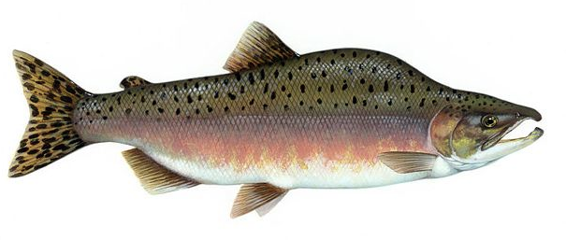
Species: _____________________________

Slide 3
Eggs incubate in gravel.
Juveniles hatch and spend 1-2 years in streams eating invertebrates.
At 1-2 years, juveniles migrate to the ocean and grow.
Fish mature into adults in the ocean.
Adults return to their home freshwater stream to spawn
Notes:
Right ages?
https://www.google.com/search?q=salmon+life+cycle&rlz=1C5CHFA_enUS521US521&source=lnms&tbm=isch&sa=X&ved=0ahUKEwj7teXGkPvTAhVIqFQKHXTEBpEQ_AUIBigB&biw=1280&bih=634#imgrc=caUa2ZxpRfez4M:

Slide 4
Eggs incubate in gravel.
Juveniles hatch and migrate directly to sea.
Juveniles eat and grow in the ocean for 1 year.
Fish mature into adults in the ocean.
Adults return to their home streams to spawn.

Slide 5
Chinook (king)
Chinook (king)
Pink
Pink
Coho (silver)
Coho (silver)
Sockeye
Sockeye
Chum
Chum
Chinook (king)
Chinook (king)
Pink
Pink
Coho (silver)
Coho (silver)
Sockeye
Sockeye
Chum
Chum

