Slide 1

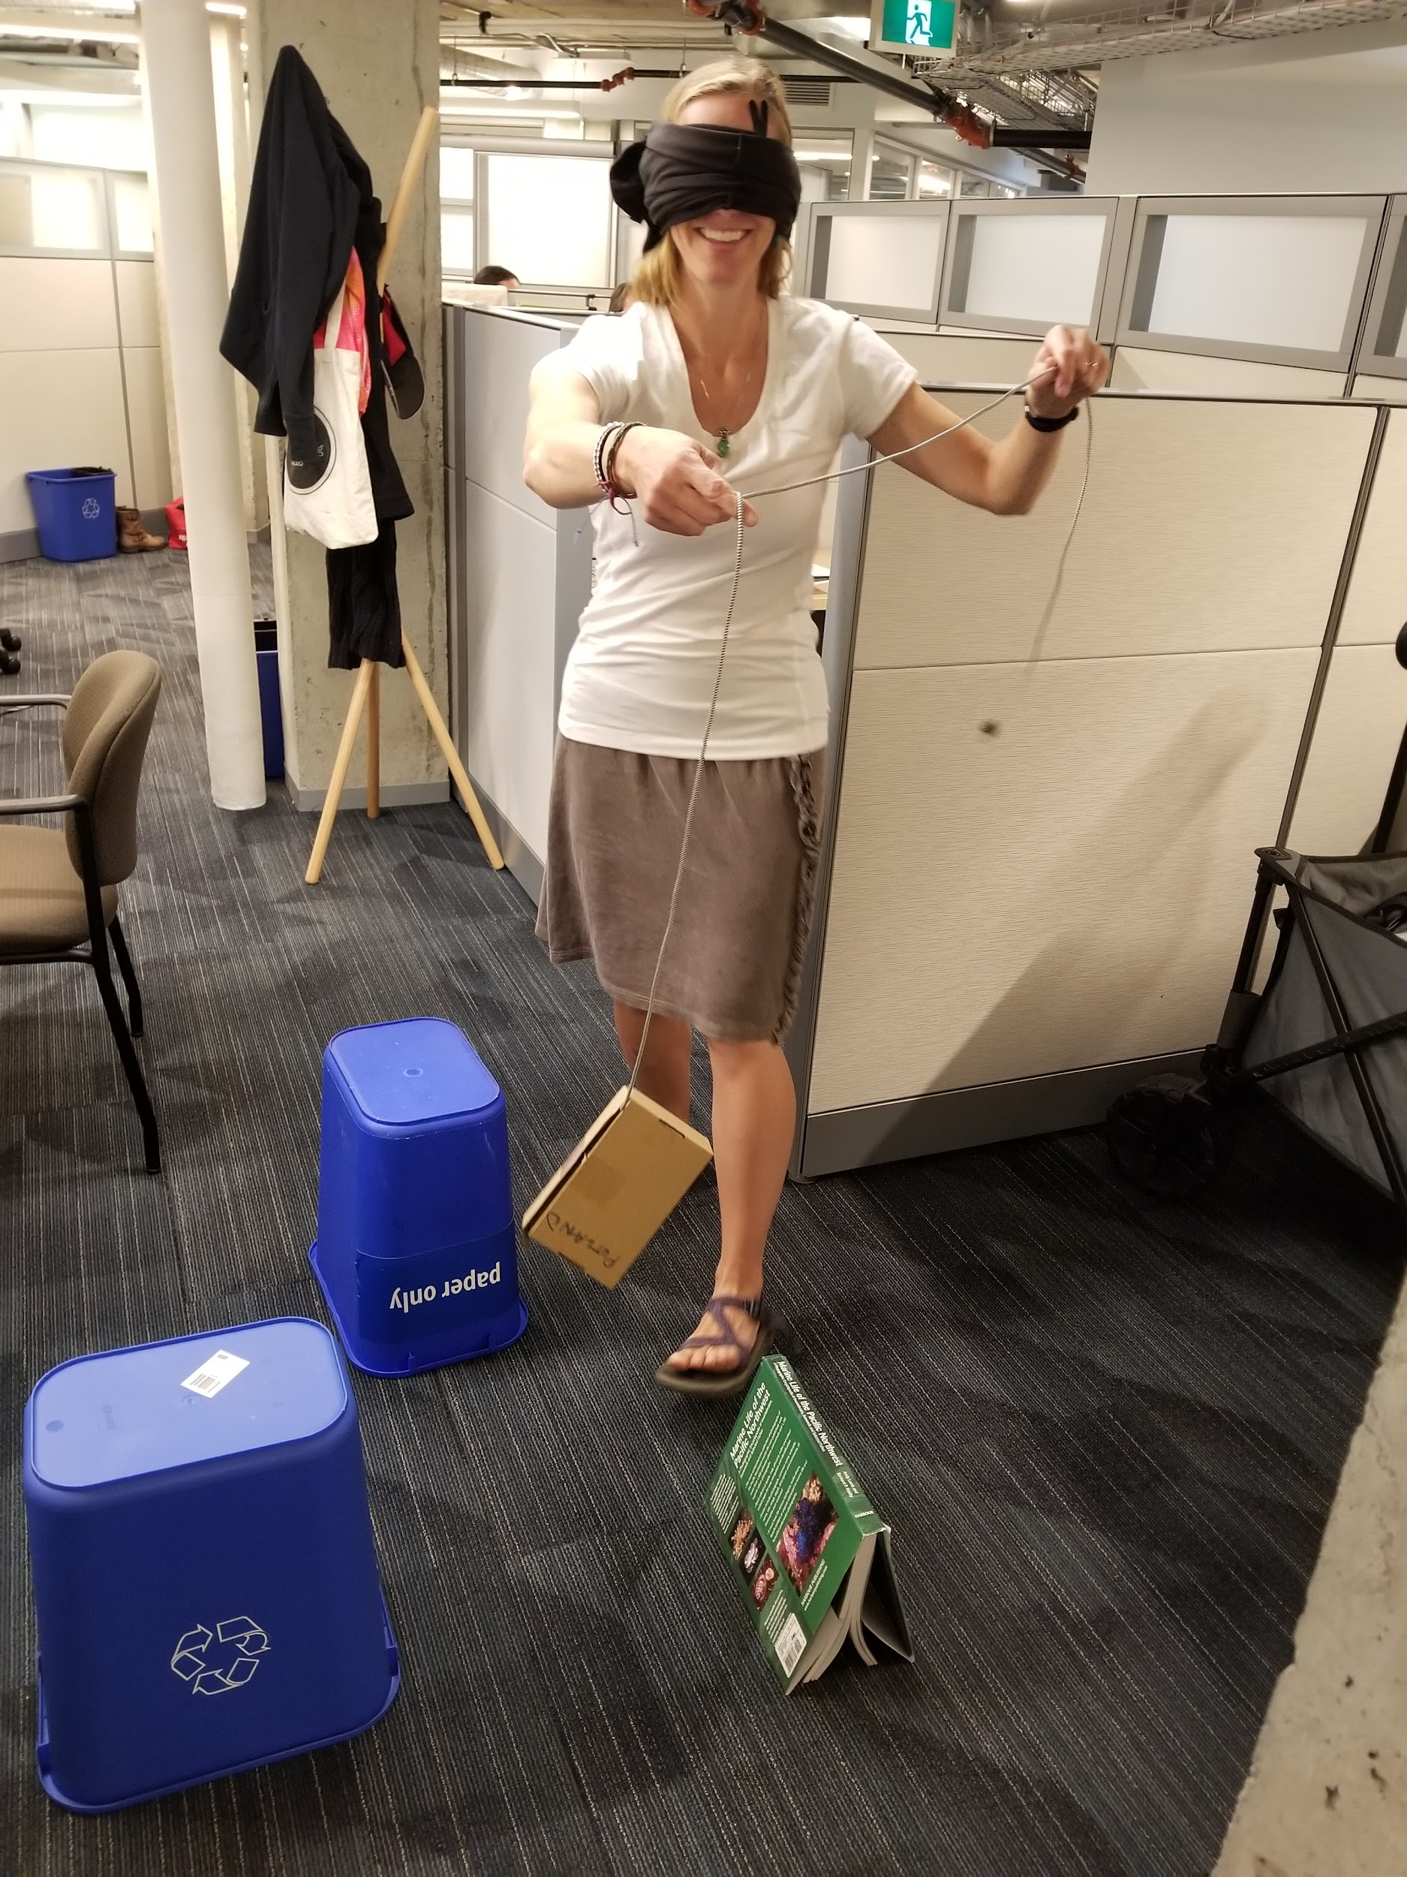
Navigate Dangerous Terrain
In real life, ROV pilots/technicians are not aboard the ROV, thus they rely on sensors and cameras mounted on the ROV to see what is in the environment. Instead, they must imagine their ROV in 3 dimensions to keep it from crashing into other objects, like rocks.
Using chairs, tables, or desks, set up a terrain that the ROV must navigate around.
Select one team member to be the ROV pilot/technician that “drives” the ROV hanging from the tether through the terrain (over or around the objects), while blindfolded.
3. The ROV pilot/technician must listen to the directions of the
other team members (who can see, but not touch the ROV).
For an additional challenge, make this a timed challenge. For every mistake the ROV makes (bumps or becomes trapped on an object) add 10 seconds to the final time.

Slide 2

Navigate Dangerous Terrain
Modified, grid version
In real life, ROV pilots/technicians are not aboard the ROV, thus they rely on sensors and cameras mounted on the ROV to see what is in the environment. Instead, they must imagine their ROV in 3 dimensions to keep it from crashing into other objects, like rocks.
Pair up. Select one team member to be the ROV pilot/technician and one team member to be the ROV. Give each person a piece of grid paper.
Using a piece of grid paper, the ROV pilot/technician blocks off certain areas that represent obstacles that the ROV must go around.
ROV pilot/technician
ROV
 | A | B | C | D | E
1
2
3
4
5
 | A | B | C | D | E
1
2
3
4
5
Example Grids: Green shows start point, and red is the end point. The ROV pilot/technician marks off blocked areas in teal.
The ROV pilot/technicians must describe to the ROV where to go to get from the green spot to the red spot, ensuring that the ROV doesn’t see the blocked off grid they created. The ROV pilot/technician can say things like, “move down two blocks to A2”, “move right one block to B3”.
For an additional challenge, use a larger grid!

Slide 3

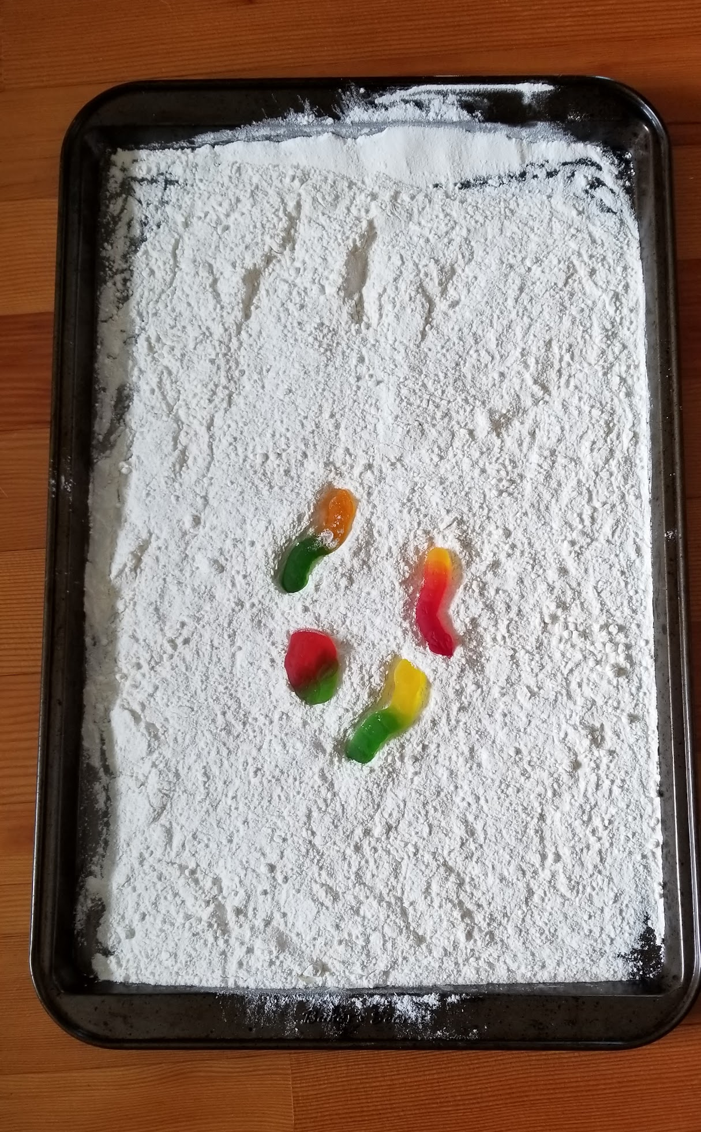
Collect a Seafloor Sample
Depending on location, the ocean floor can be covered in sediment, a loose material that can include organic debris (once living) or non-living material such as sand, mud, and rocks. Disturbed sediment can potentially cause it to lose visibility.
Using a cookie sheet covered in flour, recreate a “sediment” covered seafloor. Scatter a few gummy bears or other soft candy on top of the flour. These represent animals or other samples that are sitting on the seafloor. The light, fluffy flour replicates the soft sediment on the seafloor that is easily suspended.
Decide on a sample candy to collect. While piloting the ROV to retrieve this sample, be careful to not disturb the “sediment” or get any “sediment” on their ROV.
For an additional challenge, limit the number of attempts the ROV has to collect the item from the seafloor, and give each attempt a point value.
  For example, award 50 points for a first successful attempt, 25 points if you are successful on the second attempt or 15 points if you can successfully pick up the object on the third attempt.

Slide 4
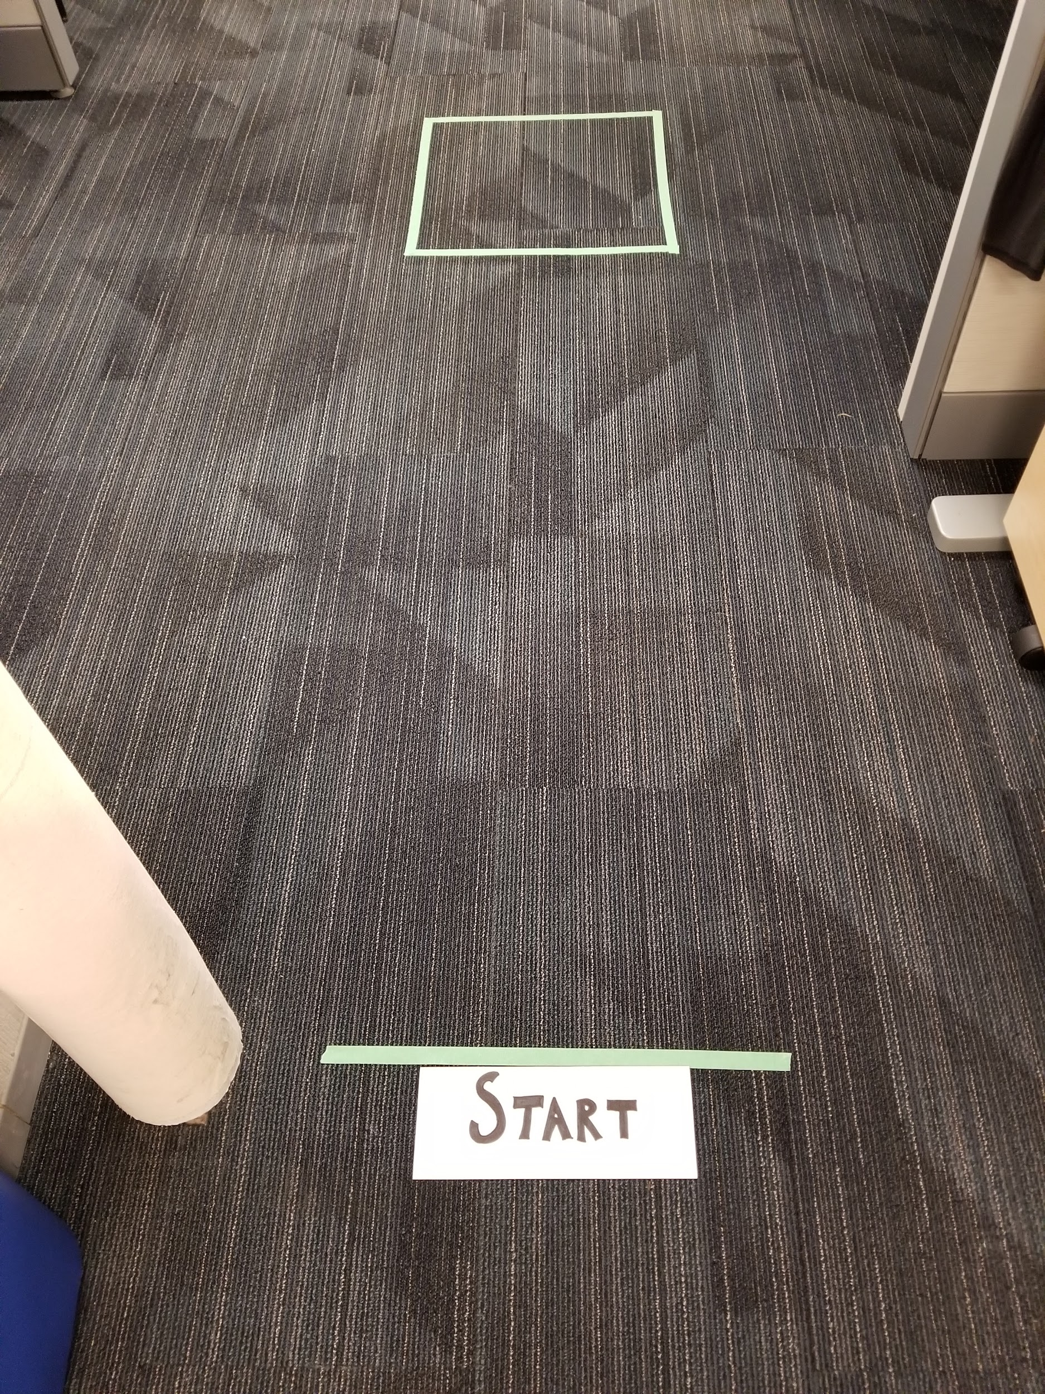
Deposit a Payload
ROV’s are often used to carry sensitive instruments for underwater deployment.
For an additional challenge, limit the number of attempts the ROV has to deposit the marshmallow on to the seafloor, and give each attempt a point value.
  For example, award 50 points for a first successful attempt, 25 points if you are successful on the second attempt or 15 points if you can successfully drop off the marshmallow on the third attempt.
Designate a taped off space on the floor as a “drop zone”. A few metres from the drop zone, designate a start point.
Use any method you’d like to attach your marshmallow to your ROV, but once the ROV has left the start line, it cannot be directly touched.
The ROV must deposit the marshmallow in the payload zone without damaging it.

